Slide 1
The Mediterranean and Middle East
2000-500 BCE

Slide 2
Middle East
Western Asia and Egypt

Slide 3
Cosmopolitan Middle East
Iron Age
Use of iron instead of bronze for weapons and tools
Iron tools were harder and sharper than bronze ones
Mesopotamia and Egypt subjected to many invaders and new peoples
Creation of a diversity of cultures

Slide 4
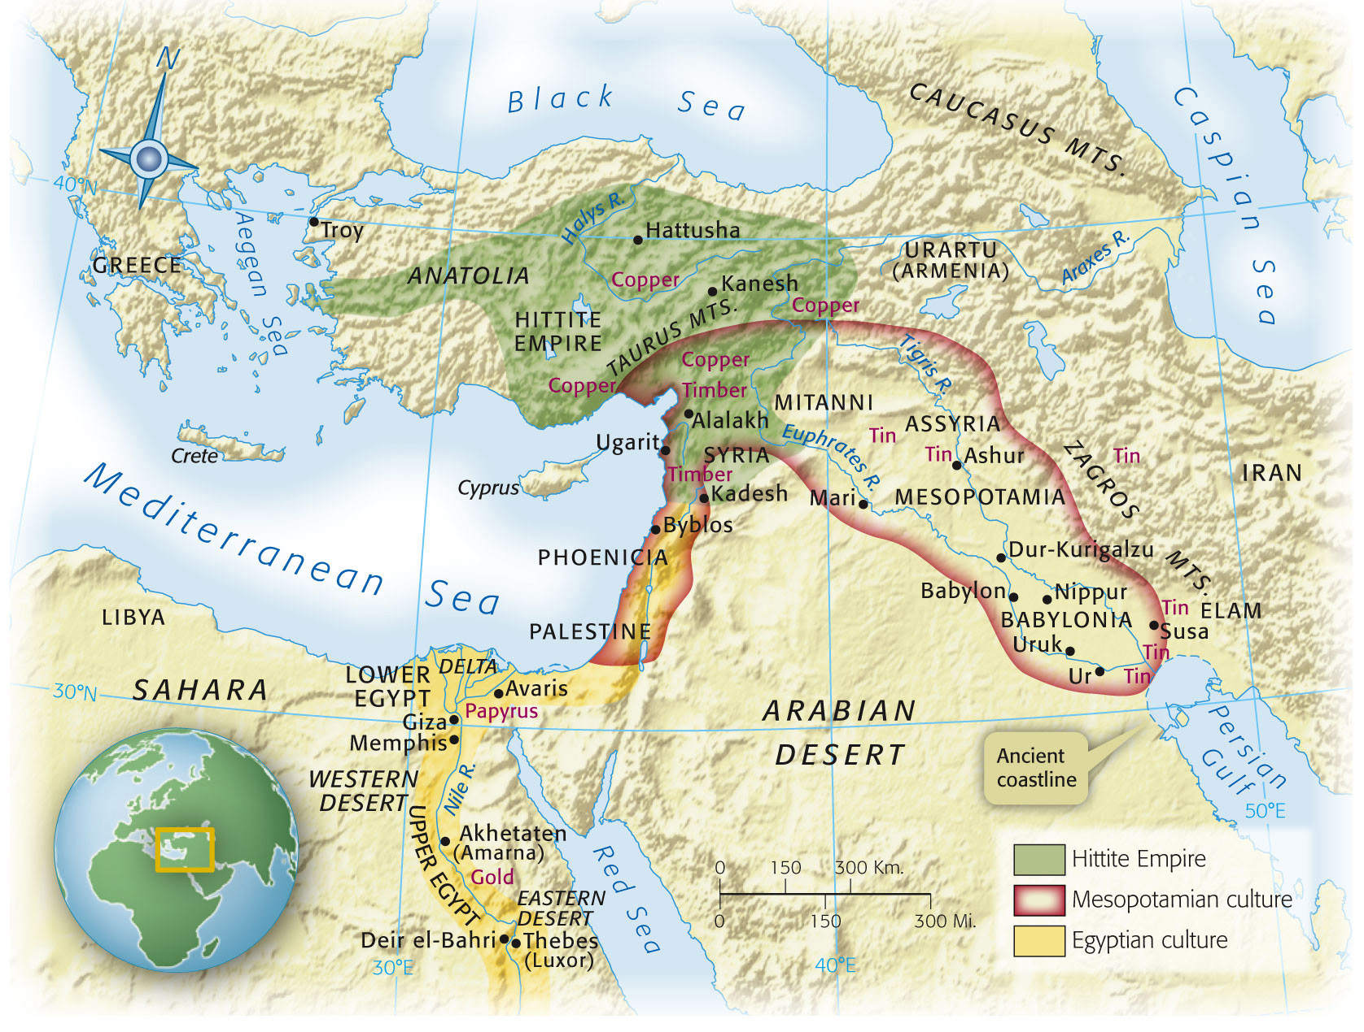
Map 4-1, p. 82
Notes:
Map 4.1: The Middle East in the Second Millennium B.C.E.
Although warfare was not uncommon, treaties, diplomatic missions, and correspondence in Akkadian cuneiform fostered cooperative relationships between states. All were tied together by extensive networks of exchange centering on the trade in metals, and peripheral regions, such as Nubia and the Aegean Sea, were drawn into the web of commerce.

Slide 5
Western Asia
Mesopotamia
Divided in half by 1500 BCE
Babylonia (south)
Assyria (north)
Hittites
State that emerged on the outskirts of Mesopotamia
Became THE power in Anatolia (Turkey)
Horse drawn chariots used in warfare
First developed iron working for tools/weapons

Slide 6
Egypt
Hyksos conquered Egypt in 1640 BCE
Introduced hors drawn chariots, composite bow
Expelled in 1532 after 30 years of war
New Kingdom (1532-1070 BCE)
Expanded territory into Palestine and Nubia
Hatshepsut
Only female ruler of the New Kingdom
Successful expeditions for luxury items
After death, all references to Hatshepsut were eliminated

Slide 7
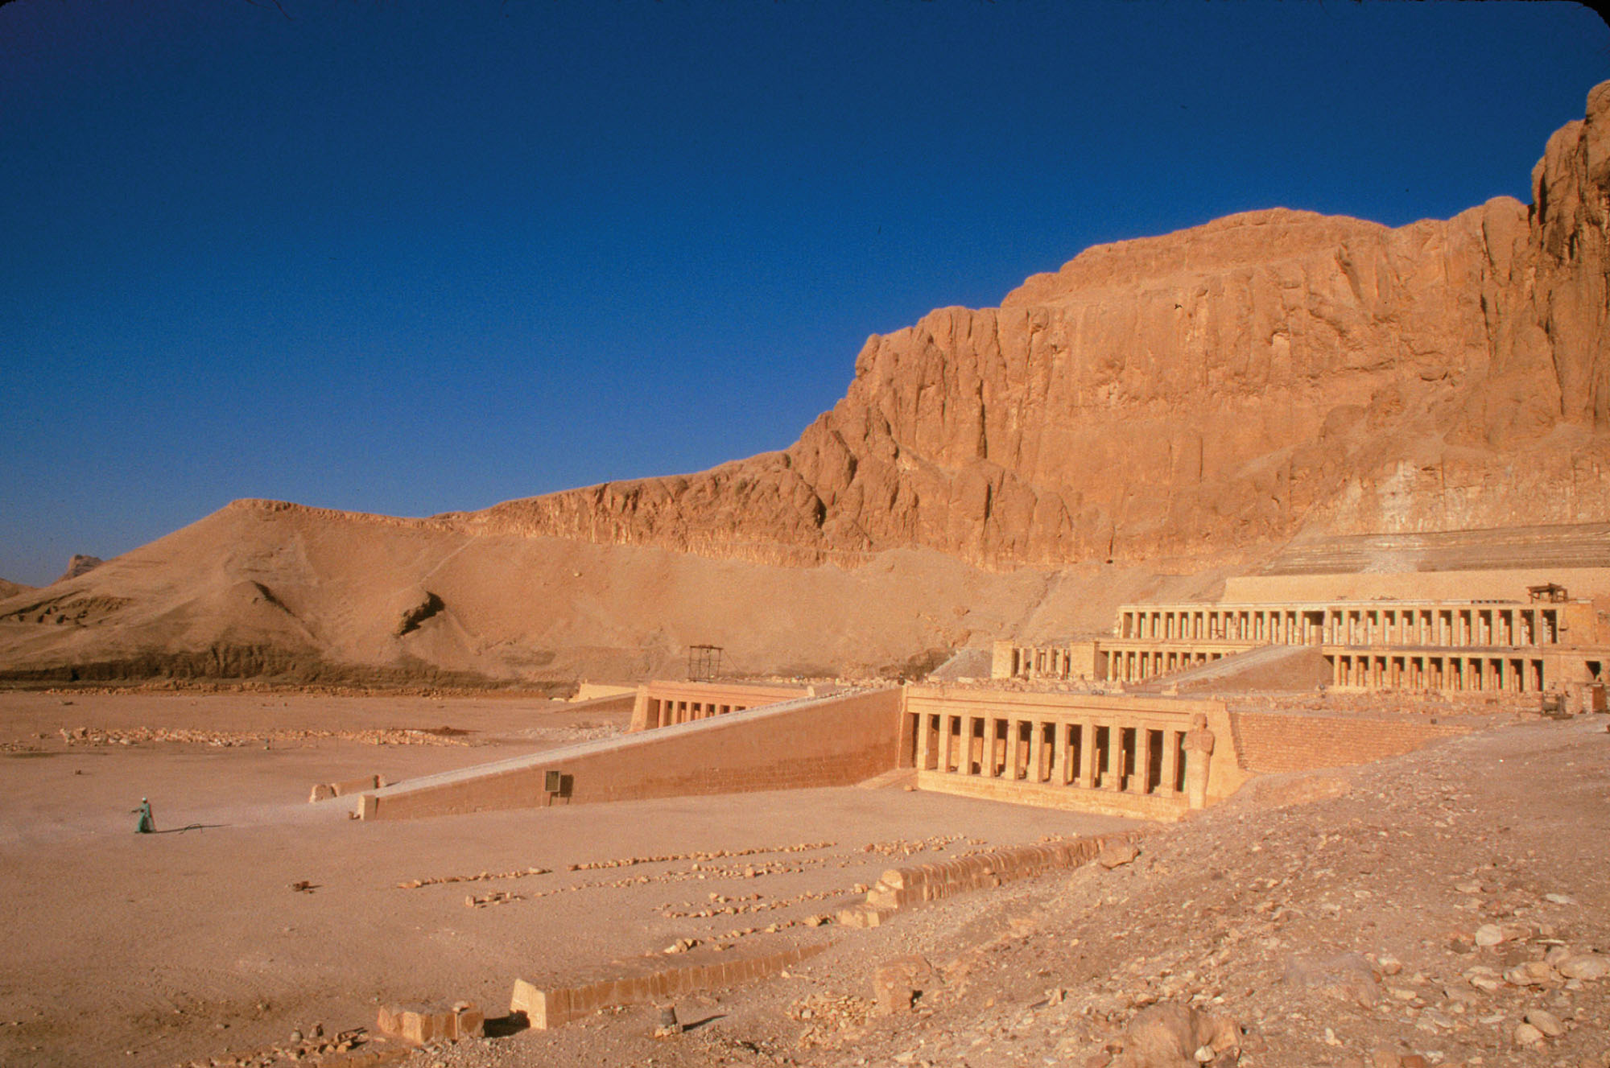
Notes:
The Mortuary Temple of Queen Hatshepsut at Deir el-Bahri, Egypt, ca. 1460 B.C.E.
This beautiful complex of terraces, ramps, and colonnades featured relief sculptures and texts commemorating the famous expedition to Punt. Hatshepsut, facing resistance from traditionalists opposed to a woman ruling Egypt, sought to prove her worth by publicizing the opening of direct contact with the source of highly prized myrrh.

Slide 8
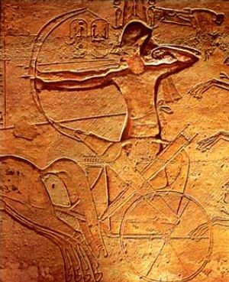
Other Rulers
Amenhotep
Ramesses II
“Inventor” of monotheism
Belief in one god
Changed his name to Akhenaten
“Beneficial to Aten”
Aten: sun god
Closed temples to other gods (including main god Amon)
Made priests mad
Moved capital of Egypt to Amarna
After his death, temples to other gods opened and Amon re-instated as main god of Egypt
Ruled for 66 yrs (1290-1224 BCE)
Monumental building projects
War with Hittites over control of Syria/Palestine and trade routes

Slide 9
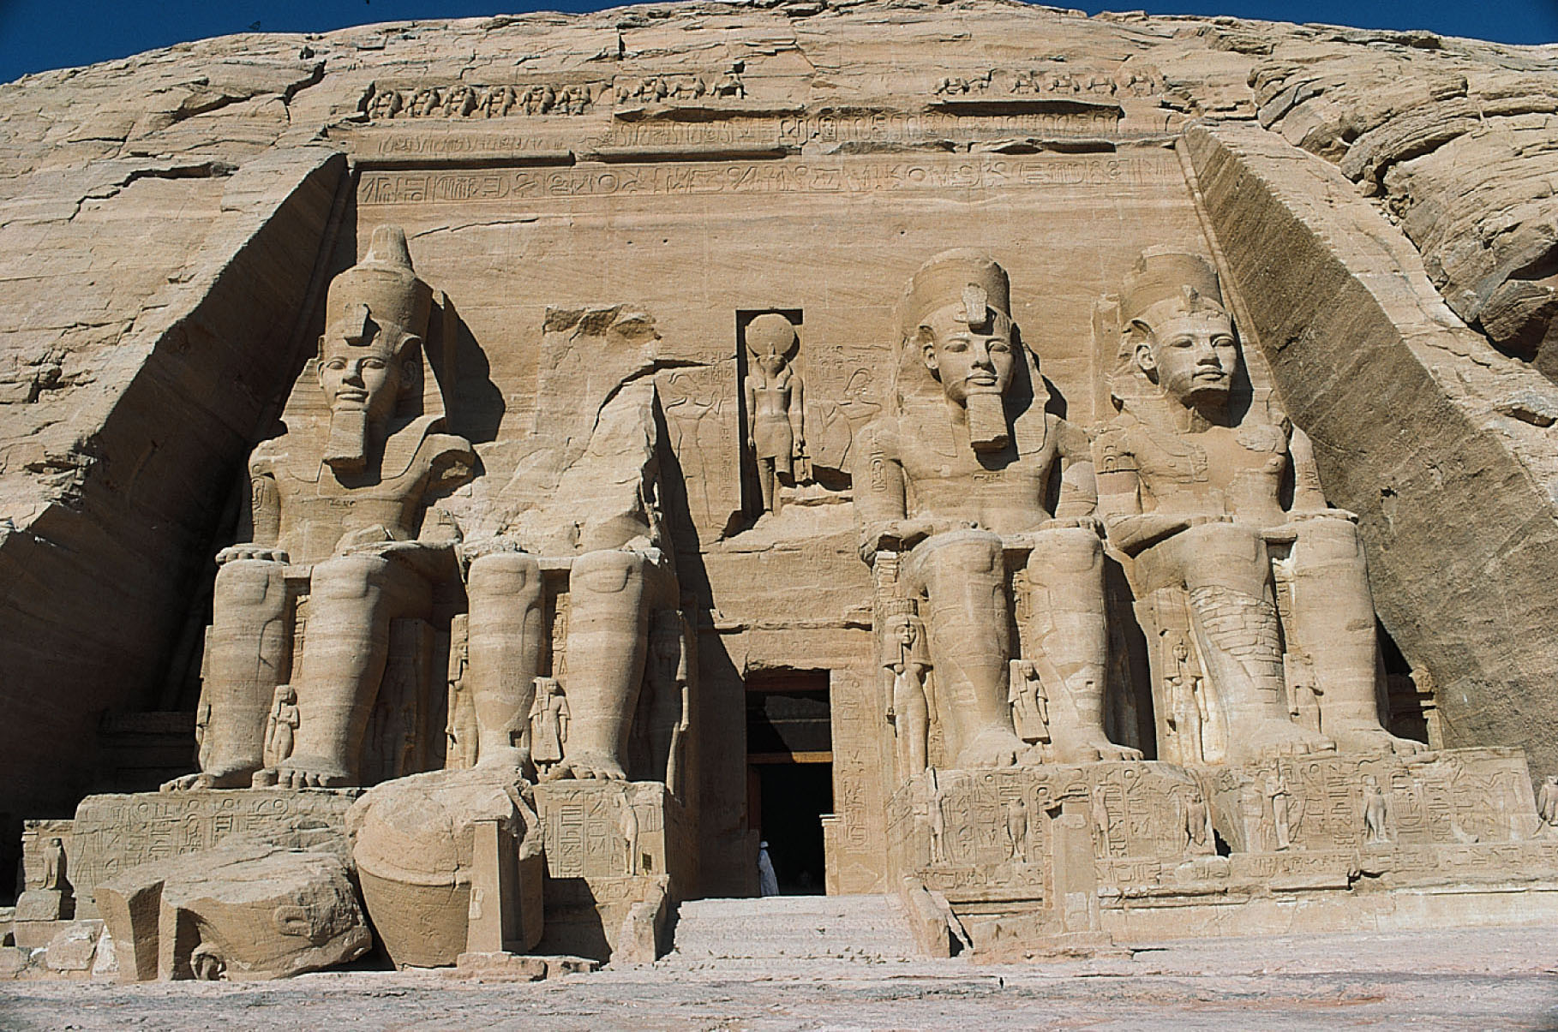
Notes:
Colossal Statues of Ramesses II at Abu Simbel.
Strategically placed at a bend in the Nile River so as to face the southern frontier, this monument was an advertisement of Egyptian power. A temple was carved into the cliff behind the gigantic statues of the pharaoh. Within the temple, a corridor decorated with reliefs of military victories leads to an inner shrine containing images of the divine ruler seated alongside three of the major gods. In a modern marvel of engineering, the monument was moved to higher ground in the 1960s C.E. to protect it from rising waters when a dam was constructed.

Slide 10
New Modes of Transportation
Allowed for more trade and better communication
Horses
Domesticated in Central Asia
2000 BCE: Mesopotamia
1600 BCE: Egypt
Helped create large states/empires due to ability to travel quickly
Allowed for horse drawn chariots and
Camels
1500 BCE: Western Asia
Travel long distances without water
Led to emergence of desert trade routes

Slide 11
Aegean World
Minoan Crete and Mycenaean Greece

Slide 12
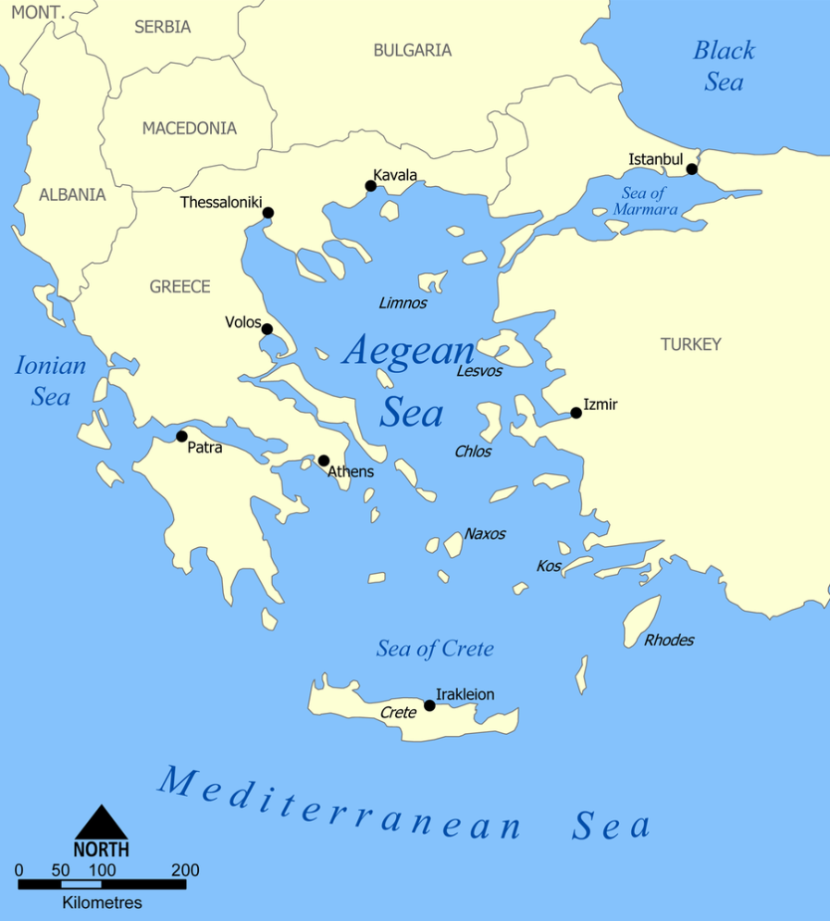
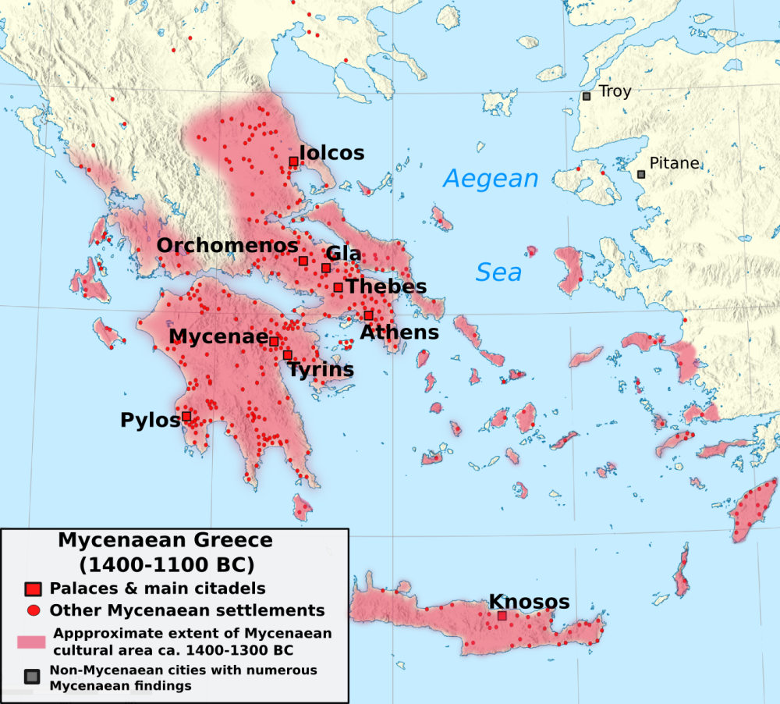
Minoan Crete
Mycenaean Greece

Slide 13
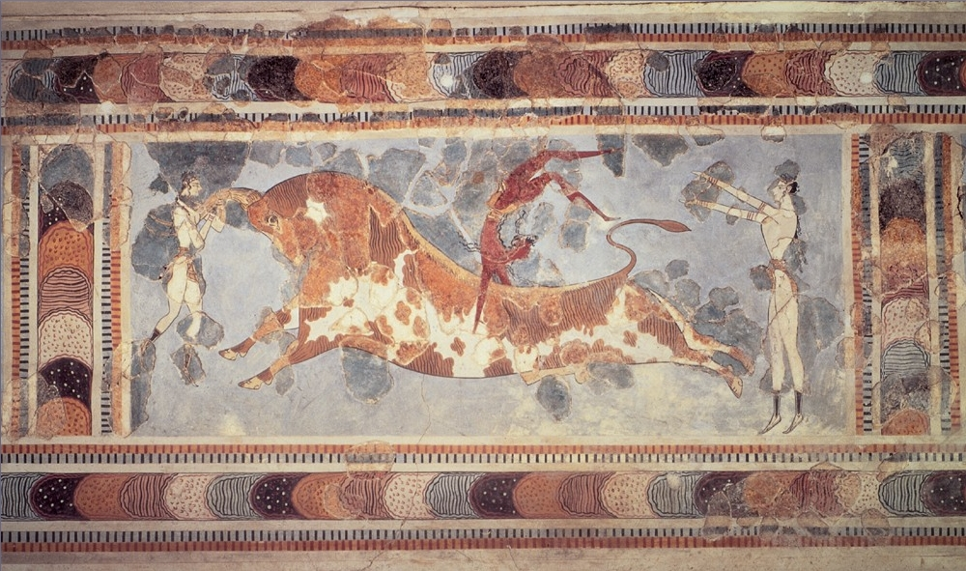
Minoan Crete
First European civilization with complex political and social structures
Un-deciphered writing
Wide spread trade documented by discovery of Minoan artifacts around the Middle East and Mediterranean
Colorful frescoes

Slide 14
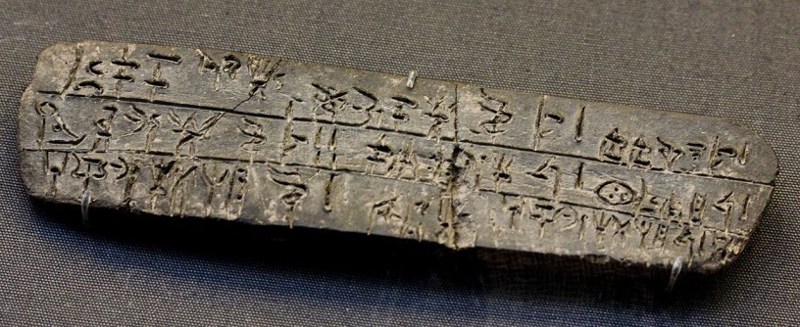
Mycenaean Greece
Probable conquerors of Minoan Crete
Influenced by art and architecture of Crete
Linear B
Mycenaean writing
Uses pictorial signs
Tablets detail economy but not historical events or figures
Long distance trade
By sea
Depended on wind
Sail during daylight hours
Keep shore within sight
Land at night

Slide 15
(Neo) Assyrian Empire
911-612 BCE

Slide 16
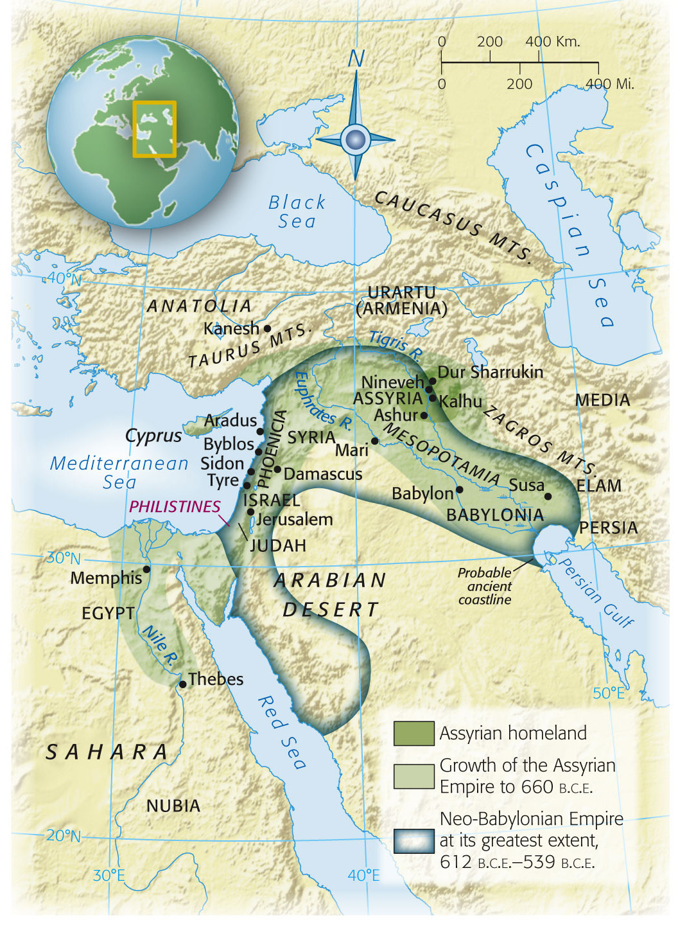
Map 4-3, p. 93
Notes:
Map 4.3: The Assyrian Empire.
From the tenth to the seventh century B.C.E. the Assyrians of northern Mesopotamia created the largest empire the world had yet seen, extending from the Iranian Plateau to the eastern shore of the Mediterranean and containing a diverse array of peoples.

Slide 17
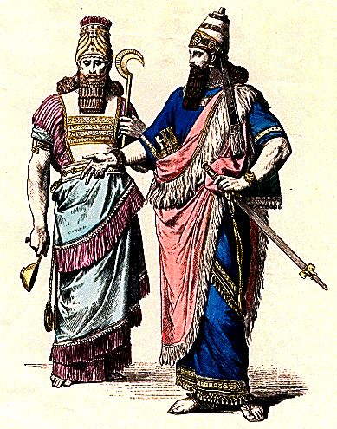
Neo-Assyrian Empire
Homeland in northern Mesopotamia
Stretched from Anatolia, Palestine, and Egypt to Mesopotamia and Iran
Larger empire than anyone had ever seen

Slide 18
Religion and Politics
King was the center of the Assyrian world
Chosen by the gods to represent them on Earth
Kings’ decisions had to be approved by the gods through divination
Superior military
Professional soldiers
½ million soldiers could be mobilized at a time
Bowmen, cavalry, spearmen, 4-man chariots
Iron weapons
Battering rams, signal fires, spies
Mass deportation
Forced move of entire communities/peoples
Up to 4 million people displaced during the empire
Deportees worked estates of the elite
Empire funded by the spoils of war
Size of the empire made it hard to control administratively
Tight control near the capital and loose control on the edges of the empire

Slide 19
Israel
2000-500 BCE

Slide 20
Israel
Historical information comes from archaeological digs and the Hebrew Bible (Old Testament)
Abraham rejects the idol worship of his home and leaves to follow Yahweh
His descendants (Isaac, Jacob)become leaders of the nomadic group that would become Israel
Famine and drought cause the Israelites to move to Egypt
Eventually enslaved and forced to work on royal building projects
New Kingdom projects??
Led out of Egypt by Moses
Eventually led by Joshua into the Promised Land of Canaan (modern Palestine)

Slide 21
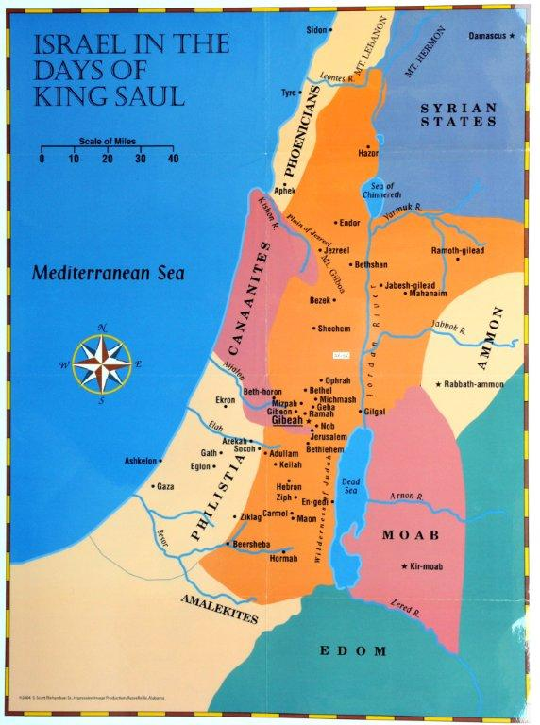
Kings
Saul (c 1020-1000 BCE)
First king of Israel
Anointed by Samuel
David (c 1000-960 BCE)
Unified Israel
Created taxes, standing army
Expanded Israel’s borders
Solomon (c 960-920 BCE)
Height of Israelite monarchy
Foreign trade
First Temple
Created elite priest class

Slide 22
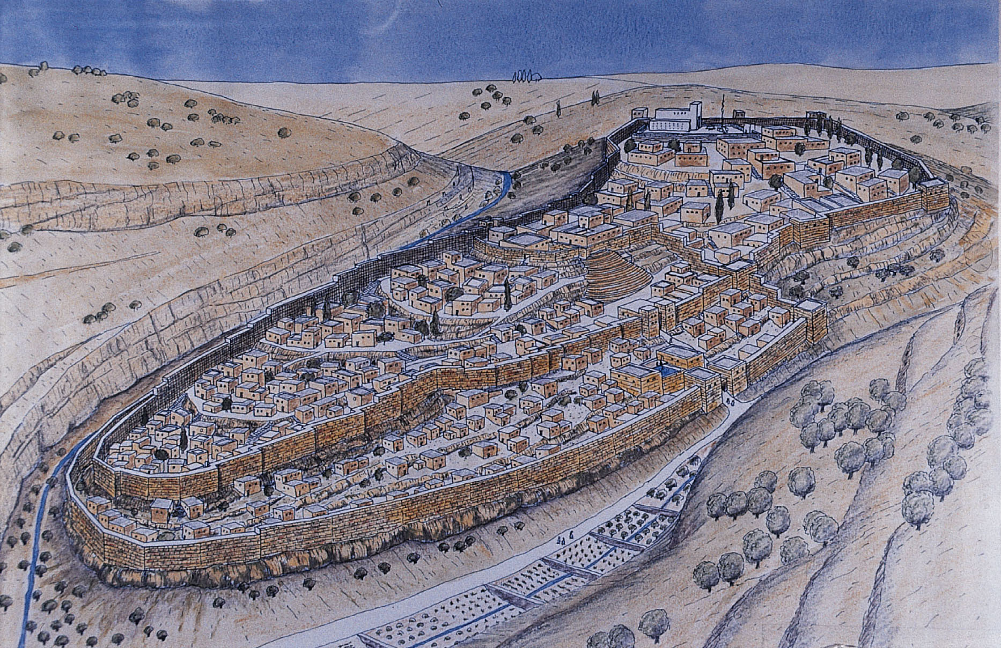
Notes:
Artist’s Rendering of Solomon’s Jerusalem.
Strategically located in the middle of lands occupied by the Israelite tribes and on a high plateau overlooking the central hills and the Judaean desert, Jerusalem was captured around 1000 B.C.E. by King David, who made it his capital (the City of David is at left, the citadel and palace complex at center). The next king, Solomon, built the First Temple to serve as the center of worship of the Israelite god, Yahweh. Solomon’s Temple (at upper right) was destroyed during the Neo-Babylonian sack of the city in 587 B.C.E. The modest structure soon built to take its place was replaced by the magnificent Second Temple, erected by King Herod in the last decades of the first century B.C.E. and destroyed by the Romans in 70 C.E.

Slide 23
Israel and Judah
Solomon’s death splits Israel in two
Israel (north)
Judah (south)
Israel destroyed by Assyrians in 721 BCE
Population is deported to the east and Persia
“Diaspora” dispersion outside the homeland of the Jews
Given the chance to return under the rule of Persian king Cyrus, but many decide to stay
Solomon’s Temple destroyed by Nebuchadnezzar in 587 BCE with the capture of Jerusalem
Some Diasporic communities eventually return to Judah and rebuild the temple

Slide 24
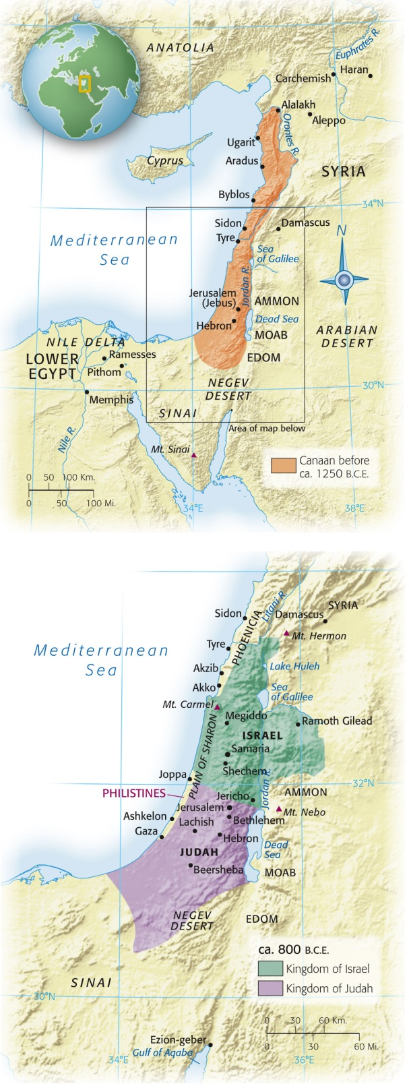
Notes:
Map 4.4: Phoenicia and Israel.
The lands along the eastern shore of the Mediterranean Sea—sometimes called the Levant or Syria-Palestine—have always been a crossroads, traversed by migrants, nomads, merchants, and armies moving between Egypt, Arabia, Mesopotamia, and Anatolia.

Slide 25
Phoenicia and the Mediterranean

Slide 26
Phoenicians
Mediterranean coast
Referred to themselves as Can’ani
(Canaanites-see Israel)
1200 BCE: Canaanite settlements destroyed
Remaining city-states: Byblos, Berytus, Sidon, Tyre
1000 BCE: Byblos = most important
Cedar distribution center
969 BCE: Tyre replaces Byblos as dominant city-state
Alliance with Solomon – materials for Temple
Began emphasis on trade of woods, metals, food, and luxury goods (including purple cloth from Tyre)
Developed a 24 consonant “alphabet” from early Canaanite script

Slide 27
Phoenician Colonies
900 BCE: Tyre begins expanding it’s territory
Cyprus
More known about colonies than Phoenician homeland
Phoenician triangle
Libya and Morocco
Spain (Iberia)
Strait of Gibraltar
Sardinia, Sicily, Malta
Trading network across entire Mediterranean

Slide 28
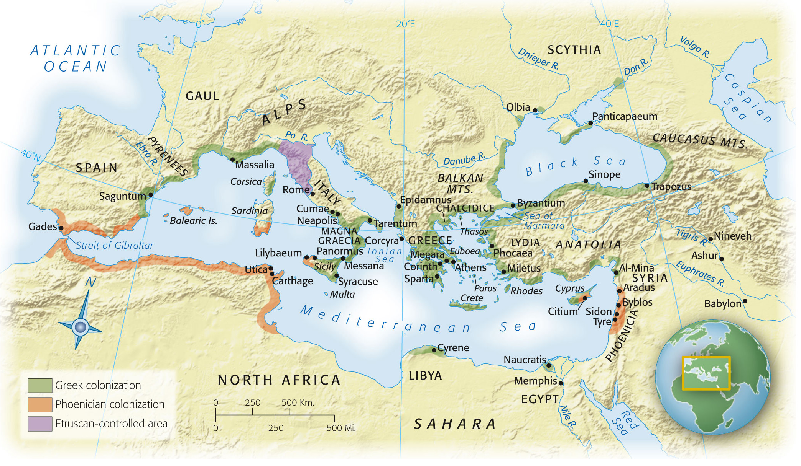
Map 4-5, p. 105
Notes:
Map 4.5: Colonization of the Mediterranean.
In the ninth century B.C.E., the Phoenicians of Lebanon began to explore and colonize parts of the western Mediterranean, including the coast of North Africa, southern and eastern Spain, and the islands of Sicily and Sardinia. The Phoenicians were primarily interested in access to valuable raw materials and trading opportunities.

Slide 29
Carthage
Modern day Tunisia
Inner and outer harbor
Inner: 220 warships
Outer: merchant ships
22 mile long wall that circled the entire city
400,000 population
One of largest cities in the world by 500 BCE
Navy
Military power of Carthage
Galleys
Propelled by rows of oars
Up to 170 rowers
Evidence of trade with Sub-Saharan Africa
Child Sacrifice

Slide 30
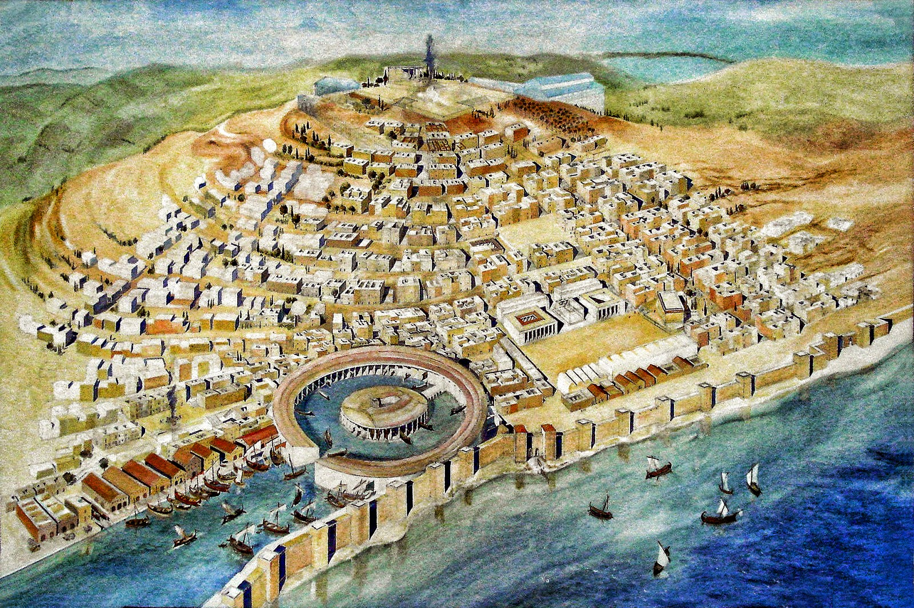

Slide 31
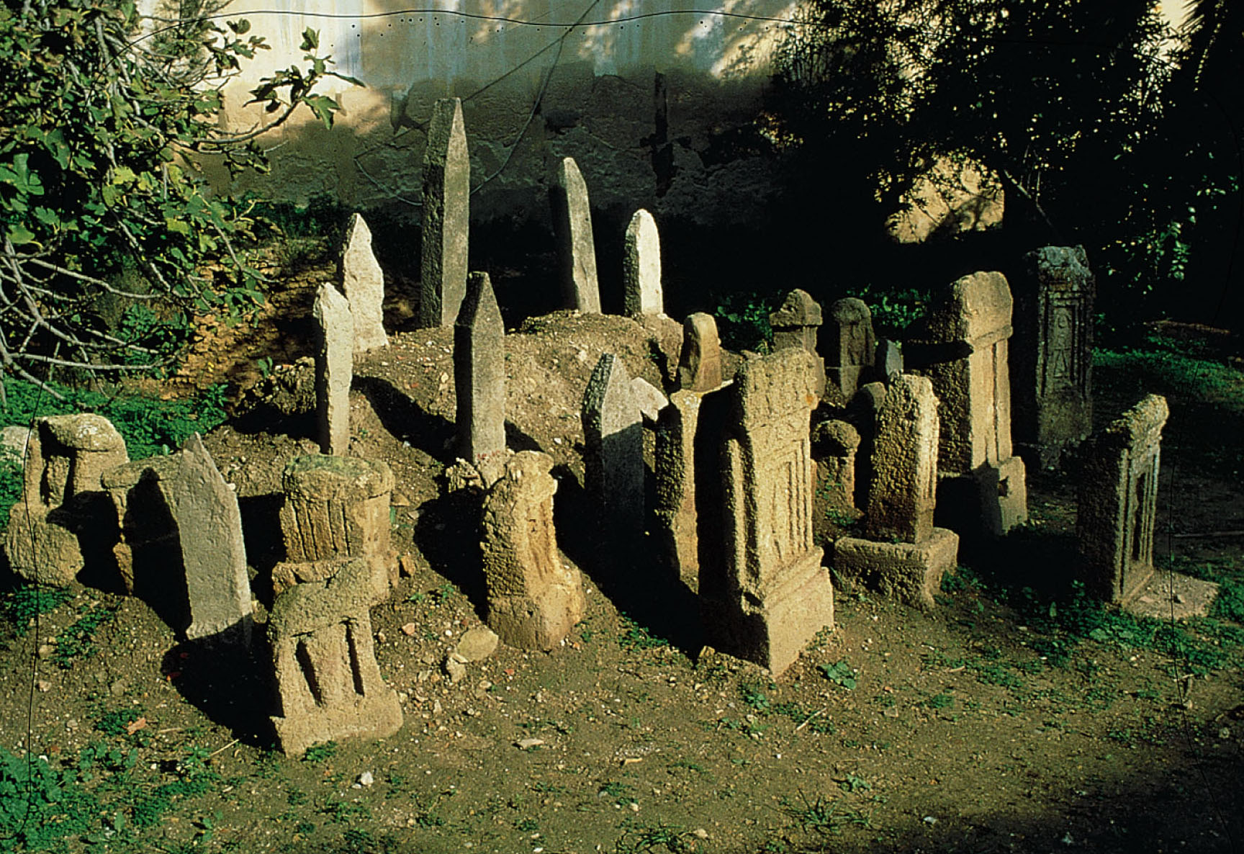
p. 107
Notes:
The Tophet of Carthage.
Here, from the seventh to second centuries B.C.E., the cremated bodies of sacrificed children were buried. Archaeological excavation has confirmed the claim in ancient sources that the Carthaginians sacrificed children to their gods at times of crisis. Stone markers, decorated with magical signs and symbols of divinities as well as family names, were placed over ceramic urns containing the ashes and charred bones of one or more infants or, occasionally, older children.

