Slide 1
Nature, Humanity, and History
To 3500 BCE
Jessica Stroo
Northeast Jones High School
The Earth and Its Peoples (Bulliet et al)
World History (Amsco)

Slide 2
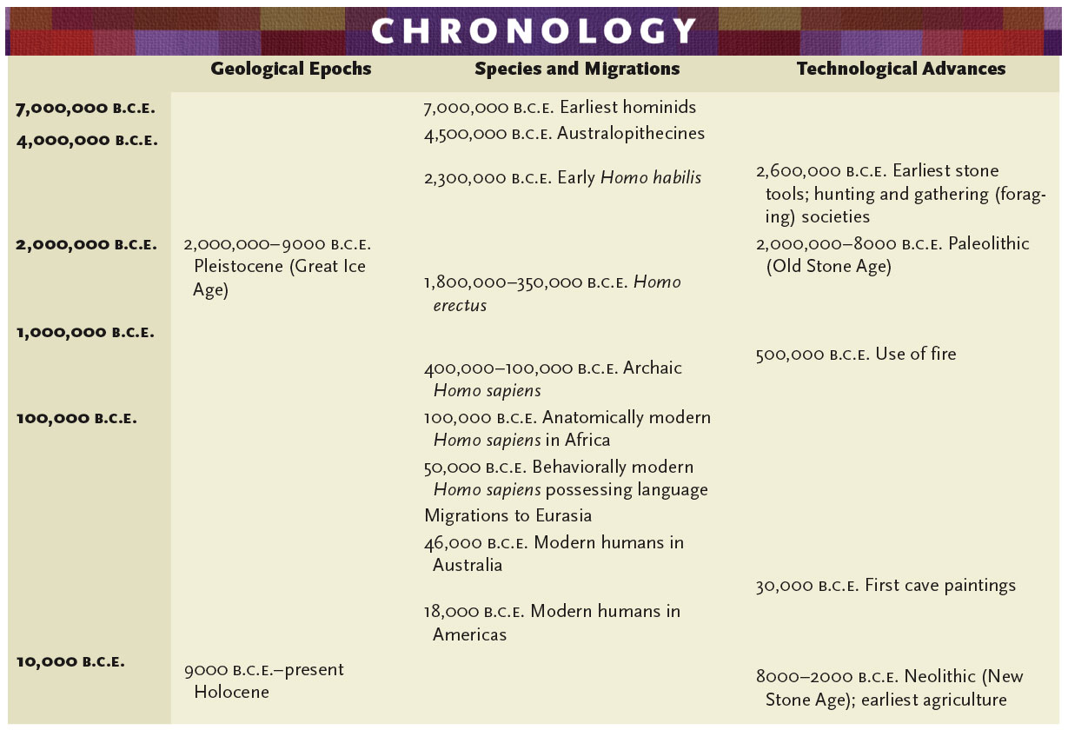
p. 7

Slide 3
1.1 Big Geography/Peopling of the Earth
Hunter-gatherers migrated from East Africa to Eurasia, Australia, the Americas
Humans used fire in new ways
Humans developed tools
Small groups of hunter/gatherers made what they needed to survive; some weren’t self-sufficient and traded people, ideas, goods

Slide 4
Evolution
1856: Neander Valley (Germany
Fossilized bones of “neanderthals”
Modern human body, heavy brow ridge, low forhead
Common in Europe 40,000 years ago
Charles Darwin
On the Origin of Species (1859)
Diversity of species and changes over time = evolution
New species can be created through evolution
The Descent of Man (1871)
Humans share characteristics with African Apes
Therefore-humans evolved in Africa (“African Genesis”)

Slide 5
Early Humans
Java Man: Indonesia (1891)
Australopithecus africanus: southern Africa (1924)
“African southern ape”
Transitional creature between apes and humans
Walked upright (bipedalism), small brain
Peking Man: Beijing, China (1929)
Lucy: Ethiopia (1974)

Slide 6
Early Humans
Great Ice Age
Pleistocene epoch
2 million BCE – 9,000 BCE
Temp. changes
Rainfall/vegetation changes
Homo habilis
Handy human
Larger brain
Ability to locate foods throughout seasons/remember locations
Homo erectus
Upright human
First to be found throughout and outside of Africa
Homo sapiens
Wise human
Modern humans
Migrated from Africa to Europe, Asia, the Americas

Slide 7
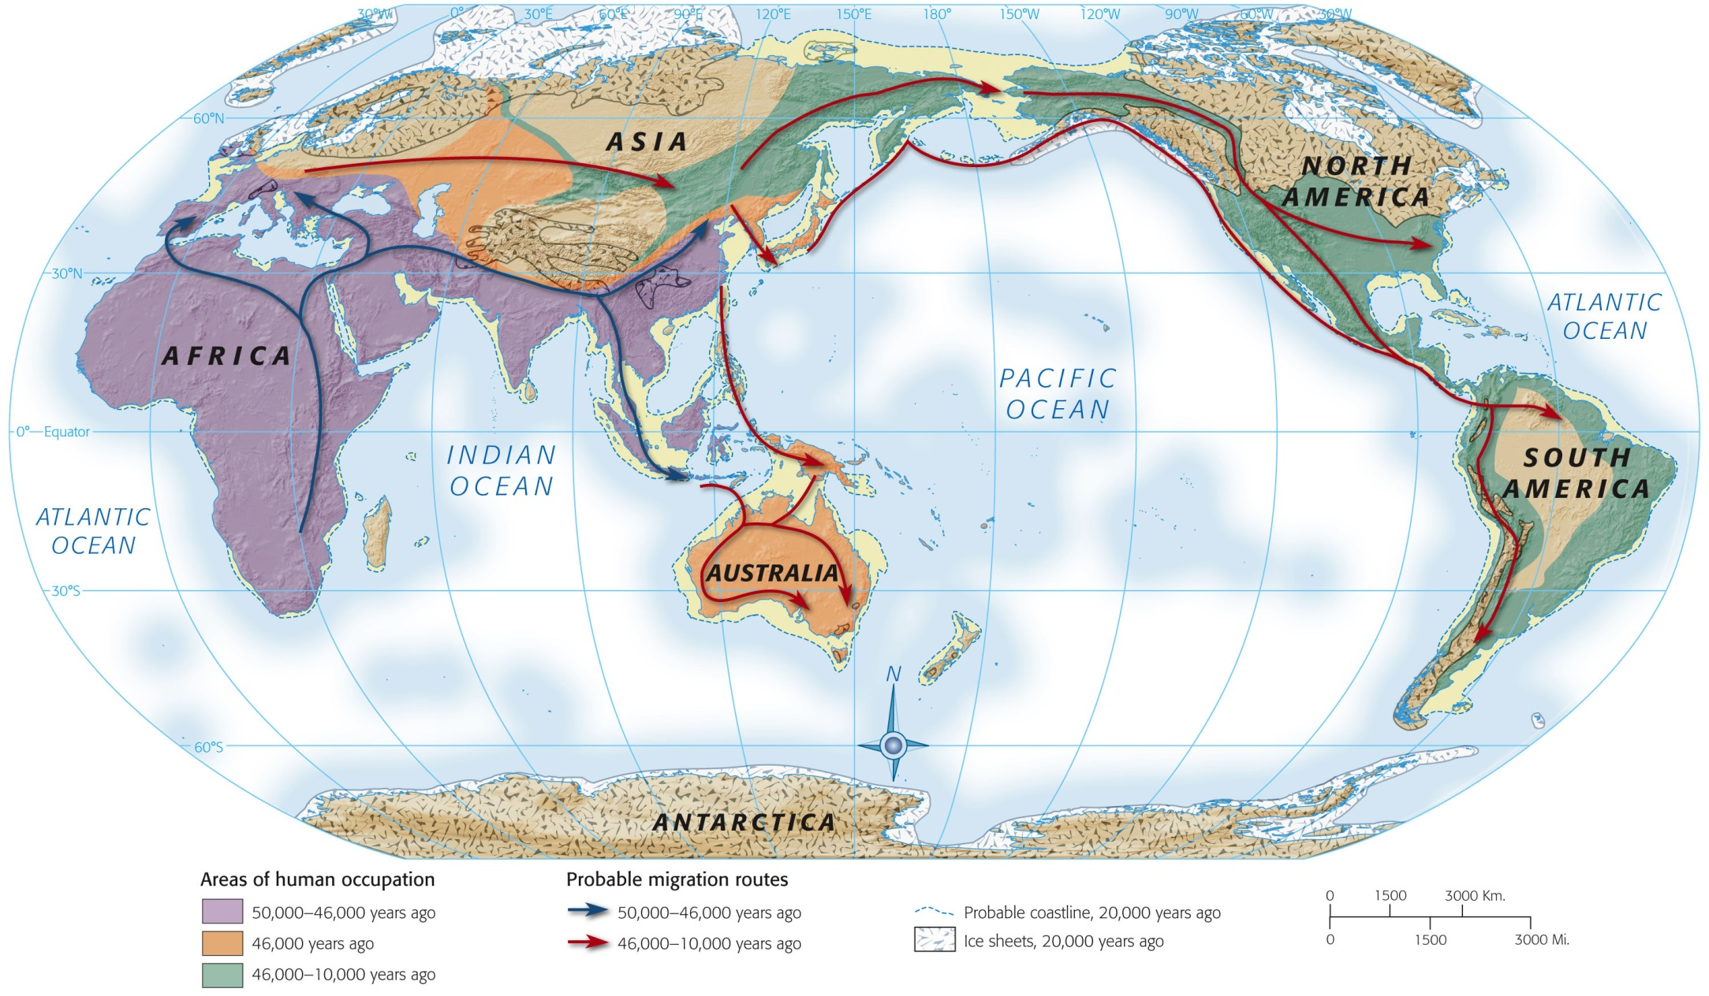
Map 1-1, p. 6
Notes:
Map 1.1: Human Dispersal to 10,000 Years Ago.
Early migrations from Africa into southern Eurasia were followed by treks across land bridges during ice ages, when giant ice sheets lowered ocean levels. Boats may also have been employed.

Slide 8
Cave Drawings
Display of artistic and intellect of hominids
Lascaux, France
http://www.lascaux.culture.fr/index.php?fichier=02_01.xml
Chauvet Caves, France
http://archeologie.culture.fr/chauvet/fr/visiter-grotte
This site is in French, but you can still do the virtual tour and see the paintings.
Altamira Cave, Spain
http://en.museodealtamira.mcu.es/Prehistoria_y_Arte/arte_Altamira.html
Cave of Hands, Argentina
http://whc.unesco.org/en/list/936

Slide 9
Notes:
Lascaux Caves, France

Slide 10
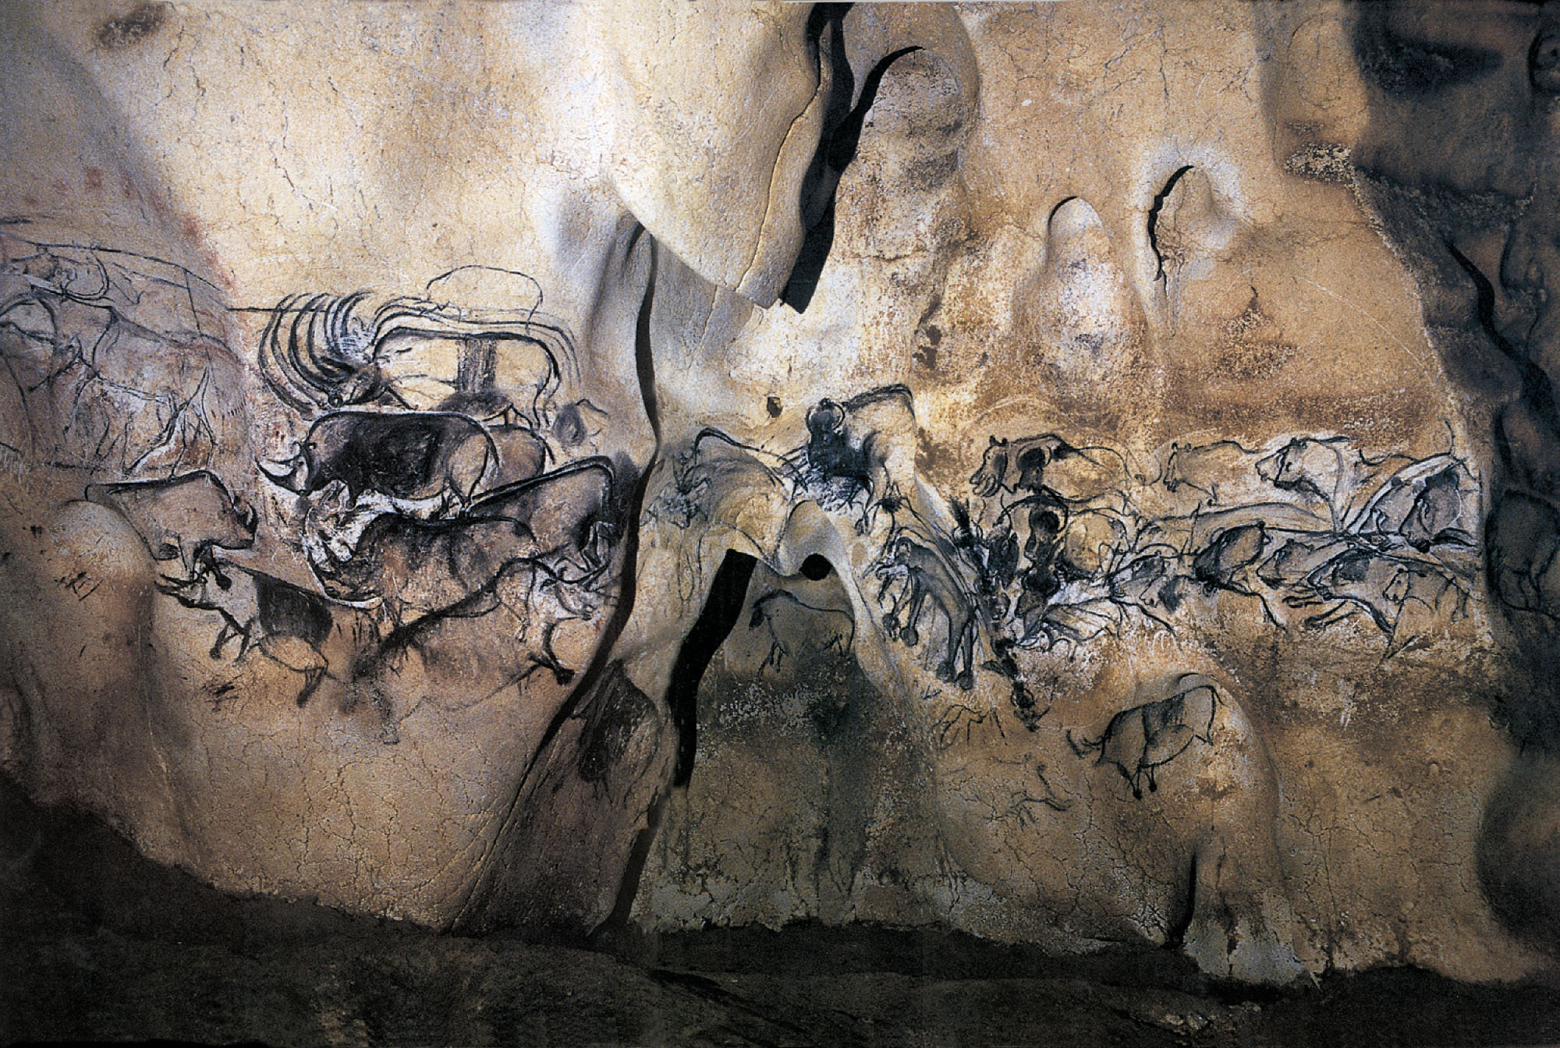
p. 12
Notes:
The Lion Panel in Chauvet Cave, France.

Slide 11
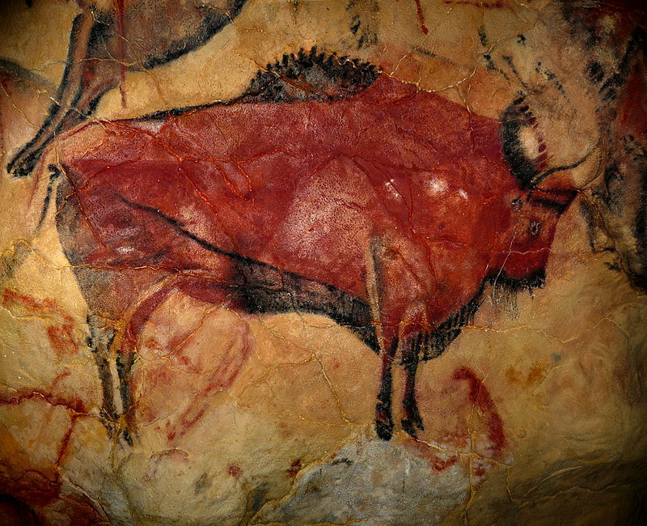
Notes:
Altamira Cave, Spain

Slide 12
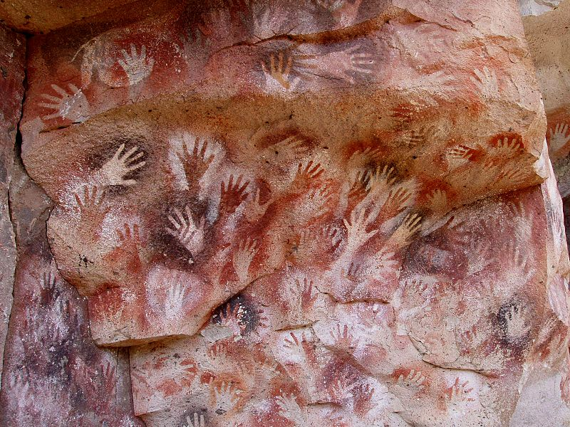
Notes:
Cave of Hands, Argentina

Slide 13
The Paleolithic Age (Old Stone Age)
Prehistory to 8,000 BCE
Tools made of stone, bone, wood, etc
Rise of Homo sapiens being successful hunters
Contributed to the extinction of mastodon/mammoth
Still hunter-gatherer societies
Spent 3-5 hrs/day hunting/gathering
Fruits, berries, seeds, edible roots

Slide 14
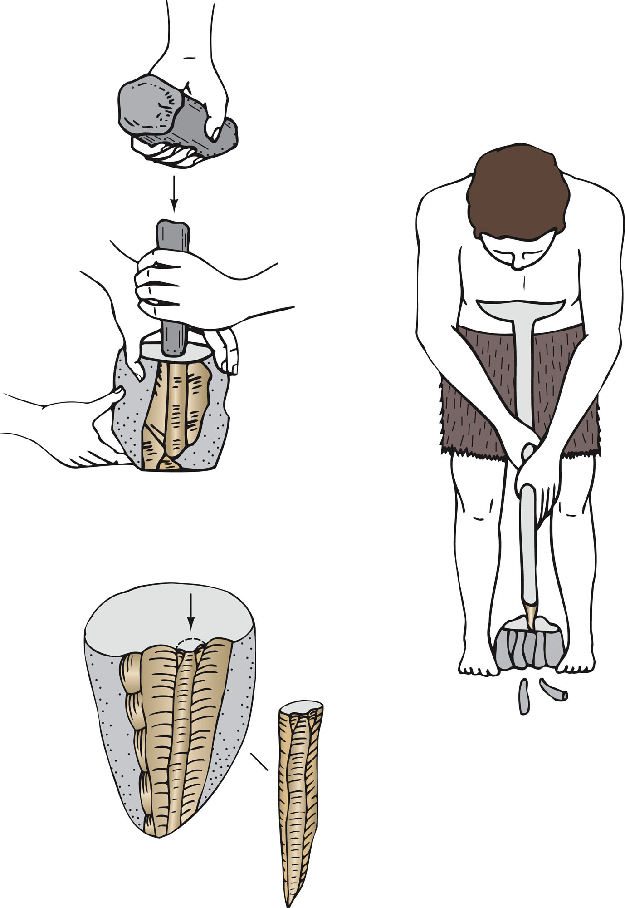
p. 14
Notes:
Making Stone Tools.
About 35,000 years ago the manufacture of stone tools became highly specialized. Small blades chipped from a rock core were mounted in a bone or wooden handle. Not only were such composite tools more varied than earlier all-purpose hand axes, but the small blades also required fewer rock cores—an important consideration where suitable rocks were scarce. (From Jacques Bordaz, Tools of the Old and New Stone Age. Copyright 1970 by Jacques Bordaz. Redrawn by the permission of Addison-Wesley Educational Publishers, Inc.)

Slide 15
Fire
1.4 million yrs ago: deliberate fires
500,000 yrs ago: sustainment of hearths
Cooking “invented” through wildfires (probably)
Meat/veggies become easier to digest and better to the taste when cooked
Gave light for after dark hours
Provided heat in colder climates/seasons
Provided protection against animals
Helped in hunting
Scare animals into traps
Smoke out bees to get honey

Slide 16
Hunter-Gatherer Society
Community
Enough people to defend/protect the group
Enough people to hunt/gather and support the group
NOT so many as the food will not feed the entire group
Mobile (most)
Follow herds/seasonal plants
Lived under overhangs/caves
Sedentary (some)
Fishing villages that relied on the sea
Did not move according to weather
Created solid structures to live in
Gender Roles
Women: gathering, cooking, child care
Men: hunting, shelter
(patriarchy!!)

Slide 17
The Neolithic Age (New Stone Age)
Began c. 8,000 BCE
Associated with the rise of agriculture
AKA: Agricultural Revolution/Neolithic Revolution
(one of the) Most important turning points in history
Rapid population increase
Changed human interaction with the environment
Domestication of crops and animals
First occurred in the Middle East (Fertile Crescent)
Wheat and barley
Shifting or Swidden Agriculture
Allowing fields to lay fallow for a period of time to restore fertility

Slide 18
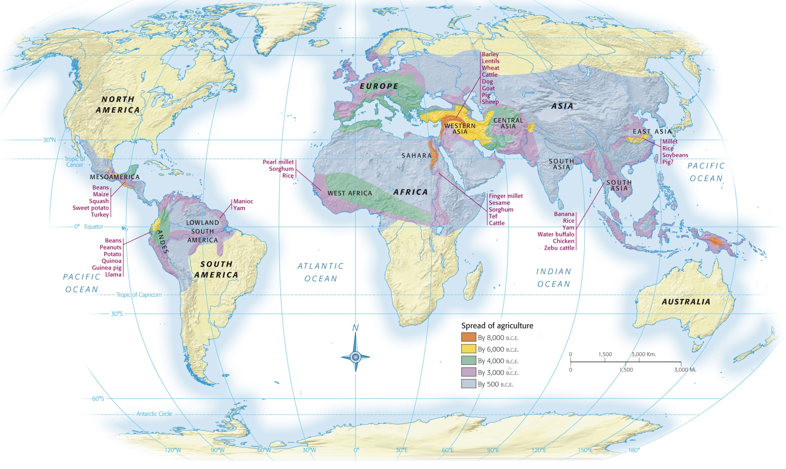
Notes:
Map 1.2: Early Centers of Plant and Animal Domestication.
Many different parts of the world made original contributions to domestication during the Agricultural Revolutions that began about 10,000 years ago. Later interactions helped spread these domesticated animals and plants to new locations. In lands less suitable for crop cultivation, pastoralism and hunting remained more important for supplying food.

Slide 19
8,000 BCE:
Barley and wheat domesticated in Middle East
Sorghum cultivated in the eastern Sahara
6,000 BCE:
Middle Eastern crops spread to Greece
5,000 BCE
China domesticates rice
Saharan farmers domesticate: blackeyed peas, millet, sesame, gourds
West Africa domesticates: rice and yams
Mexico (corn), Brazil/Panama (manioc), Mesoamerica (beans/squash)
4,000 BCE:
Middle Eastern crops spread to Central Europe
African farmers settle along Nile River in order to use the flood waters to water crops
Peru: potatoes/quinoa cultivated
2,600 BCE:
Central Europeans use ox-drawn plows
2,000 BCE
India cultivates beans, green/black grams
CROPS

Slide 20
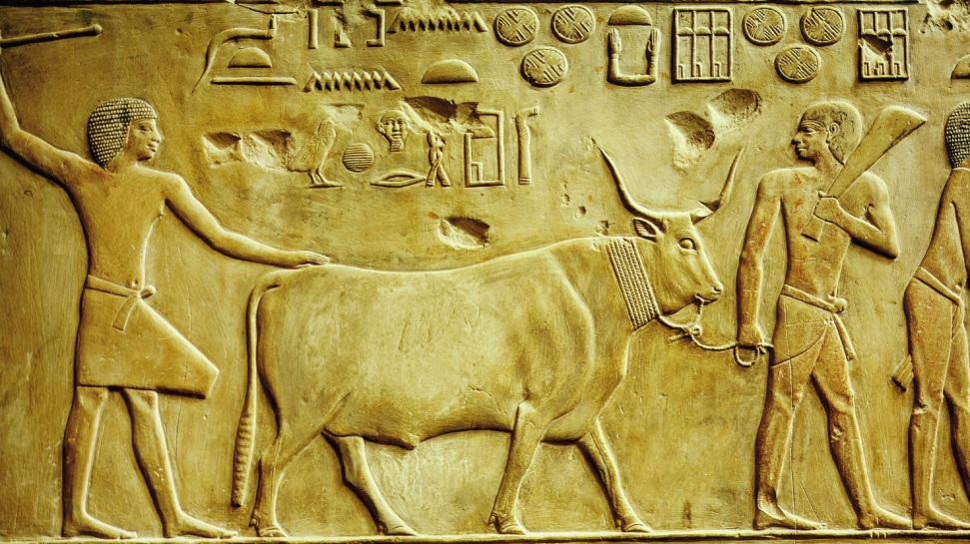
Animals
Dogs were the first to be domesticated
Used in Siberia for hunting
Sheep/goats: provided meat, milk, skins
Cattle/donkeys: beasts of burden
Llamas: only domesticated beast of burden in the Americas
Notes:
Domestication of Animals.
Carved in Egypt ca. 2380 B.C.E., this limestone relief sculpture shows two workers leading a prize bull. It is from the funerary chapel of Ptahhotep, a high-ranking official who lived in the period of the Old Kingdom (see Chapter 2).

Slide 21
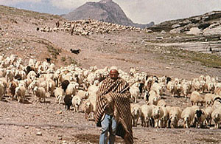
Agriculture vs. Pastoralism
Pastoralism
Mobile groups that followed/depended on large herds of animals
Central Asia/Africa
Arid areas where agriculture could not thrive

Slide 22
Effects of Agriculture
Positive (?)
Negative
Less likely to starve due to surplus of food
Creation of cities/civilizations
Art/architecture
Stonehenge (megalith)
Religion
Neolithic goddesses
Specialized labor
Less varied diet—less nutritious than the varied diets of foragers
Shorter in height
Death at an earlier age
Disease (from animals, close contact with others)
Water contamination (human and animal waste, disease)
Harder/longer work
Cultivation, clearing, protection of land

Slide 23
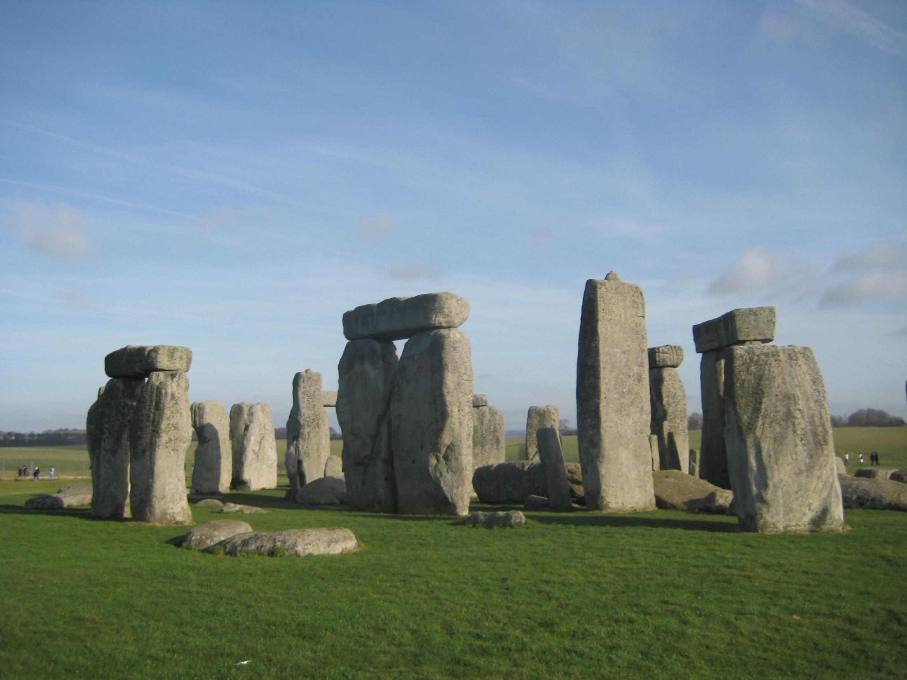
Notes:
Stonehenge, England

Slide 24
Early Cities
Jericho
Çatal Hüyük
Jordan River
Round, mud dwellings
(early dwellings)
Rectangular buildings
Open courtyards
Plastered walls
(later dwellings)
Stone wall protection
Turkey
Mud brick
NO protective wall
Long distance trade
Metallurgy

Slide 25
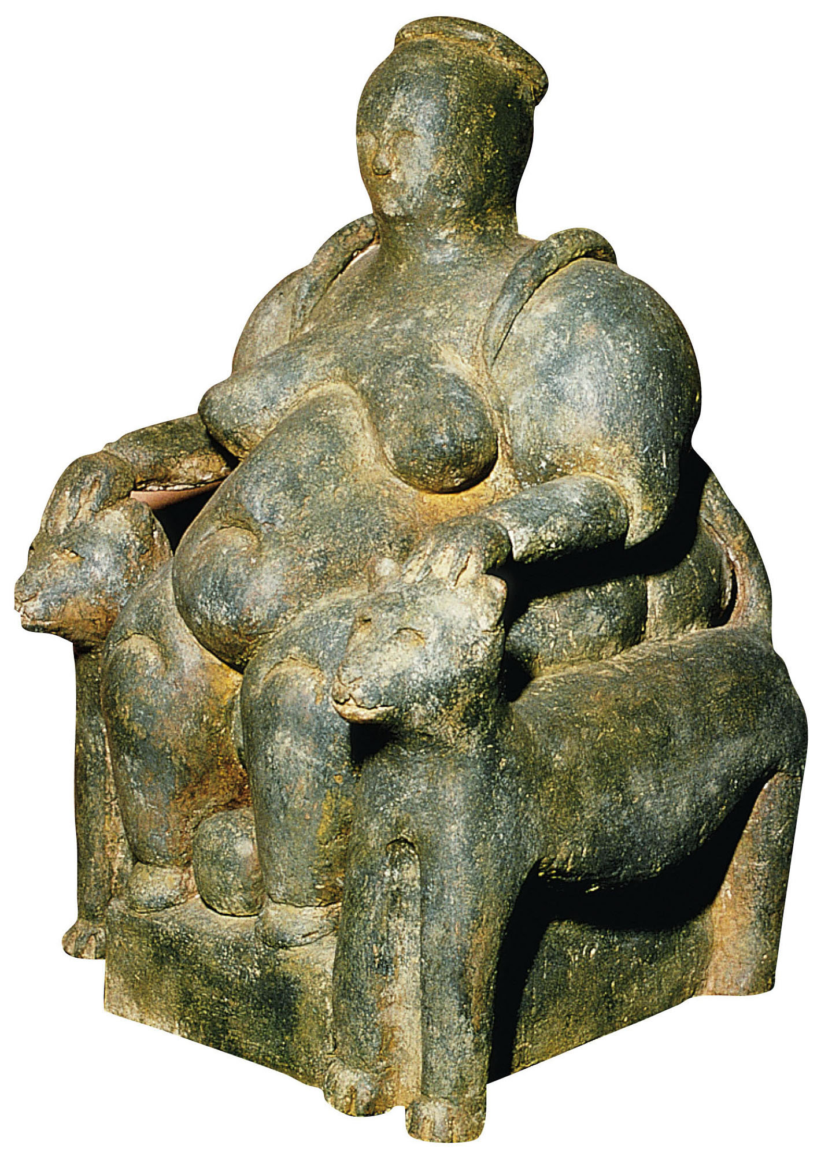
p. 23
Notes:
Neolithic Goddess.
Many versions of a well-nourished and pregnant female figure were found at Çatal Hüyük. Here she is supported by twin leopards whose tails curve over her shoulders. To those who inhabited the city some 8,000 years ago, the figure likely represented fertility and power over nature.

