Slide 1
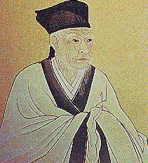
Chinese Philosophies & Ethical Codes
Ms. Susan M. Pojer Horace Greeley HS
Chappaqua, NY

Slide 2
Confucianism

Slide 3
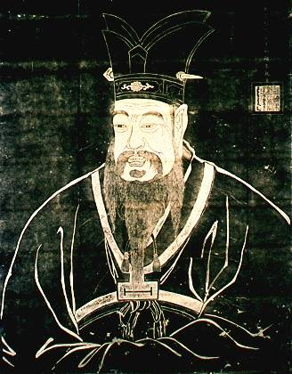
Confucius
551 – 479 B.C.E.
Born in the feudal state of Liu.
Became a teacher and editor of books.

Slide 4
Major Confucian Principles
Li --> Rite, rules, ritual decorum (Binding force of an enduring stable society)
Ren --> humaneness, benevolence, humanity
Shu --> Reciprocity, empathy
Do not do unto others what you would not want others to do unto you.
Yi --> Righteousness
Xiao --> Filial Piety (Respect your elders!)

Slide 5
5 Principle Relationships
1. Ruler
Subject
2. Father
Son
3. Husband
Wife
4. Older Brother
Younger Brother
5. Older Friend
Younger Friend

Slide 6
Organizing Principles
Status
Age
Gender

Slide 7
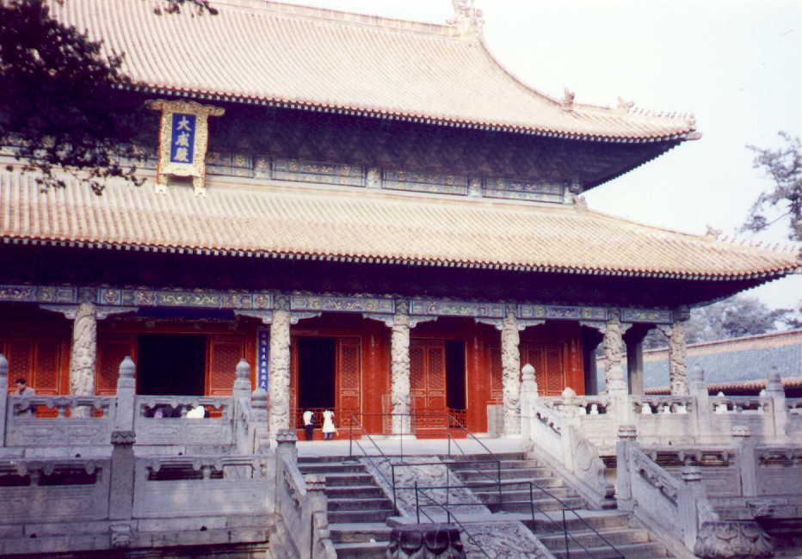
Confucian Temple Complex

Slide 8
The Analects
The single most important Confucian work.
In Chinese, it means “conversation.”
Focus on practicalities of interpersonal relationships and the relationship of the role of rulers and ministers to the conduct of government.

Slide 9
Sayings from The Analects
Knowing what he knows and knowing what he doesn’t know, is characteristics of the person who knows.
Making a mistake and not correcting it, is making another mistake.
The superior man blames himself; the inferior man blames others.
To go too far is as wrong as to fall short.

Slide 10
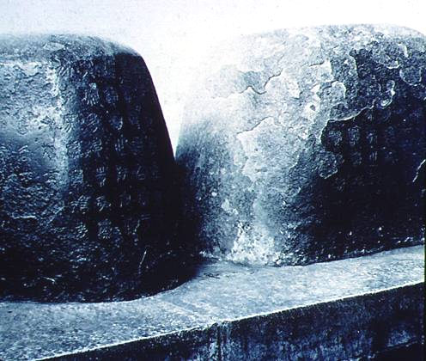
Stones Engraved with Confucius' Life Stories

Slide 11
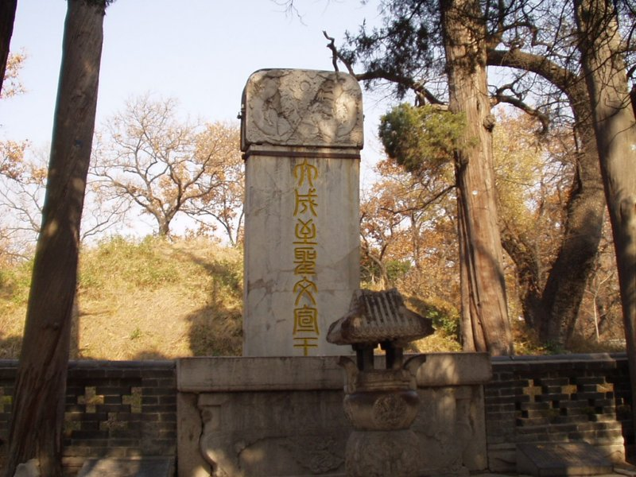
Confucius' Tomb

Slide 12
Mencius
372 - 289 B.C.E.
Disciple of Confucius.
Starts off with the assumption that “people are basically good.”
If someone does something bad, education, not punishment, is the answer.
Good people will mend their ways in accordance to their inherent goodness.

Slide 13
Social Cohesion is Paramount!
The emperor is the example of proper behavior --> “big daddy”
Social relationships are based on “rites” or “rituals.”
Even religious rituals are important for SOCIAL, not religious reasons, acc. to Confucius.

Slide 14
Differences in Cultures
INDIA
CHINA
1. Brahmin
1. Scholar-Gentry
2. Kshatriyas
2. Peasants
3. Vaishyas
3. Artisans
4. Shudras
4. Merchants
Untouchables
Soldiers
Imperial Nobility
Domestic Slaves

Slide 15
Legalism

Slide 16
Han Fei
280? - 233 B.C.E.
Han Fe Zi.
Lived during the late Warring States period.
Legalism became the political philosophy of the Qin [Ch’in] Dynasty.

Slide 17
Major Legalist Principles
1. Human nature is naturally selfish.
2. Intellectualism and literacy is discouraged.
3. Law is the supreme authority and replaces morality.
4. The ruler must rule with a strong, punishing hand.
5. War is the means of strengthening a ruler’s power.

Slide 18
Authoritarian
One who favors the principle that individuals should obey a powerful authority rather than exercise individual freedom.
The ruler, therefore, “cracks his whip” on the backs of his subjects!

Slide 19
Daoism

Slide 20
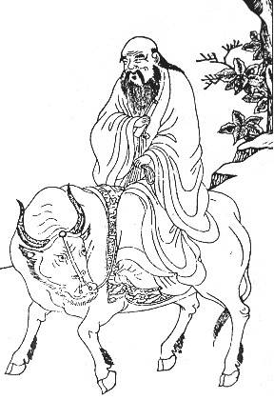
Lao Zi [Lao-Tzu]
Not sure when he died. [604 B.C.E. - ?]
His name means “Old Master”
Was he Confucius’ teacher?

Slide 21
The Dao De Jing
The basic text of Daoism.
In Chinese, it means The Classic in the Way and Its Power.
“Those who speak know nothing: Those who know are silent.” These words, I am told, Were spoken by Laozi. If we are to believe that Laozi, Was himself one who knew, How is it that he wrote a book, Of five thousand words?

Slide 22
Major Daoist Principles
1. Dao [Tao] is the first-cause of the universe. It is a force that flows through all life.
2. A believer’s goal is to become one with Dao; one with nature. [“The butterfly or the man?” story.]
3. Wu wei --> “Let nature take its course.” --> “The art of doing nothing.” --> “Go with the flow!”
4. Man is unhappy because he lives acc. to man-made laws, customs, & traditions that are contrary to the ways of nature.

Slide 23
The "Dao" [Tao]
To escape the “social, political, & cultural traps” of life, one must escape by:
1. Rejecting formal knowledge and learning.
2. Relying on the senses and instincts.
3. Discovering the nature and “rhythm” of the universe.
4. Ignoring political and social laws.

Slide 24
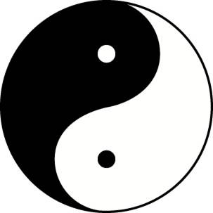
The Universe of Opposites: Find the Balance!
Yin
Feminine
Passive
Darkness
Cold
Weak
Earth; Moon
Masculine
Active
Light
Warmth
Strong
Heaven; Sun
Yang

Slide 25
The Uniqueness of Daoism
How is a man to live in a world dominated by chaos, suffering, and absurdity??
Confucianism --> Moral order in society.
Legalism --> Rule by harsh law & order.
Daoism --> Freedom for individuals and less govt. to avoid uniformity and conformity.

Slide 26
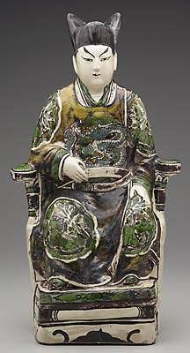
What's Your Philosophy of Life?

