Slide 1
India and SE Asia
1500 BCE – 1025 CE

Slide 2
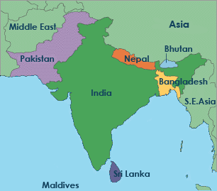
Geography
Indian “subcontinent”
Modern Pakistan, Nepal, Bhutan, Bangladesh, India, Sri Lanka
North: mountains, meadows of Hindu Kush/Himalayan Mountains
Indus and Ganges River basins
Indian Ocean coastal lands
Monsoon winds
June: winds from the south deposit large amounts of rainfall
Ships use monsoon winds to aid in speedy travel

Slide 3
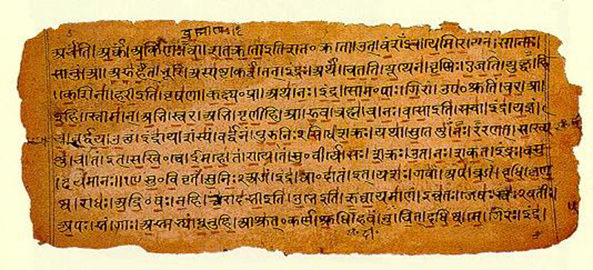
Vedic Age
1500-500 BCE
Vedas: religious texts; main source of information of the time
1000 BCE: New peoples migrate into India
Aryas: lighter skinned, Indo-European language speakers
Settled in the North
Dasas: dark skinned, Dravidian language speakers
Settled in the South
New technologies
Iron allowed for stronger/harder tools
Ability to clear land, plow fields
Monsoon rains allowed for multiple crops per year
Led to increase in food production and ultimately an increase in population

Slide 4
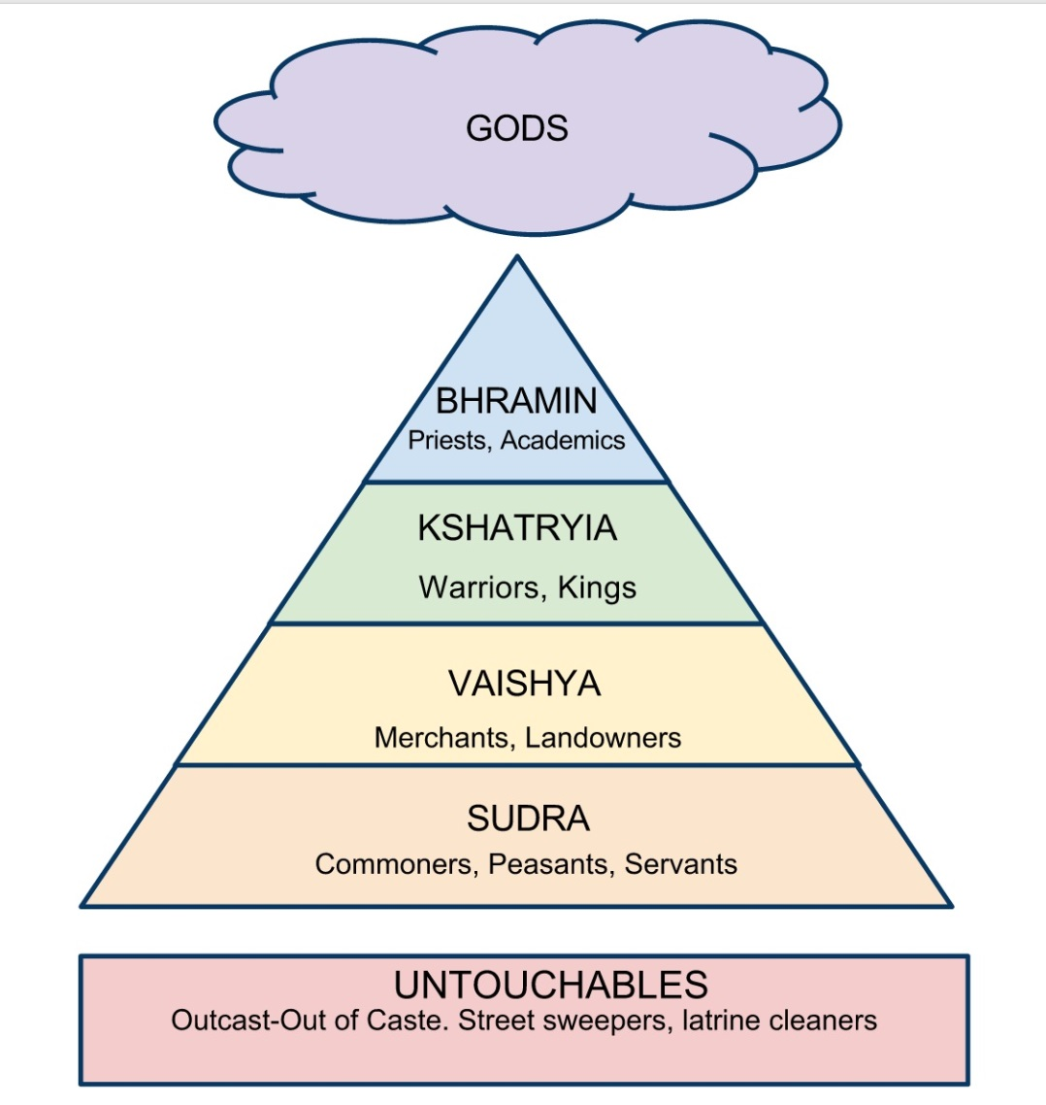
The Caste System
Varna: “Color” (class)
People are born into a varna
Jati: sub-caste/birth group
Each jati has specific duties to perform
Interact/marry ONLY within your jati/varna
Reincarnation
Karma: deeds from this life influence your reincarnate life
Can be re-born to a higher jati
“You are where you deserve to be”

Slide 5
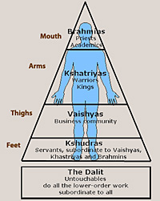
Castes
Brahmin: priests, scholars
Mouth of Purusha
Intellect and knowledge
Kshatriya: warriors, officials
Arms of Purusha
Vaishya: merchants, artisans, landowners
Thighs of Purusha
Shudra: peasants, laborers
Feet of Purusha
Untouchables: excluded from caste system
AKA “pariah” or “harijan”
Leather tanning, cremations, garbage disposal
Touching of dead bodies/animals

Slide 6
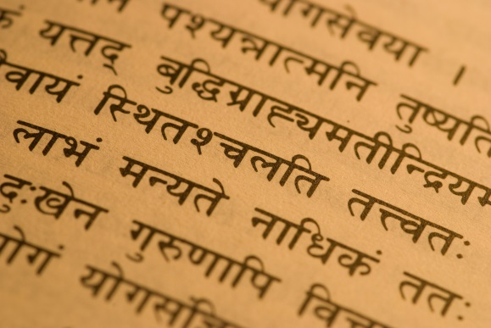
Vedic Religion/Sacred Texts
Male deities
Indra: war, thunderbolt
Varuna: sky, justice, order
Agni: fire, sacrifice
Brahmin priests = only ones who know prayers/rituals
Did not want lower classes to be able to read/write
Brahmanas: descriptions of rituals
Rig Veda: 1000 hymns to various deities
Bhagavad-Gita: The most sacred of Indian texts
Dialogue between Krishna (god) and Arjuna (warrior)
Krishna allows Arjuna to see with a “divine eye”
Sanskrit: Aryan upper class language

Slide 7
Opposition to Vedic Religion
700 BCE
Reactions against power of the Brahmin
Retreat to wilderness
Individuals attracted “cult” followings
Abandonment of towns and the caste system
Question the exclusivity of the priestly class
Gave alternate paths to salvation
Yoga: pursuit of insight to nature through physical and metal discipline
Special diets
Meditation
Moksha: liberation through distancing oneself from worldly desires
Upanishads
100+ dialogues between teachers and students
Questioning of the Vedic religion

Slide 8
Jainism
Mahavira (540-468 BCE)
AKA Jina (the Conqueror)
Holiness of all life
Extreme non-violence
Masks to prevent inhaling insects
Asceticism
“Severe self-discipline and avoidance of all forms of indulgence, typically for religious reasons”
Nudity (clothing comes from killing something)
Eventual starvation

Slide 9
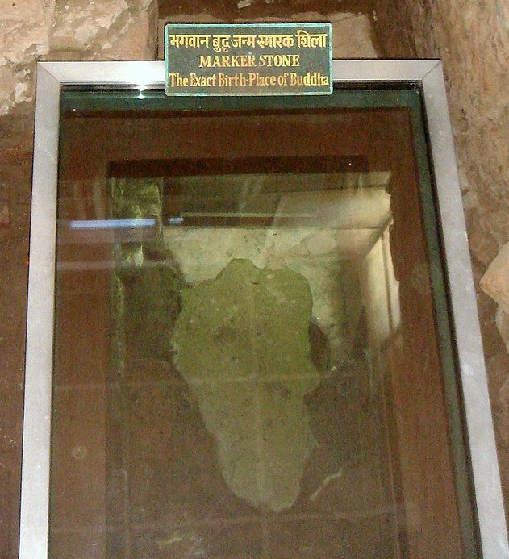
Siddhartha Gautama (563-483 BCE)
Kshatriya family in the Himalayan mountains
Abandoned family for life of asceticism
6 years of meditation
Determined that asceticism did nothing for a life of spiritual insight
Adopted “Middle Path” of moderation
Gained insight while sitting under a tree on the Ganges River
The Buddha (Enlightened One)
Four Noble Truths
Eightfold Path

Slide 10
The Four Noble Truths
Life is suffering
Suffering arises from desire
The solution to suffering lies in the curbing of those desires
Desire can be curbed by following the Eightfold Path
Aka “dharma” (law)

Slide 11
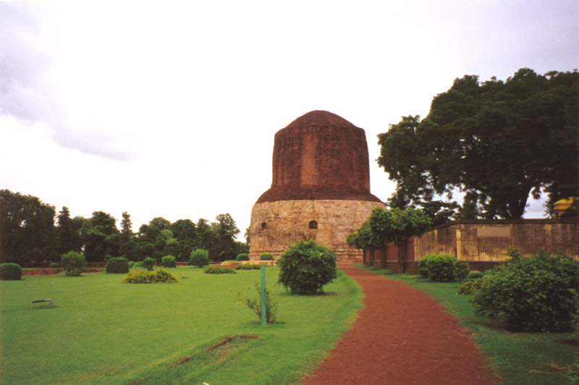
Site of the First Sermon where Buddha preached on the
Four Noble Truths

Slide 12
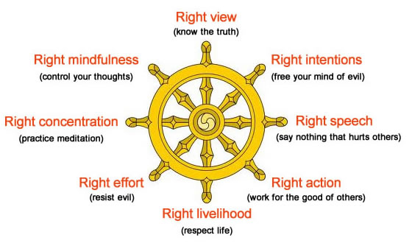
The Eightfold Path

Slide 13
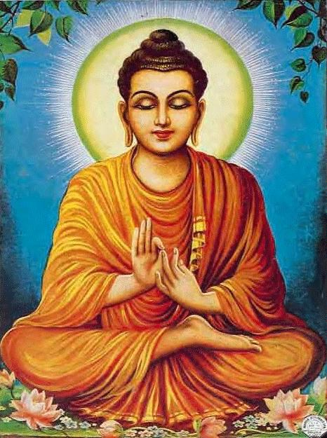
Buddhism
Emphasis on the individual
People are composite beings with out a “soul” that exists in the afterlife
Denial of the usefulness of gods
Live in moderation
Minimize desires in order to end suffering
Search for spiritual truth through meditation and self discipline
Nirvana: ultimate reward (“snuffing out the flame”)
Release from reincarnation cycles
Achievement of tranquility

Slide 14
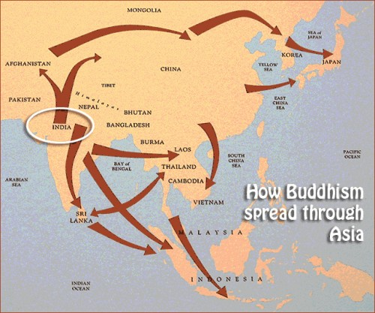
Spread of Buddhism
Buddha’s death
No instructions for followers— “Be your own lamp”
India, Central Asia, Southeast Asia, East Asia
Monasteries established
Hierarchies of monks and nuns
Stupas
Buddhist temples erected
Symbolized the universe
Remains of Buddha

Slide 15
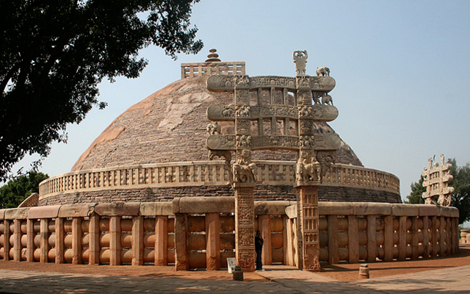
The Great Stupa
The Great Stupa
Built at the birthplace of Ashoka’s wife (India)

Slide 16
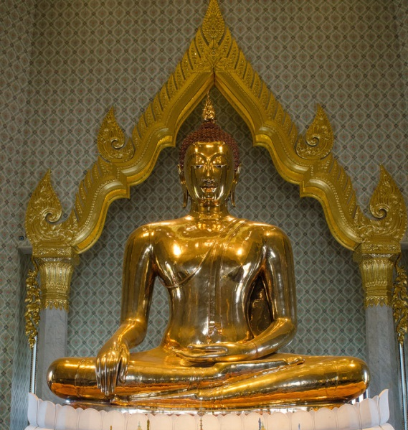
Transformation of Buddhism
Buddha began to be worshipped as a god
Bodhisattvas
Men/women who achieve nirvana but choose to be reincarnated in human bodies in order to help others
Art
Early art portrayed symbols rather than the Buddha himself
2nd century CE: statues of Buddha appear
Syncretism of Buddhist and Greek styles
Mahayana Buddhism (Great Vehicle)
Embraced “modern” aspects of the religion
Theraveda Buddhism (Teachings of the Elders)
Closest to original teachings

Slide 17
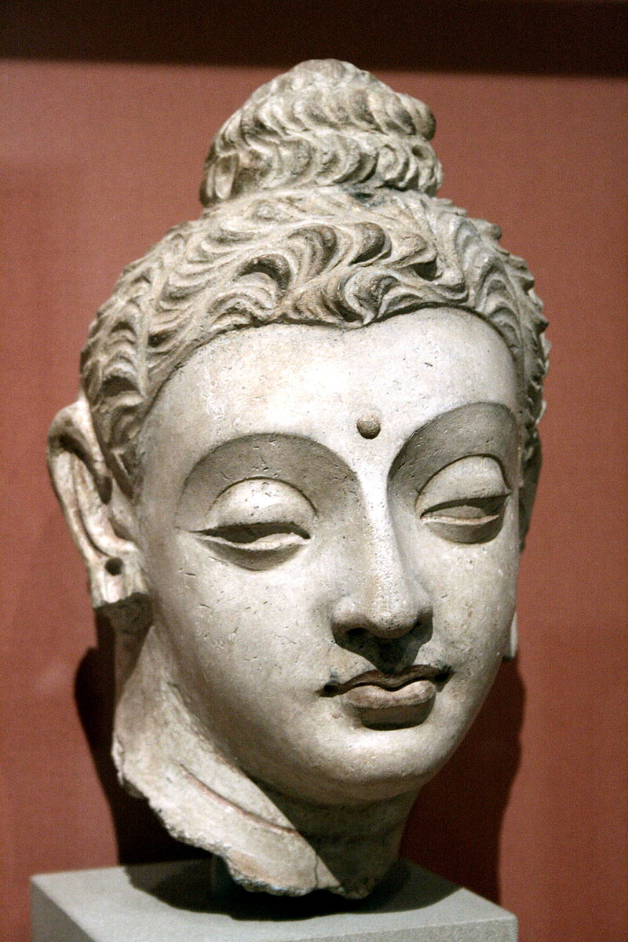
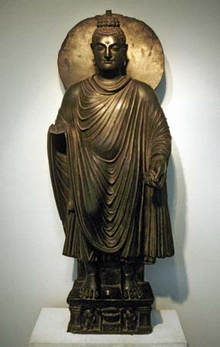
Gandharan Art

Slide 18
Hinduism
Result of Vedic religion adjusting to Jainism and Buddhism
Vedic transformed by 4th century CE
Includes aspects of Buddhism, fertility rituals, other religions
Emphasis of individual devotion to a single god
330 million gods (?)
All gods are manifestations of a single divine force
Vishnu: the preserver
Appears as avataras (incarnations)
Rama (hero)
Krishna (cow herd god)
Buddha (rival religion)
Shiva: creation and destruction
Devi: fertility

Slide 19
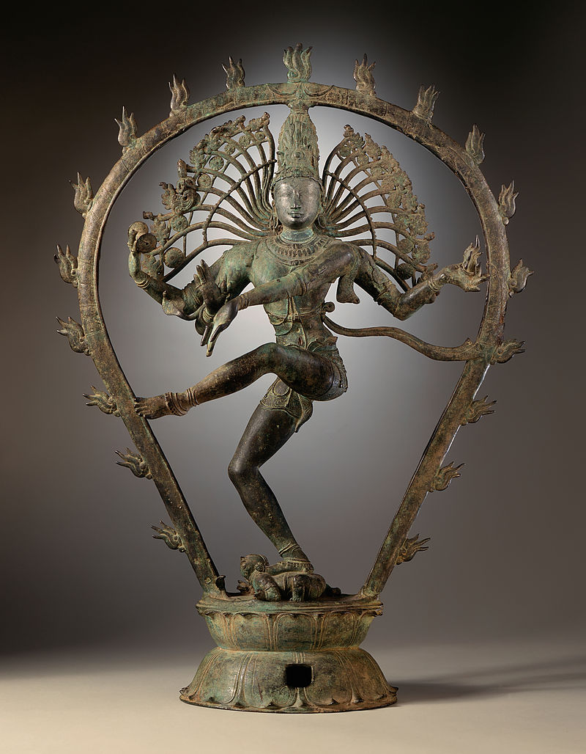
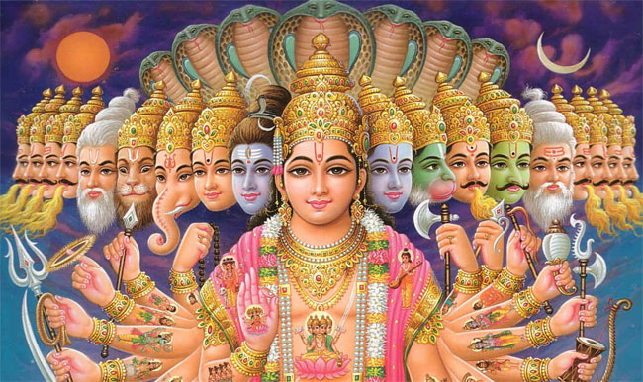

Slide 20
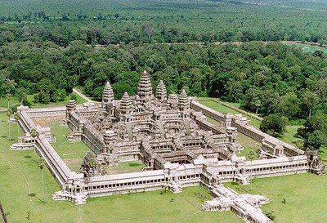
Hindu Worship
Gave the people a personal deity with whom they could make divine and direct connections
Direct opposition to Theraveda Buddhism
Temples
“plain” and elaborate
Statues
Embodied by gods
Puja: service to deity
Bathing, clothing, feeding statues
Pilgrimages
Temples, shrines, sacred locations
Ganges River

Slide 21
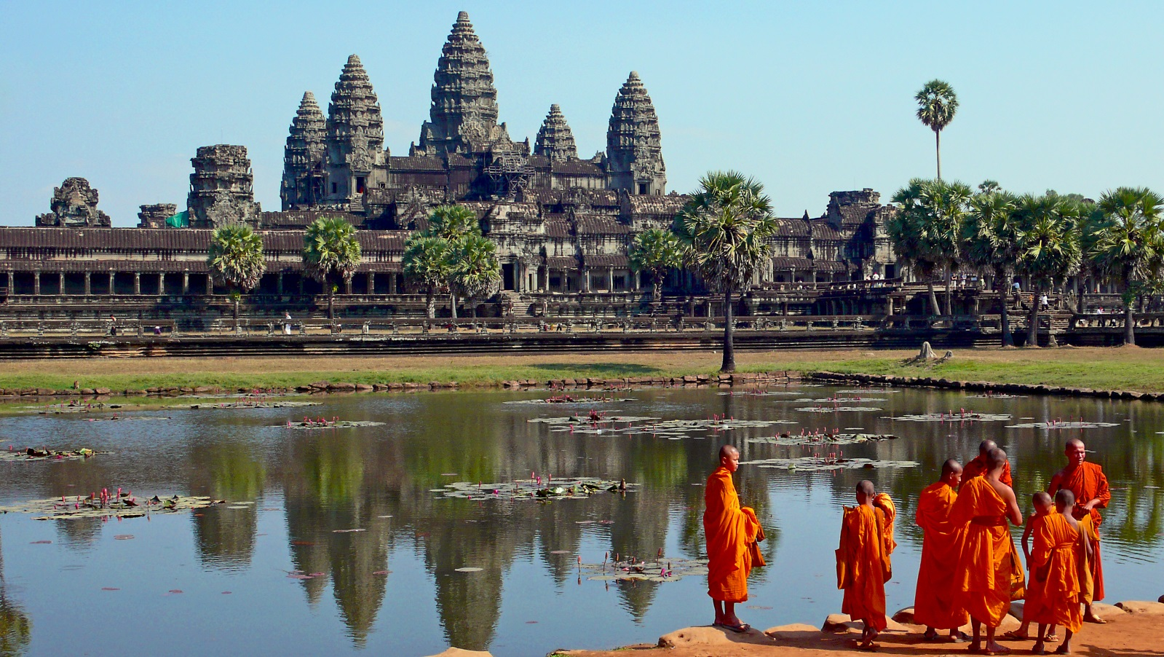
Angkor Wat
Built as a temple to honor Vishnu in 12th century
Eventually transformed to Buddhist temple
Largest religious temple in the world

Slide 22
Mauryan Empire (324 BCE – 184 BCE)
India’s first centralized empire
Chandragupta Maurya
4th Century BCE
Control of Magadha
Kautilya
Brahmin advisor to Chandragupta
Arthashastra (treatise on government)
“My enemy’s enemy is my friend”
Tax collection
Spy “agency”
Economy
¼ harvest value tax to gov’t
Mining, liquor, weapon monopolies
Irrigation fees
Standard coinage
Armed Forces
Infantry, cavalry, chariot
War elephants
Pataliputra: capital
Height during/after Ashoka (see next slide)
Fall of Empire
$$$$$ of army/bureaucracy
External threats

Slide 23
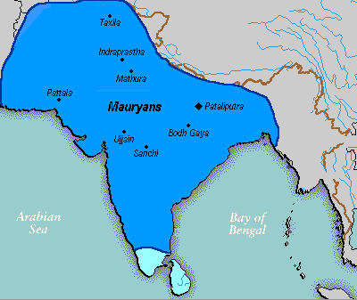

Slide 24
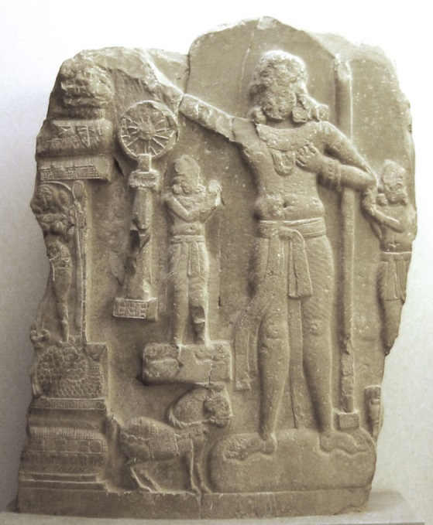
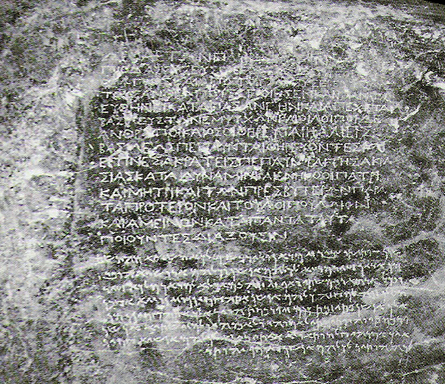
Ashoka
Chandrapgupta’s grandson
Conquest of Kalinga
Hundreds of thousands killed
Brutality caused Ashoka to convert to Buddhism
Nonviolence, morality, moderation , religious toleration
Pillars of Ashoka
40-50 ft tall / 50 tons
Earliest, decipherable Indian writing
Edicts of Ashoka for all to see
Emphasized morality, nonviolence
Reminded people of his ability to
punish those who did wrong

Slide 25
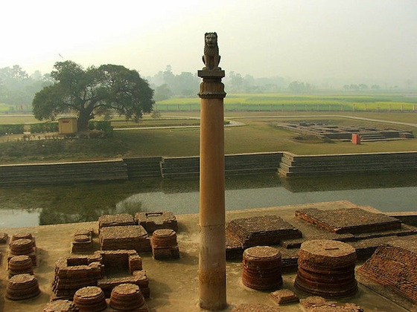

Slide 26
Political Fragmentation
500 years of foreign rule after fall of Mauryan Empire
Greco-Bactrian forces (Alexander the Great)
Central Asian groups
Kushans
Flourishing of economy and culture
India becomes center for international trade
Merchants and artisans become political powers
Ramayana and Mahabharata
Indian epics
Science and Technology
Herbal remedies
Standardization of Sanskrit into administrative language

Slide 27
Gupta Empire (320-550 CE)
Founded by Chandra Gupta
Named after Chandragupta Maurya
Smaller in territory size than Mauryan
Not as centralized as Mauryan
“Theater state”
Full of rituals and ceremonies
Invention of zero
Arabic numerals
Decline in women’s rights
Loss of right to own/inherit property
Barred from (some) religious ceremonies
Treated like the Shudra
Obey father, husband, sons
Sati: widow cremation
Escape to monasteries
Higher social status = more freedom

Slide 28
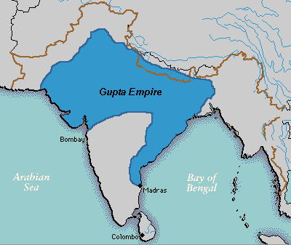

Slide 29
Religion and Fall of the Empire
Gupta monarchs were Hindu
Reestablishment of caste system
Brahmins receive land
Taxes go to priests
Practiced religious tolerance
Traditional temple style emerges
Raised platform and towers
Trade declines due to failing of Roman Empire
Begin trading with Malay Peninsula and Indonesia
Silk Roads still dangerous
Fall of Empire
5th century CE: Invasion of Huns
Exhaustion of treasury

Slide 30
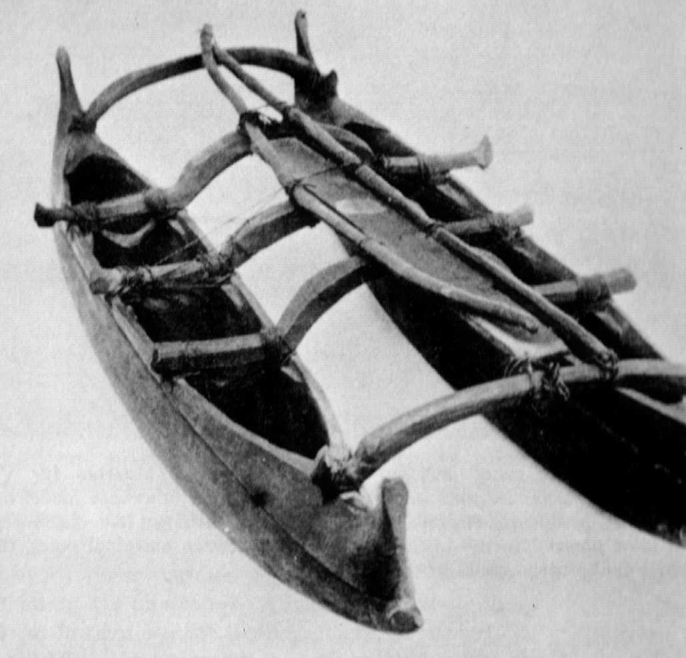
Southeast Asia
3 zones
Indochina
Malay Peninsula
Pacific Islands
Modern Day: Myanmar (Burma), Thailand, Laos, Cambodia, Vietnam, Malaysia, Singapore, Indonesia, Brunei, Philippines
Malay peoples
Migrated from southern China (3000 BCE)
Great navigators
Eventually settle islands across the Pacific and Indian Oceans

Slide 31
Cultural Transfusion
SE Asia is located along trade routes
Chinese silk
SE Asian goods: spices (cinnamon, pepper, cloves, nutmeg), wood, religion
Spread of Hinduism/Buddhism
Merchants and sailors
Sanskrit and governmental structures in Malaysia
Maharaja (great king)
Sea Trade
6th century CE
India, Sri Lanka, Strait of Malacca

