Slide 1
Rome

Slide 2
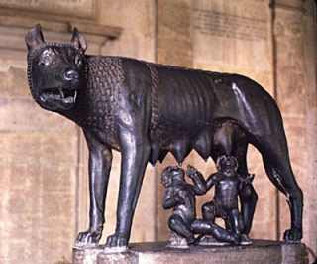
Early Rome
Founded in 753 BCE
Agricultural society
Land = power
Social status depended on owning land
Senate (Council of Elders)
Wealthy land-owners that “made the rules”
Monarchy (753 BCE – 507 BCE)
7 kings
1st = Romulus (founder)
Last = Tarquinius Superbus (tyrant)
Overthrown by Brutus the Liberator and the Senate

Slide 3
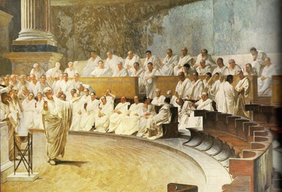
Roman Republic (507 BCE - 31 BCE)
NOT a modern democracy
The Assembly
Males only
Wealthy males had more voting power than poor males
Consuls
Elected for only one year
Presided over meetings
Military leader
The Senate
REAL power of Rome
Served for life

Slide 4
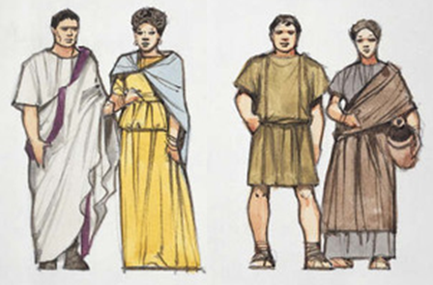
Conflict of the Orders
Order = social class
Patricians
elite, wealthy class
Plebeians
poorer class, majority of population
Plebeians refused to work, fight, etc in order to get more rights from the patricians

Slide 5
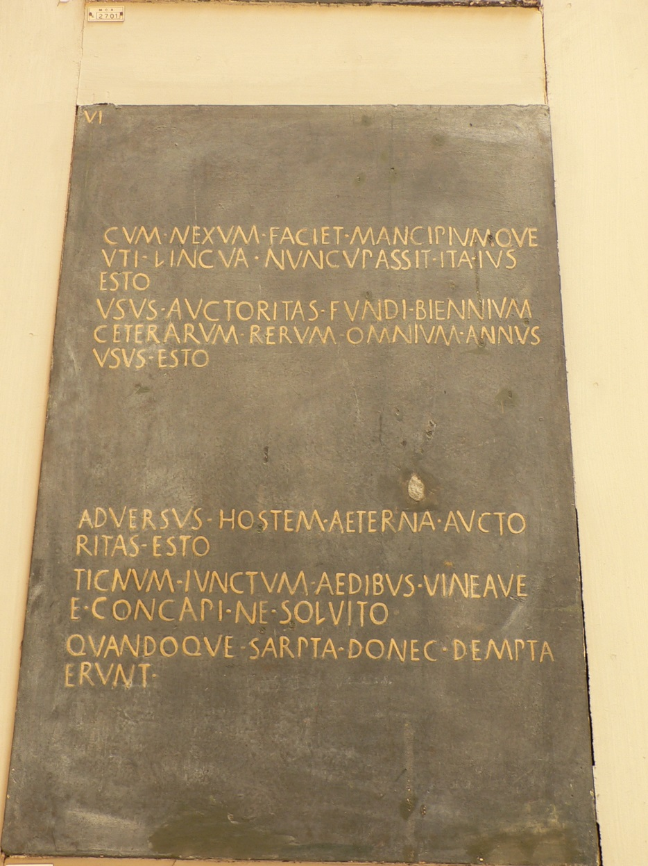
The Conflict of the Orders
Twelve Tables
450 BCE
Laws published on 12 stone tablets
Tribunes
New official position created
Taken from lower classes
Could help protect the affairs of lower classes
Eventually created a new elite class

Slide 6
Roman Expansion
Roman army was key to expansion
Led by consuls seeking military victory
Similar to Greek hoplites
“Unified” (by conquering) the majority of the Italian peninsula by 290 BCE
Allowed conquered peoples full privileges of citizenship
Allowed an “inexhaustible” pool of soldiers
264 BCE – 202 BCE: Wars against Carthaginians
200 BCE – 146 BCE: Wars against Hellenistic kingdoms
Eventual takeover of Sicily, Sardinia, Spain
59 BCE – 51 BCE: Julius Caesar conquers Gaul (France)

Slide 7
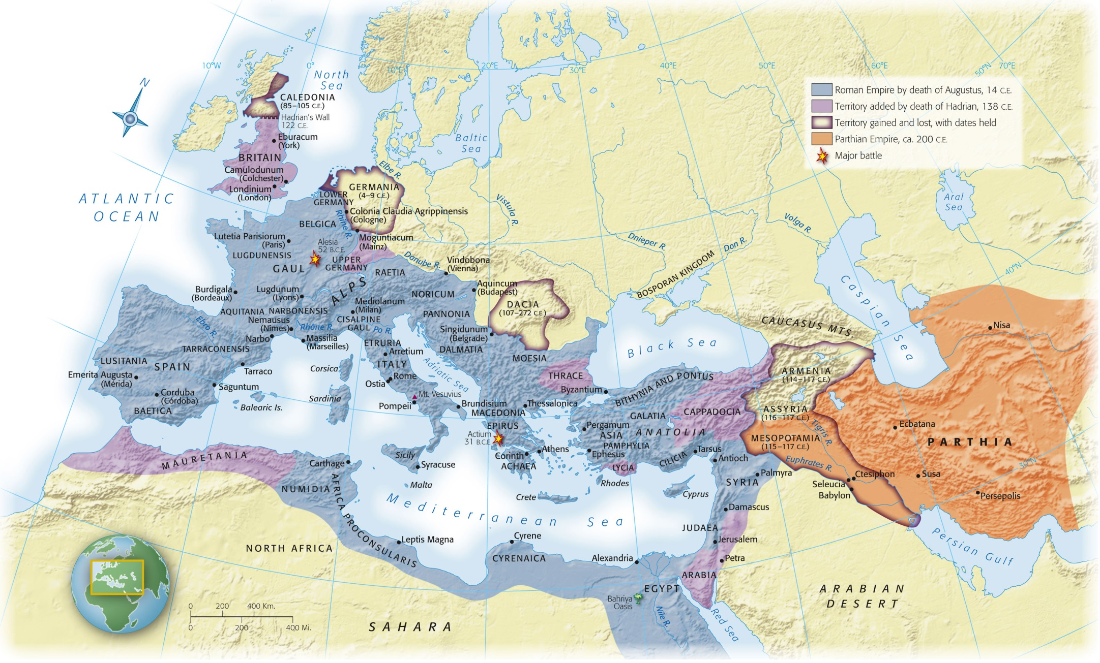
Map 6-1, p. 152
Notes:
Map 6.1: The Roman Empire.
The Roman Empire came to encompass all the lands surrounding the Mediterranean Sea, as well as parts of continental Europe. When Augustus died in 14 C.E., he left instructions to his successors not to expand beyond the limits he had set, but Claudius invaded southern Britain in the mid-first century and the soldier-emperor Trajan added Romania early in the second century. Deserts and seas provided solid natural boundaries, but the long and vulnerable river border in central and eastern Europe would eventually prove expensive to defend and vulnerable to invasion by Germanic and Central Asian peoples.

Slide 8
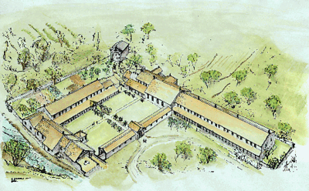
Fall of the Republic
Latifundia
Small farms taken over by wealthy estates/ranches
Cash crops rather than grains for food
Cattle, grapes for wine
Created dependence on foreign grain
Poor peasants couldn’t find work due to cheap POW labor
Movement into cities/urban areas
Lived in poverty
Decline in land owning men = decline in available soldiers

Slide 9
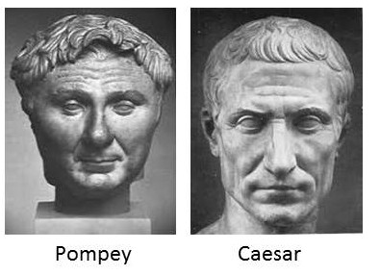
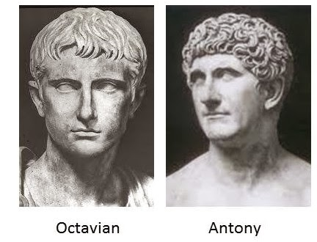
Ambition
Gaius Marius
NOT from the traditional ruling class
Allowed men in army without owning land
Promised land upon retirement
Elected consul 6x (ILLEGAL!!!!)
Armies became more loyal to their generals than to Rome
Julius Caesar, Mark Antony, Octavian
Generals used armies to further their personal power

Slide 10
The Principate/Roman Empire (31 BCE – 330 CE)
Established by Octavian (aka Augustus)
Kept the structure of the Republic
Ruled under the title of dictator
Those that ruled after him took the title “emperor”
Dead emperors viewed as gods
Law
Laws were studied and codified
Importance of individual rights

Slide 11
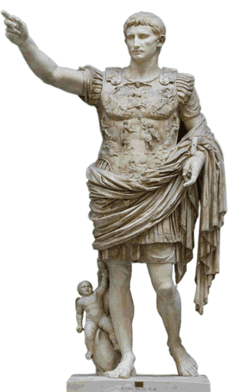
Pax Romana
“Roman Peace”
Height of empire
27 BCE – 180 CE
Begun with Augustus
200 years of peace and prosperity
Limited threat of invasion
Supported trade
Guaranteed safety along roads
Romanization

Slide 12
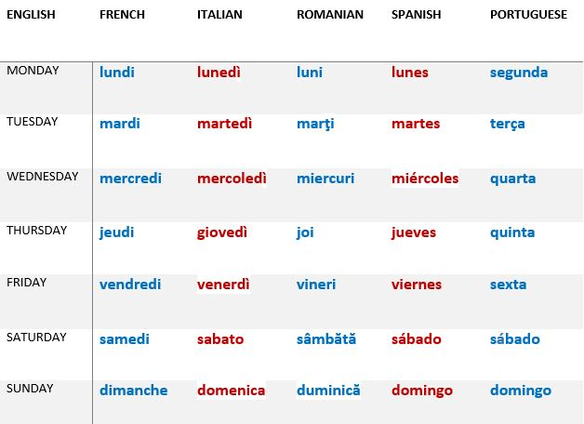
Romanization
The spread of Latin and the Roman way of life
Spanish, French, Italian, Romanian, Portuguese come from Latin
“Romance languages” comes from “Roman” not referring to love ☺
NOT forced in most places
Social and political advantages for conquered lands “converting” to Roman culture
Similar to the advantage of learning English today

Slide 13
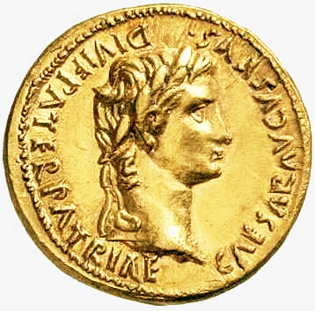
Economics
Agricultural based economy
Latifundia
Grain imported
Some long distance trade
Luxury goods
China-silk
India-spices
Africa-animals
Interior provinces (such as Gaul) supplied wealth to the central government
Taxes

Slide 14
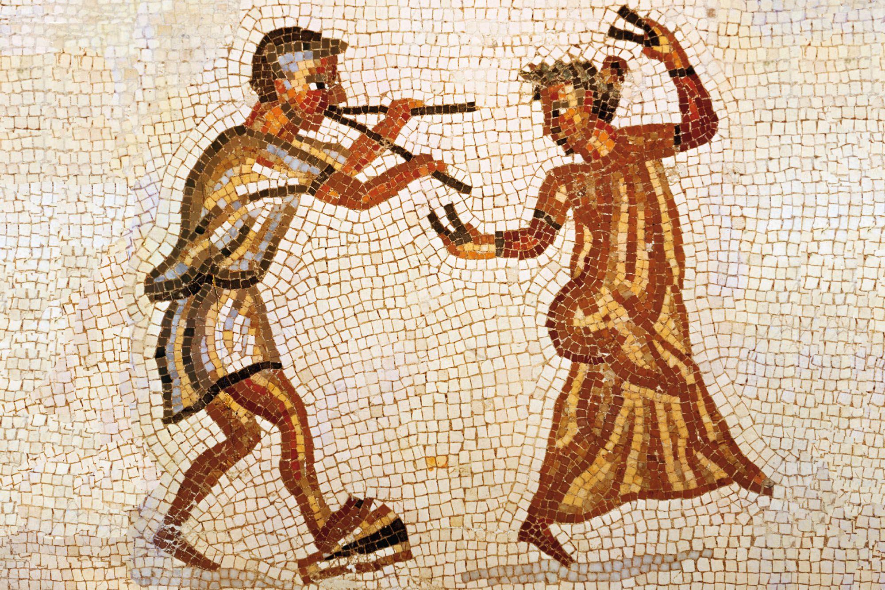
Notes:
Dancing Girl Wearing Silk Garment, Second–Third Century C.E.
This Roman mosaic depicts a musician accompanying a dancer who is wearing a sheer garment of silk imported from China.

Slide 15
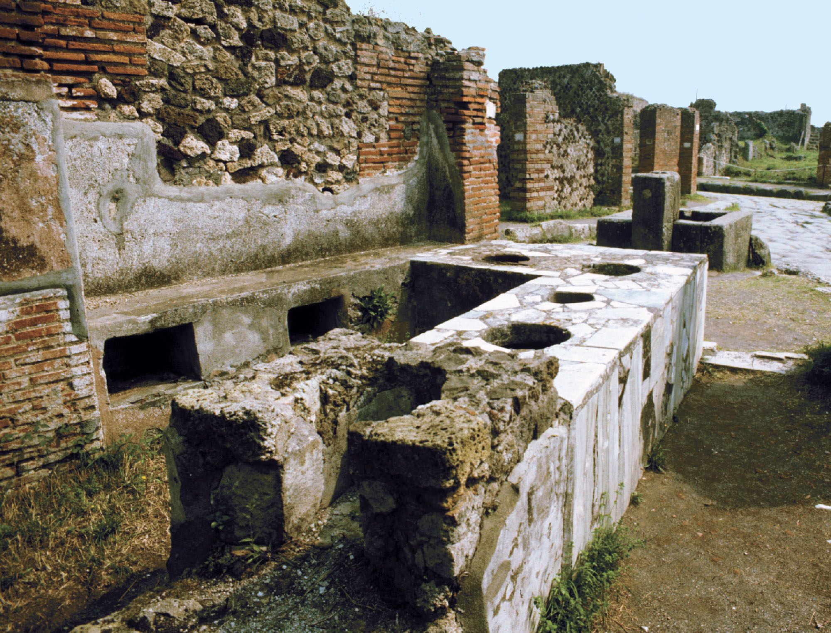
p. 158
Notes:
Roman Shop Selling Food and Drink.
The bustling town of Pompeii on the Bay of Naples was buried in ash by the eruption of Mt. Vesuvius in 79 C.E. Archaeologists have unearthed the streets, stores, and houses of this typical Roman town. Shops such as this sold hot food and drink served from clay vessels set into the counter. Shelves and niches behind the counter contained other items. In the background can be seen a well-paved street and a public fountain where the inhabitants could fetch water.

Slide 16
Society
Paterfamilias
Patriarchy
Several generations
Slaves
Patron/Client Relationship
Patrons (wealthy members of society) provided protection, loans, legal advice to those in the lower classes (clients)
Clients were obligated to follow patron into battle, work land
Women
Rights of a child
Under authority of males
Cannot own land
“Urban” empire
Administration centered in towns
Majority of population still living in rural/agricultural areas
Large city problems
Strained food/water supply
Sewage problems
Elite live lavishly
Poor live in slums

Slide 17
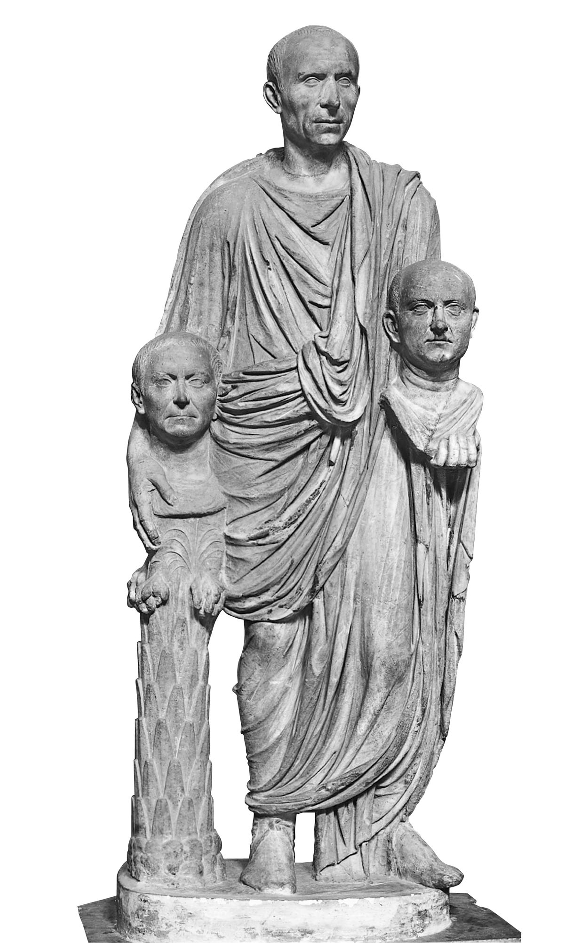
p. 153
Notes:
Statue of a Roman Carrying Busts of His Ancestors, First Century B.C.E.
Roman society was extremely conscious of status, and the status of an elite Roman family was determined in large part by the public achievements of ancestors and living members. A visitor to a Roman home found portraits of distinguished ancestors in the entry hall, along with labels listing the offices they held. Portrait heads were carried in funeral processions.

Slide 18
Religion
Numina: invisible forces that controlled the world (usually connected to nature)
Many gods stolen from Greek religion and renamed
Pax deorum: Peace of the gods
Agreement between the gods and the people
Sacrifices to honor/win favor of the gods
Gods reciprocate by favoring the Republic

Slide 19
Christianity
6 CE: Judaea (Jewish homeland/modern Israel) comes under Roman rule
Jews waited for the Messiah to drive out the oppressive Romans
Jesus
Offended Jewish officials
Accused of blasphemy by claiming to be the Messiah
Pontius Pilate (Roman governor) sentenced him to death by crucifixion
Paul
Jew from Tarsus (SE Anatolia)
Spoke Greek and Aramaic
Allowed him to travel easily between Greek, Roman, and Jewish traditions

Slide 20
Christianity
Monotheistic
Caused dissention between Romans and believers
Christians refused to worship the emperor
Seen as not being loyal to the emperor/empire
First converts
“Disenfranchised groups” (women, children, poor)
These groups found acceptance in the new religion

Slide 21
Technology
The Roman Road
Allowed merchants to safely travel and sell products
Allowed Christianity to spread across the empire
Aqueducts
Use of gravity to move water to cities
Usually elevated above ground over long distances
Used arches
Arches
Allowed for the distribution of enormous weight without thick supports
Concrete
Allowed the creation of domes and vaulted ceilings
Distinguished Roman architecture from the angular Greek architecture

Slide 22
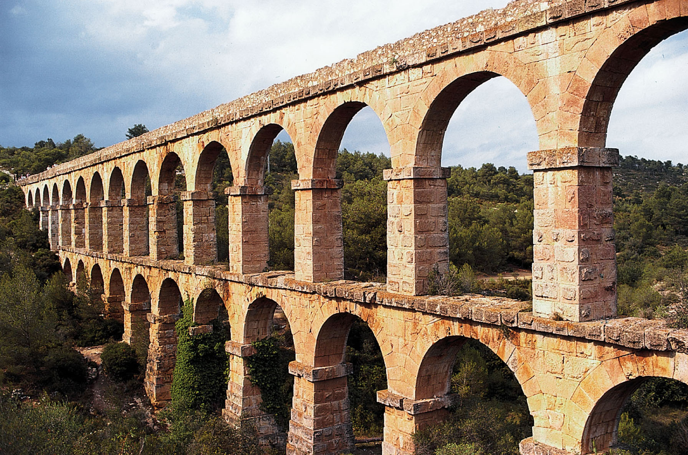
p. 161
Notes:
Roman Aqueduct Near Tarragona, Spain.
The growth of towns and cities challenged Roman officials to provide an adequate supply of water. Aqueducts channeled water from a source, sometimes many miles away, to an urban complex, using only the force of gravity. To bring an aqueduct from high ground into the city, Roman engineers designed long, continuous rows of arches that maintained a steady downhill slope. Scholars sometimes can roughly estimate the population of an ancient city by calculating the amount of water that was available to it.

Slide 23
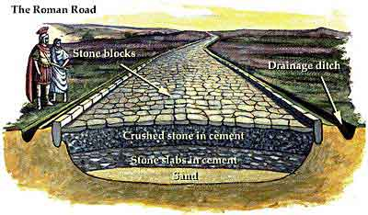

Slide 24
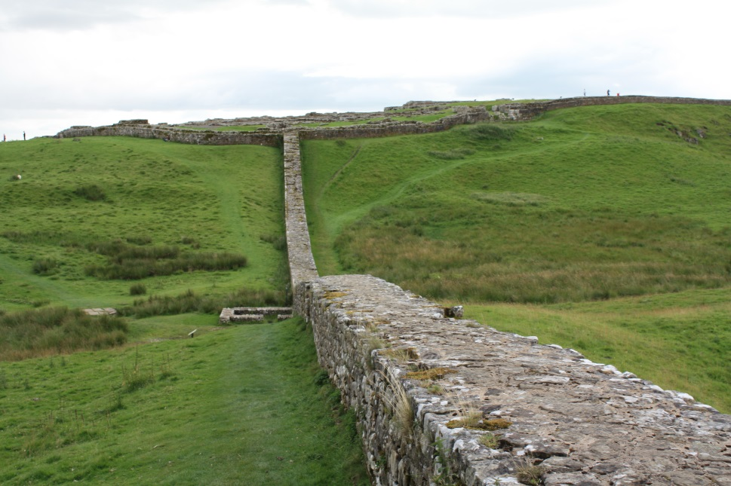
Defending the Empire
Defending the vast empire became very challenging and expensive
Army became defensive rather than offensive
Many borders protected by rivers, mountains, etc
Walls, forts built in areas without natural barriers
MOST surrounding neighbors were less technologically advanced

Slide 25
Third Century Crisis (235-284 CE)
Frequent change in rulers and administration
Reign for only a few months/years until overthrow or death
Outside threats
Germanic tribes began to raid towns deep into the empire
Cities began building their own walls for protection
Some regions broke away from the empire

Slide 26
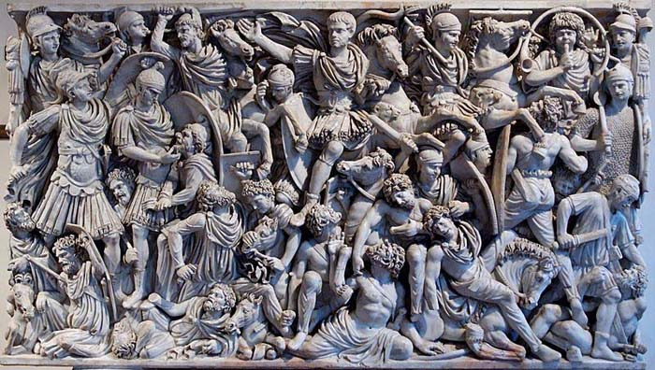
Third Century Crisis (235-284 CE)
Constant protection = draining of the treasury
Interruption in trade = no $ coming in
Emperors hoarded $
Value of coins was reduced and barter system resumed
Urban aristocracy disappeared
People moved out of the cities
Precursor to the Middle Ages

Slide 27
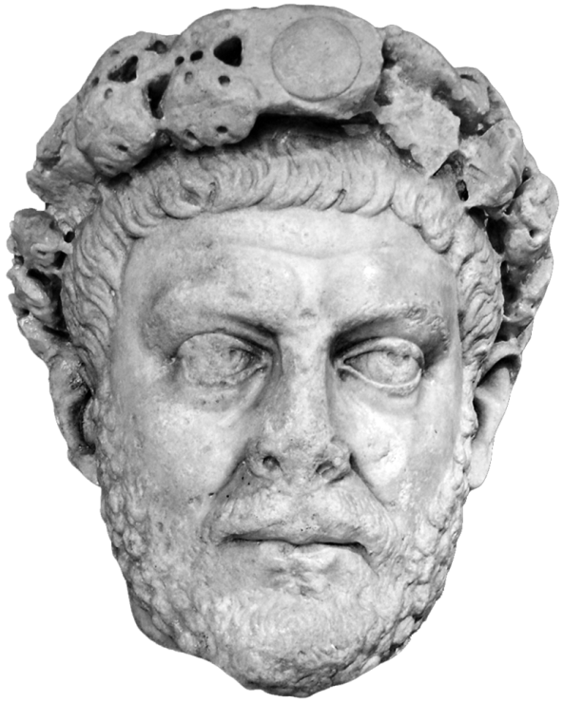
Diocletian (284-305 CE)
Eastern Europe; born a commoner
Divided the empire in half
Co-emperor was Marcus Aurelius
Diocletian ruled the west, Aurelius ruled the east
Radical reforms to help the flailing empire
Halted inflation
Issued edicts to set the maximum price for goods/services
Frozen professions
Did not allow people to change important professions
Made them hereditary
Creation of a black market
Death to those discovered
Reforms created distrust of the government
Too much government control

Slide 28
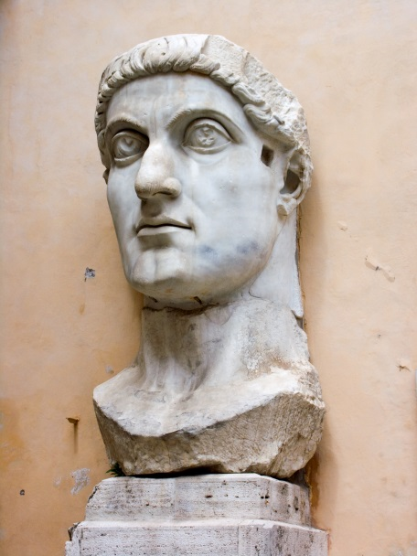
Constantine (306-337 CE)
Reunited the empire after end of Diocletian’s rule
Converted to Christianity after believing that the Christian God helped him win a battle
313: Edict of Milan
Ended persecution of Christians
Religious freedom to all
324: capital moved to Byzantium
Renamed Constantinople
Closer to invasion prone areas of the empire
Eastern half of empire in better shape than the western half
More Christians in eastern half

Slide 29
The Fall of Rome (476 CE)
The move of the capital to Byzantium/Constantinople is seen as “end” of Roman Empire
Eastern half survived for another 1000 years as the Byzantine Empire
Move = transformation of empire into a new empire
Other factors
Empire too vast to control/administer easily
Rome sacked by various invaders in 410, 455, 476
Dependence on slave labor
Spread of Christianity/erosion of traditional Roman values/religion

