Slide 1
China
Qin and Han Dynasties

Slide 2
Qin Dynasty
221-206 BCE

Slide 3
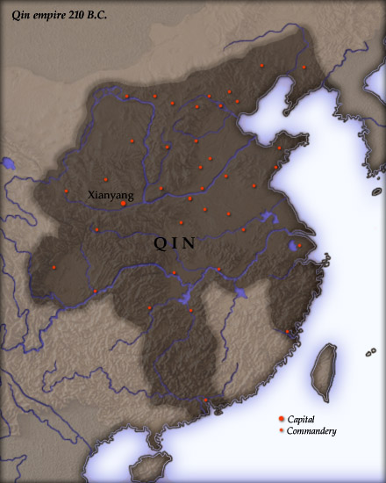
Unification of China
Qin = superior warring state from Warring States Period (see Ch 3)
Qin conquered various neighbors and rivals
By 221 BCE, all of northern/central China unified under Qin
Creation of the first Chinese Empire

Slide 4
Qin Shi Huangdi
Ascended the throne in 246 BCE at age of 13 under the name Zheng
Shi Huangdi means “First Emperor”
Claimed his dynasty would last for 1000 years
Central administration of the empire with Legalist principles and policies
Reform
Abolition of primogeniture
Passing of all land to eldest son
New laws requiring land to be divided among several heirs
Standardization
Weights, measures, coinage, writing, law
Help unified diverse groups

Slide 5
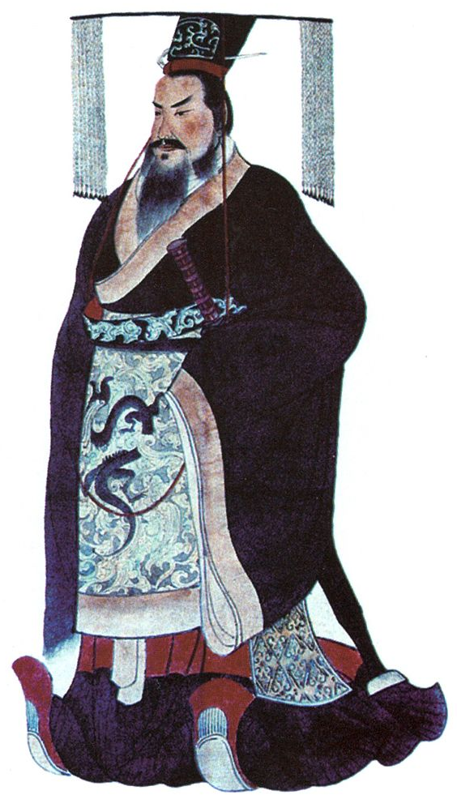

Slide 6
LI Si and Legalism
Li Si = Prime Minister
Convinced Shi Huangdi that scholars were “subverting the goals of the regime”
Felt that the Confucian morals were in direct opposition of a ruler’s absolute power
Crackdown on Confucians and Confucian traditions
Burned Confucian books
Killed Confucian scholars

Slide 7
External Threats from xiongnu
Nomads on the northern border of the empire
At times, peaceful trade between nomads and Chinese farmers
Other times, nomads raided villages
Chinese response
Began building walls to keep out invaders
Began training mounted soldiers (cavalry)
Shi Huangdi’s response
Send soldiers to drive nomads from empire
Connected/extended existing walls around empire
Precursor to Great Wall
Huangdi’s aggression caused nomads to band together and create the Xiongnu Confederacy
The Xiongnu would continue to cause problems for China for hundreds of years

Slide 8
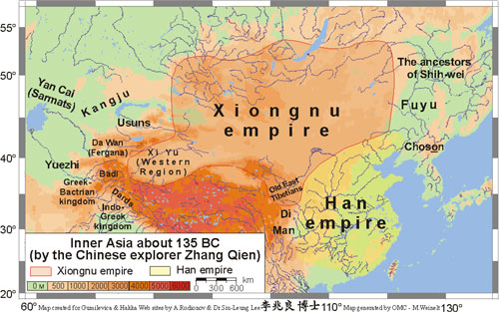

Slide 9
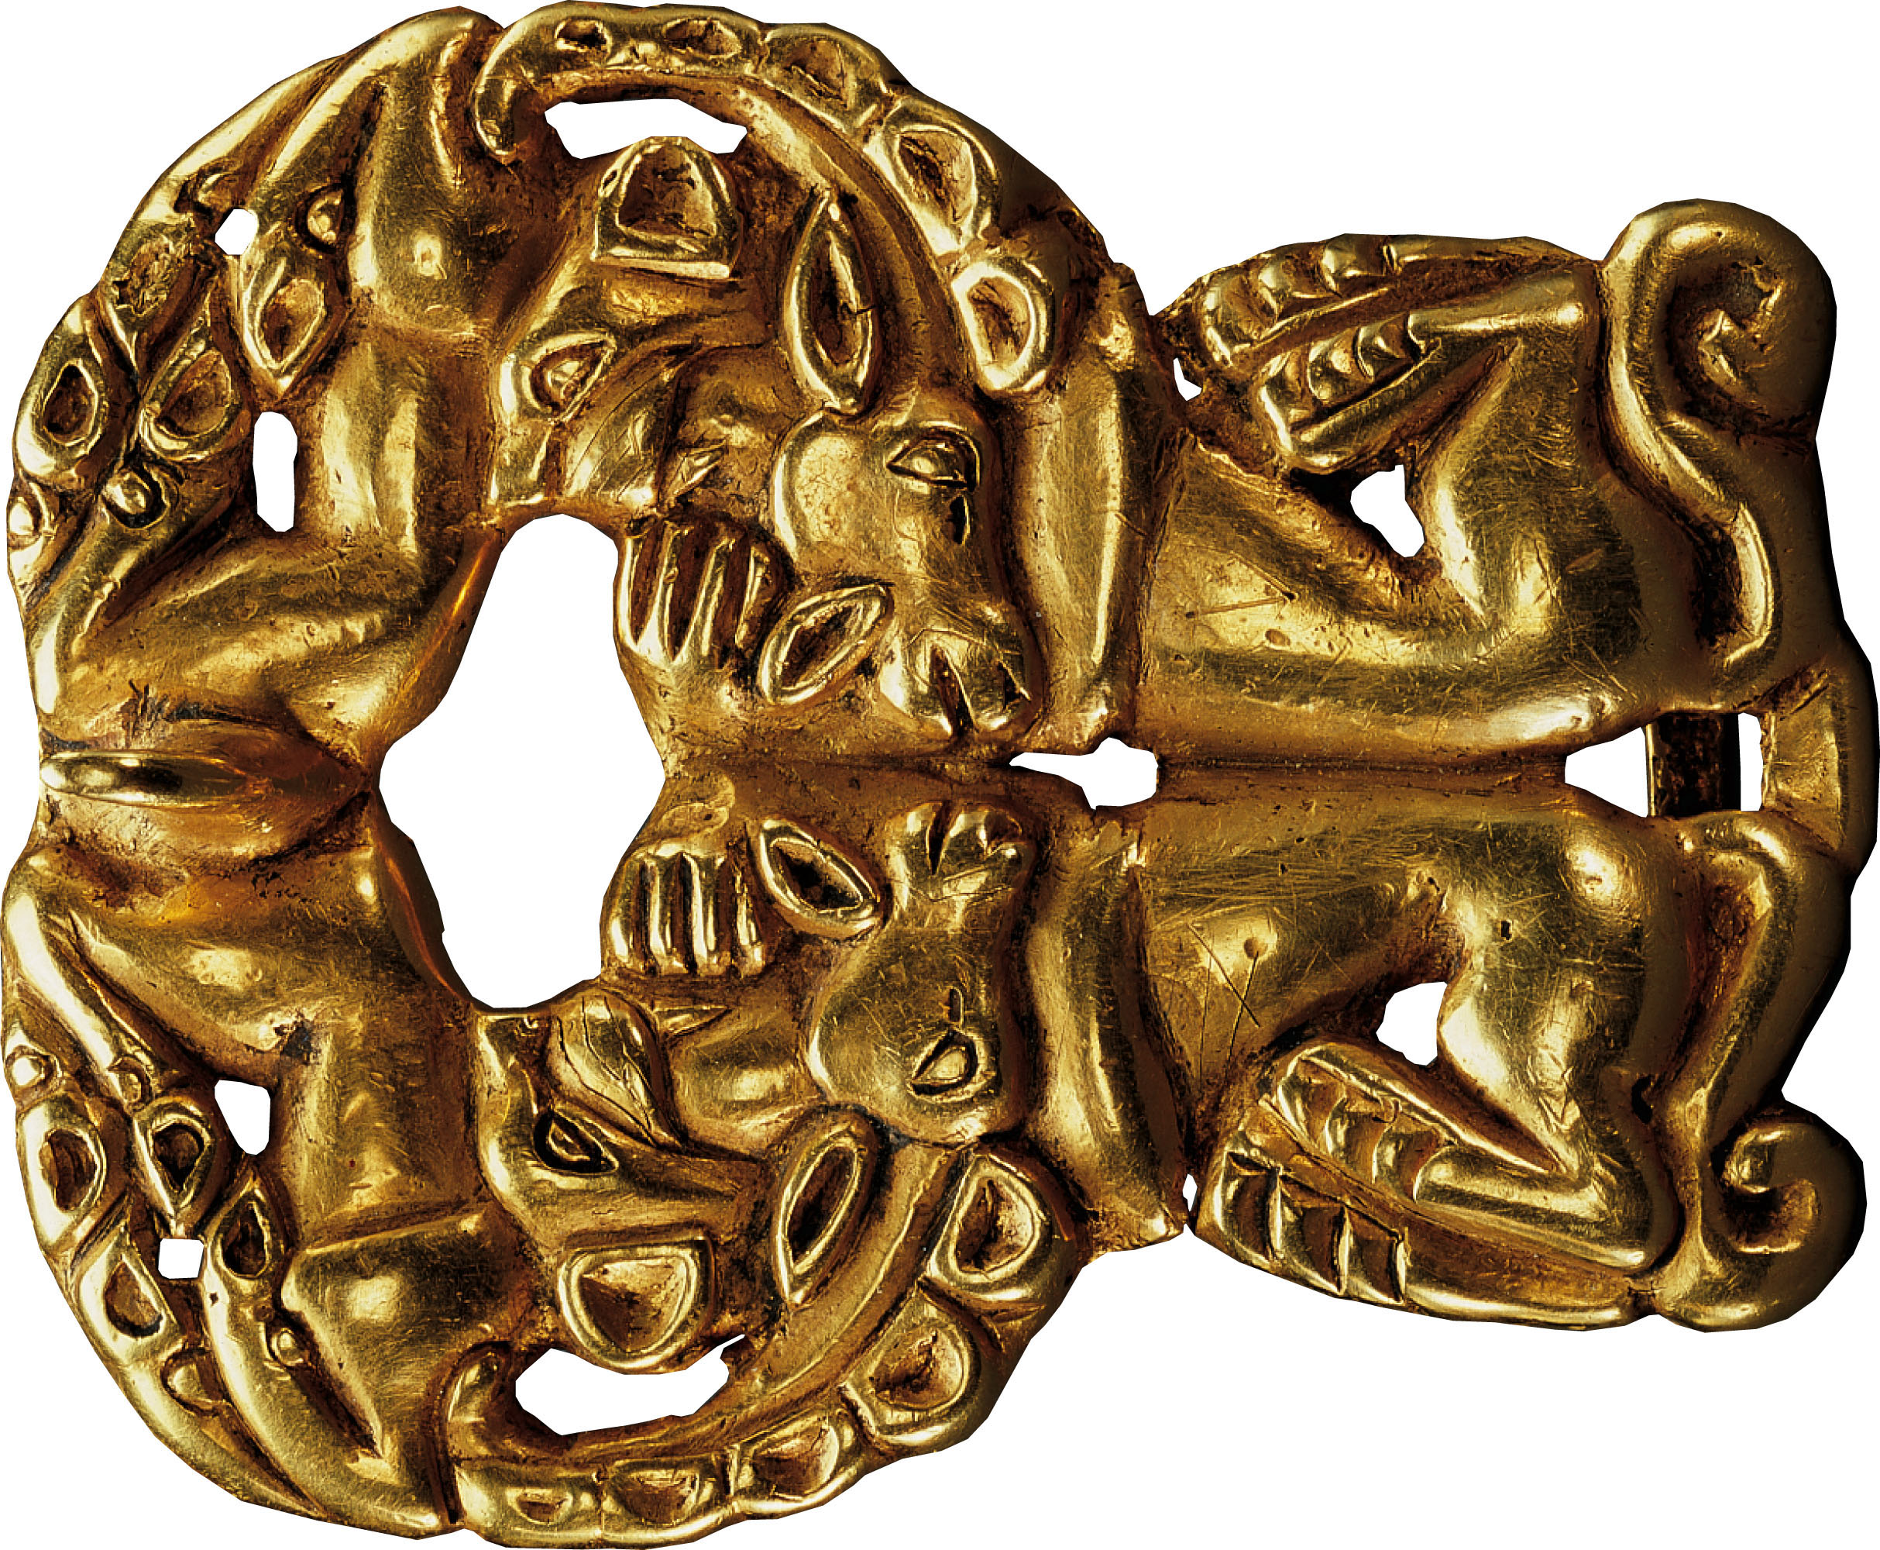
p. 168
Notes:
Gold Belt Buckle, Xiongnu, Second Century B.C.E.
The Xiongnu, herders in the lands north of China, shared the artistic conventions of nomadic peoples across the steppes of Asia and eastern Europe, such as this fluid, twisting representation of the animals on which they depended for their livelihood. Shi Huangdi’s military incursion into their pasturelands in the late third century B.C.E. catalyzed the formation of the Xiongnu Confederacy, whose horse-riding warriors challenged the Chinese for centuries.

Slide 10
Fall of the Qin
Oppressive policies
Mandatory military service
Forced labor for roads, walls, buildings
The Terra Cotta Army
Huangdi’s elaborate tomb that mimicked China’s geography
7000 life sized terra cotta soldiers to guard the afterlife
Huangdi’s successors were weak and the dynasty collapsed after only a few years

Slide 11
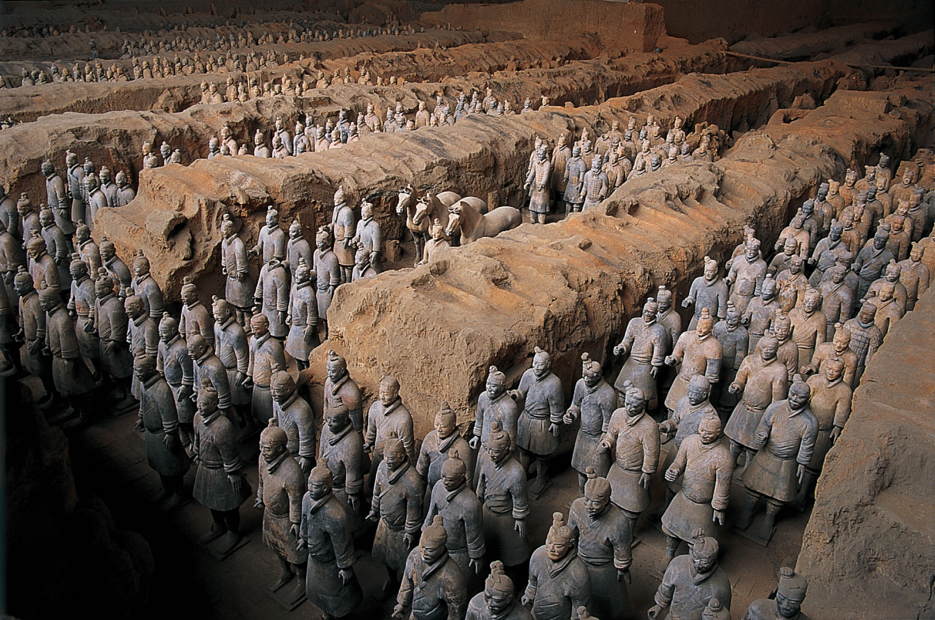
p. 167
Notes:
Terracotta Soldiers from the Tomb of Shi Huangdi, “First Emperor” of China, Late Third Century B.C.E.
Near the monumental tomb that he built for himself, the First Emperor filled a huge underground chamber with more than seven thousand life-sized baked-clay statues of soldiers. The terracotta army was unearthed in the 1970s.

Slide 12
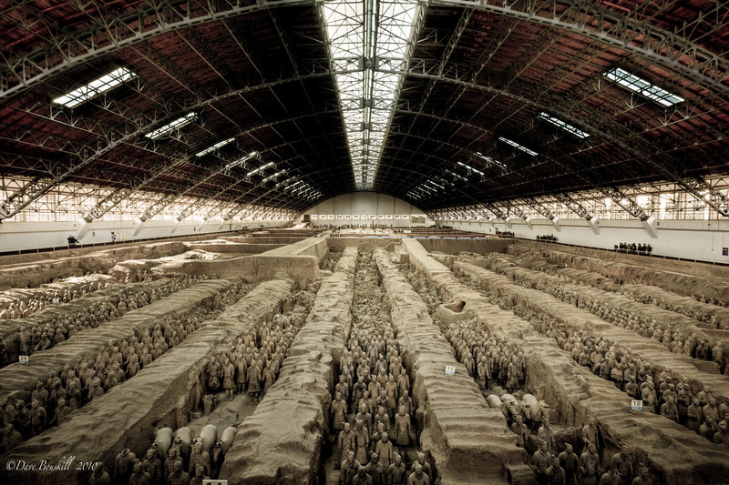

Slide 13
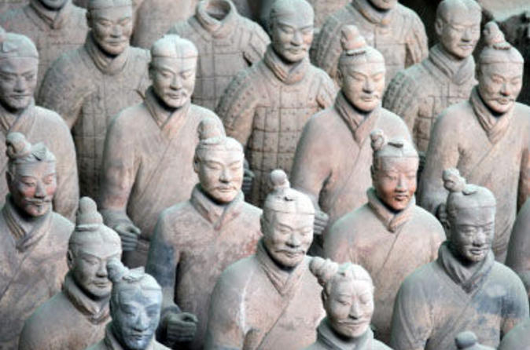

Slide 14
The Han Dynasty
202 BCE – 220 CE

Slide 15
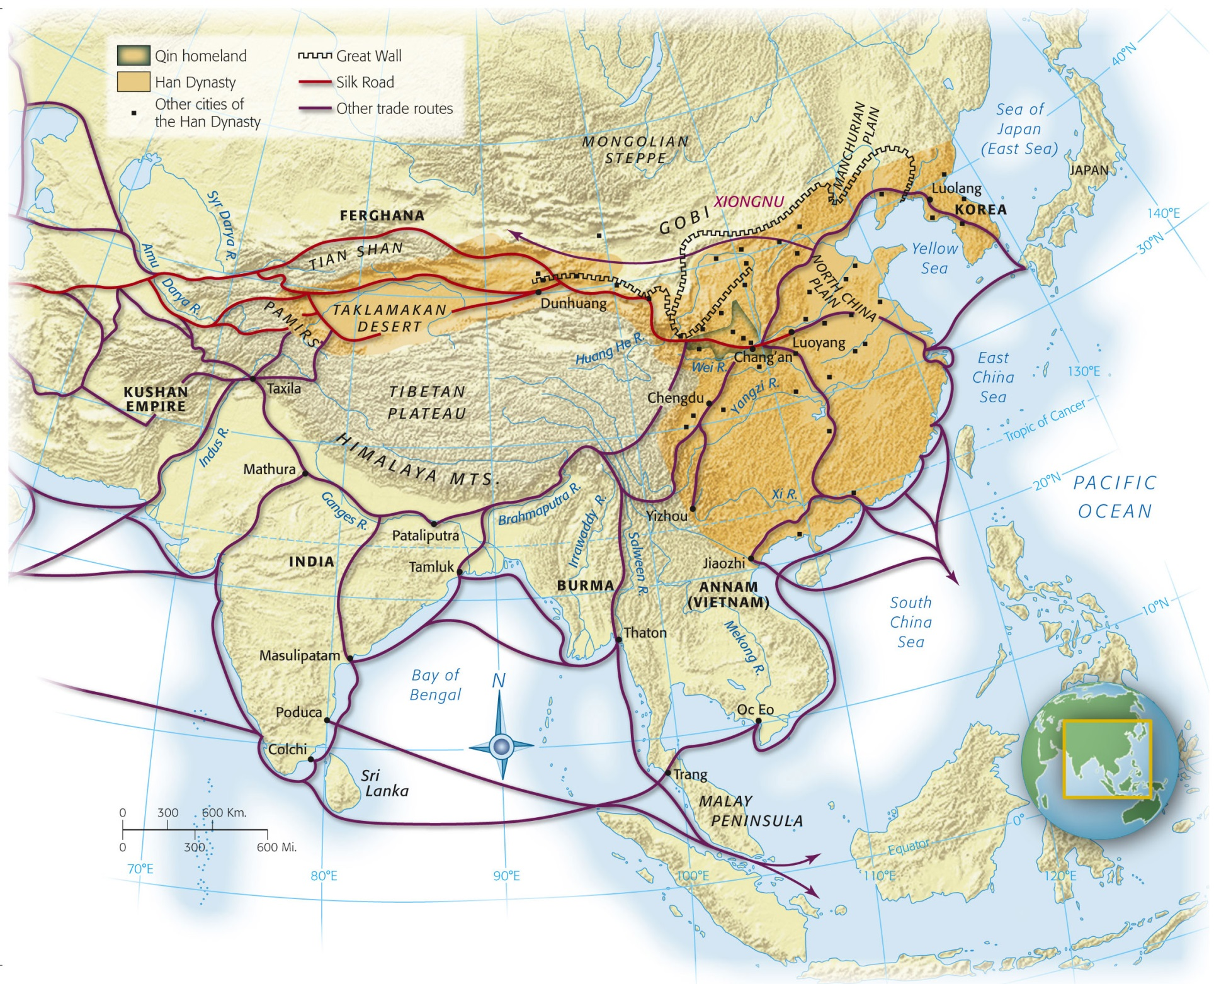
Notes:
Map 6.2: Han China.
The Qin and Han rulers of northeast China extended their control over all of eastern China and extensive territories to the west. A series of walls in the north and northwest, built to check the incursions of nomadic peoples from the steppes, were joined together to form the ancestor of the present-day Great Wall of China. An extensive network of roads connecting towns, cities, and frontier forts promoted rapid communication and facilitated trade. The Silk Road carried China’s most treasured products to Central, South, and West Asia and the Mediterranean lands.

Slide 16
Early Emperors
Gaozu
Wu
First emperor of the Han Dynasty
Denounced extreme Qin policies, but retained Legalist institutions
Adopted an appeasement policy when dealing with Xiongnu
“gifts” (aka bribes) to buy safety
Substantially increased the power of the emperor
Increased size of empire
Abandoned Xiongnu appeasement
Built up Chinese military
By first century CE the Xiongnu had disbanded
Expensive wars caused Wu to establish monopolies on salt, iron, alcohol

Slide 17
Confucianism
Adopted by the Han as the “official ideology” of the empire
Confucian university
Chang’an (capital)
Confucian scholar exam for official positions

Slide 18
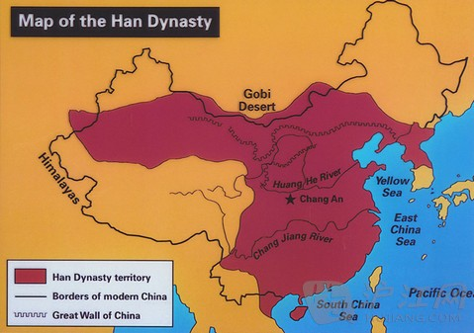
Chang’an
Modern Xi’an
Surrounded by a wall
Carefully planned with roads, imperial compound, homes/buildings
Model of urban planning
Dichotomy of elite and poor
Elite live in lavish homes
Poor live “as closely as the teeth of a comb”

Slide 19
Society
Patriarchal
Family = fundamental social unit
Included living AND ancestral spirits
Ancestor veneration
Sons favored over daughters
Filial piety (Confucianism)
Women
Cook, take care of family, make clothes
Submit to males
Arranged marriages
Ban Zhao
“Lessons for Women”

Slide 20
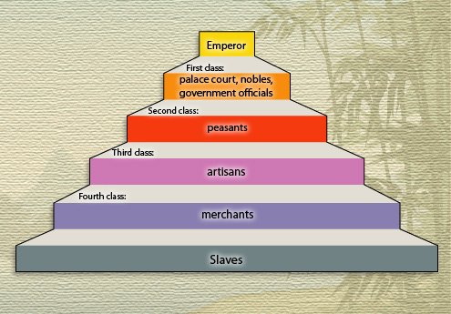
Social Classes
Gentry
Scholar offiials
Confucian
Exempt from taxes, military/labor service
Became a privileged class
Merchants
Some wealthy
Viewed as being greedy parasites
Blamed for China’s problems on occasion

Slide 21
Technology
Astrology/Observation of celestial bodies
Watermill
Horse collar
Heavier loads could be pulled by horses
Paper by 2nd century BCE
Crossbow trigger
Roads that traversed the empire
Similar to Roman Road
Canal system

Slide 22
Religion
Based in nature
Ghosts/spirits
Daoism
Alchemy
Turn common items into precious metals
Challenged Chinese tradition and led to uprisings
Buddhism
Originated in India in 5th century BCE
Arrival in China c. 1st century CE
Spread via Silk Road
Opposed traditional values of children and the family
Eventually changed to fit Chinese traditions

Slide 23
Fall of the Han (220 CE)
Yellow River
Flood caused river to change course
Many deaths
Economy destroyed
Widespread poverty
25 CE: capital moved to Luoyang
Corrupt officials, weak leaders, poverty

