Slide 1
Greece and Iran

Slide 2
Ancient Iran (Persia)
1000-500 BCE

Slide 3
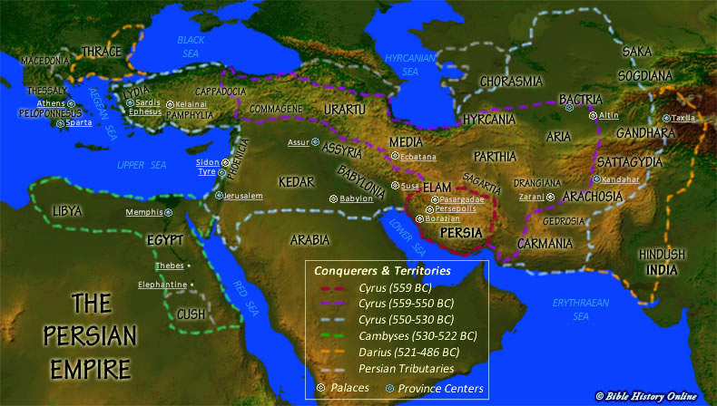
Land of the Aryans
Iran, Afghanistan, Pakistan, Turkmenistan
Link between western Asia and central/southern Asia
Majority of surviving historical accounts are Greek

Slide 4
Persian Empire
Medes
Western portion
First group to achieve complex political organization in the area
Persians
Southeastern portion
Achaemenids
The two groups intermarried to create the empire

Slide 5
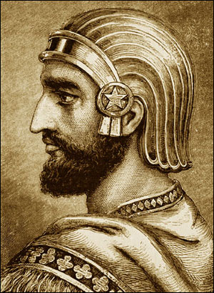
Cyrus
Persian father, Median mother
United Persian tribes and overthrew Median monarch
Placed both races in positions of authority
Kept Median traditions/government structure
Defeated Lydia, Anatolia, some Greek city-states, Neo-Babylonian dynasty

Slide 6
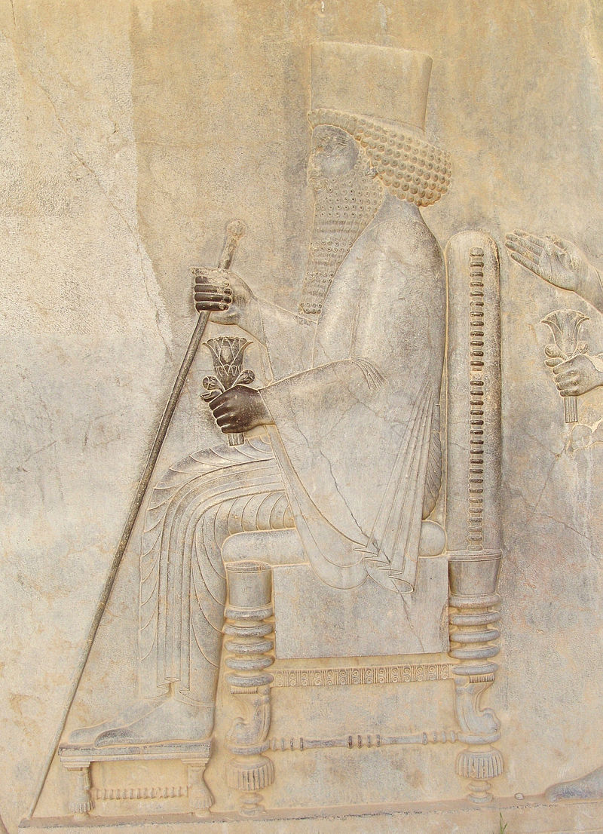
Darius I
Diminished the official role of the Medes
Second founder of the Persian Empire
Stretched empire from eastern Europe to Libya and Russia
New organizational structure that would continue until the end of the empire

Slide 7
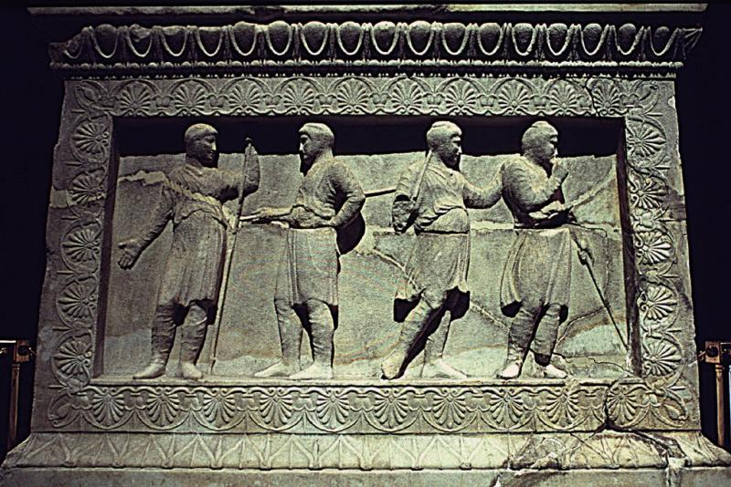
New Organizational Structure
Divided empire
20 provinces
Satrap: Persian “governor” in charge of a province
Collect taxes
Local court system
Hereditary (eventually)

Slide 8
Persian Royal Road
1600 miles
Postal system
Royal messengers could travel across empire from modern Turkey to Iran within roughly a week
111 rest stops
Caravanserai
Guards at each stop

Slide 9
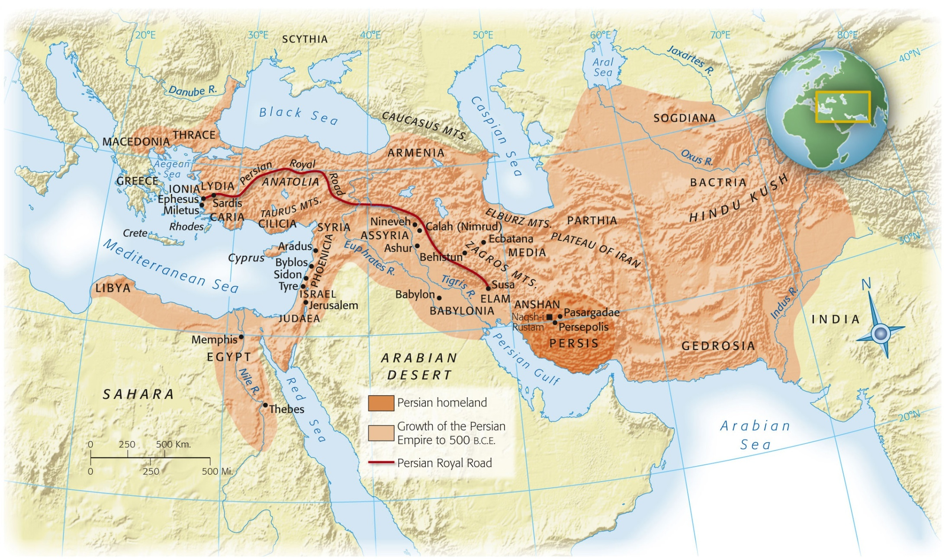
Persian Royal Road

Slide 10
Society
Patriarchal
Warriors
King
Landowning aristocracy
Women had political influence, could own property
Priests
AKA magi
Peasants
Labor units divided by men, women, children, etc
Officials distributed food and other necessities
Pregnant women/women with babies received extra
Skilled laborers received more than unskilled

Slide 11
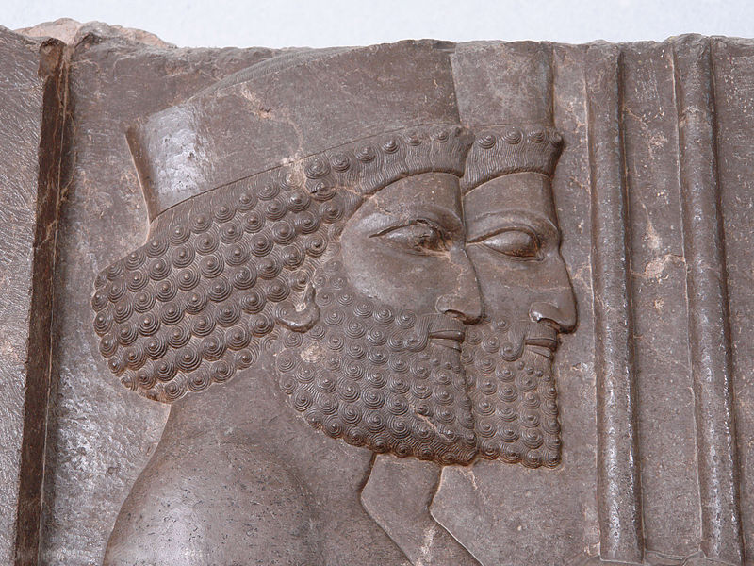
Decline of the Achaemenid Empire
Policy of toleration under Cyrus, Darius
Rebuilding of temple in Jerusalem
Xerxes (486-465 B.C.E.) harshly represses rebellions in Mesopotamia and Egypt
Increasing public discontent
©2011, The McGraw-Hill Companies, Inc. All Rights Reserved.
*
Notes:
*

Slide 12
Capital(s)
Susa
persepolis
Administrative center of empire
In geographical center
Elam/Mesopotamia
Near modern Iran/Iraq border
Location of the tomb of the prophet Daniel (?)
Ceremonial capital
Persian homeland
Symbol of power/wealth
Marriages, coronations, burials
Propaganda relief sculptures
Images of all classes all willingly cooperating together

Slide 13
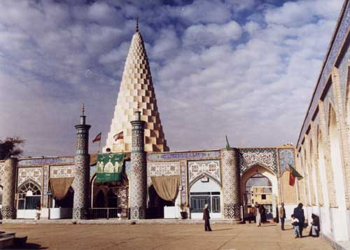
Susa
Notes:
Daniel’s tomb

Slide 14
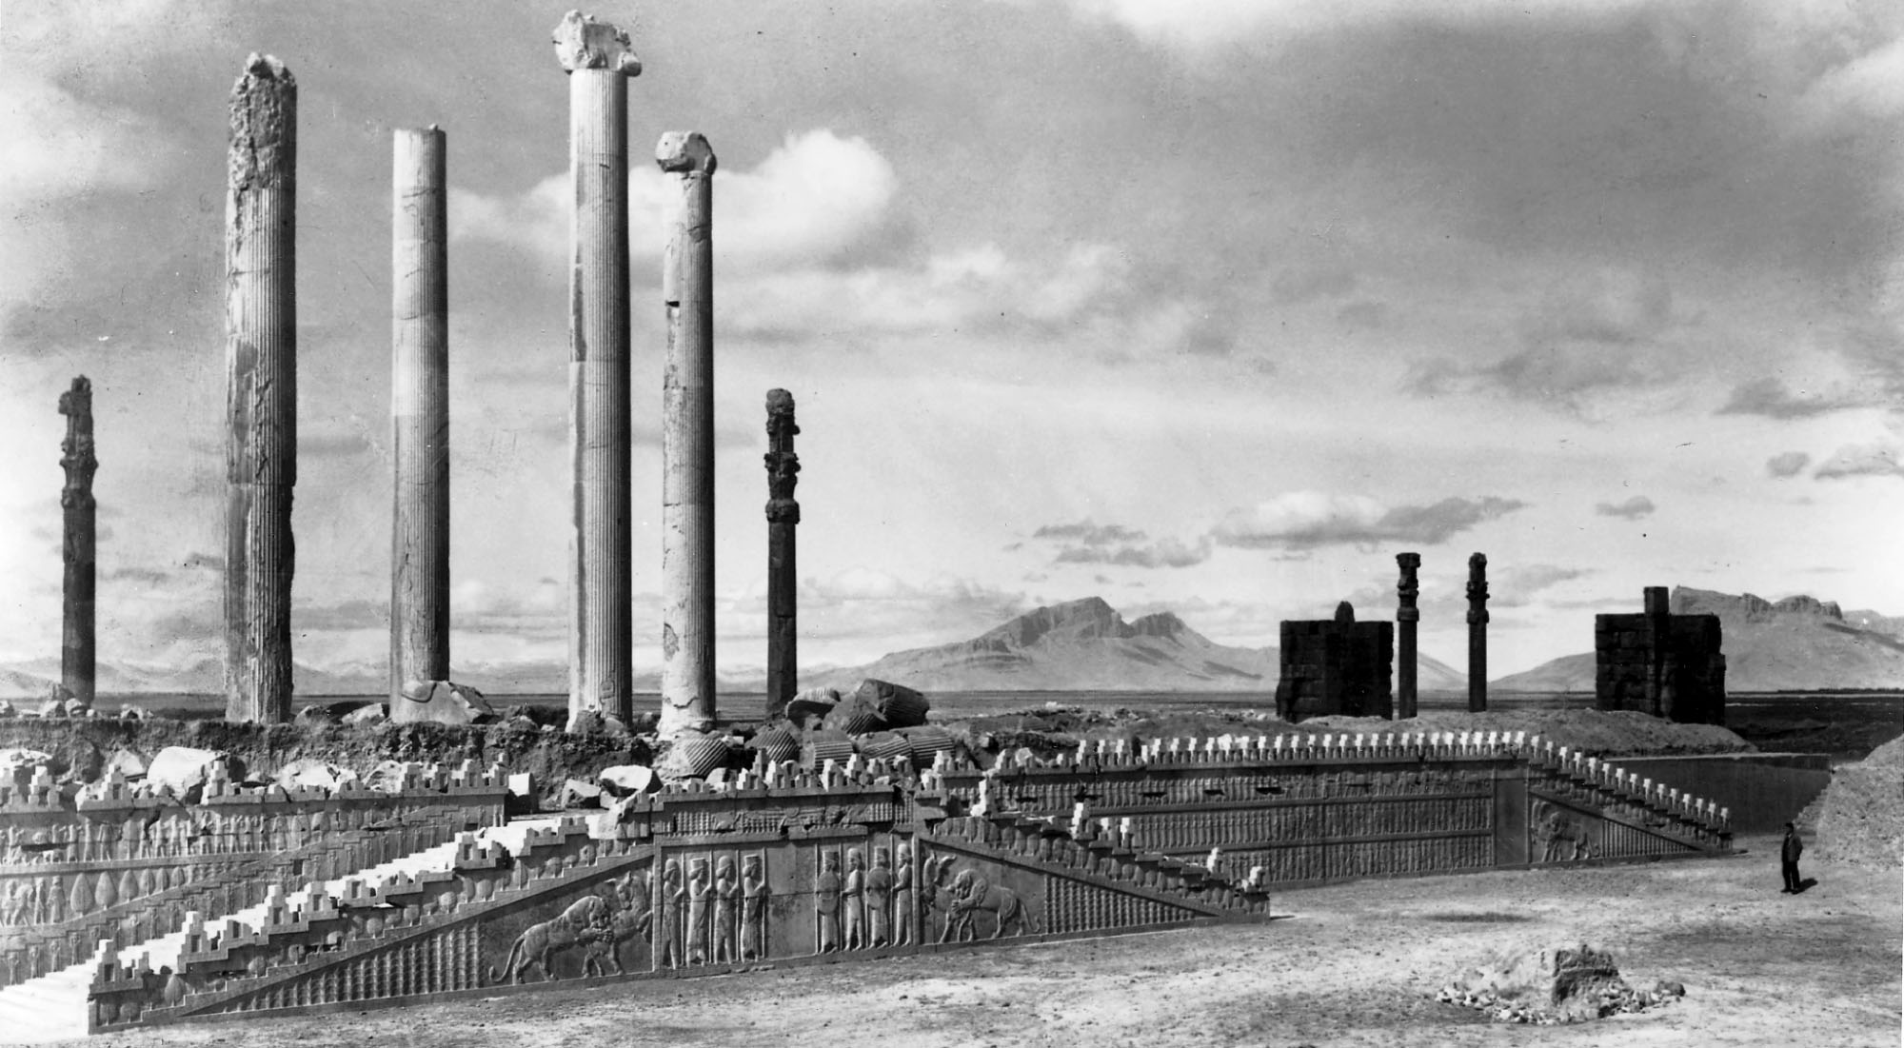
Persepolis
Notes:
View of the East Front of the Apadana (Audience Hall) at Persepolis, ca. 500 B.C.E.
Persepolis, in the Persian homeland, was built by Darius I and his son Xerxes, and it was used for ceremonies of special importance to the Persian king and people—coronations, royal weddings, funerals, and the New Year’s festival. The stone foundations, walls, and stairways of Persepolis are filled with sculpted images of members of the court and embassies bringing gifts, offering a vision of the grandeur and harmony of the Persian Empire.

Slide 15
Zoroastrianism
The Gathas: ancient Iranian hymn by Zoroaster
Ahuramazda (like the car ☺ ) – chief god
Created the world
World damaged by Angra Mainyu (hostile spirit)
Struggle between good and evil
Afterlife = reward/punishment depending on life lived
Darius tied his reign to religion by claiming to be appointed by Ahuramazda

Slide 16
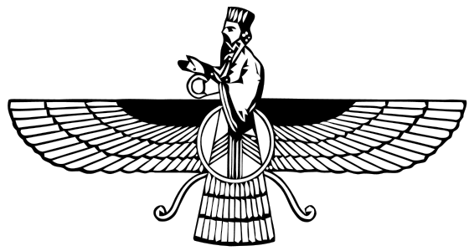
Zoroastrianism
Belief in one supreme deity
High ethical/moral standard for humans
Promised salvation
Influenced Judaism (?)

Slide 17
Ancient Greece
1000-500 BCE

Slide 18
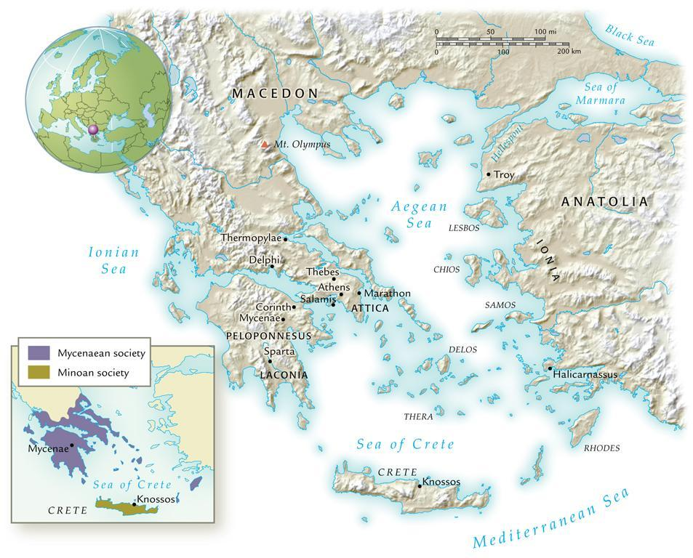
Classical Greece, 800-350 B.C.E.
©2011, The McGraw-Hill Companies, Inc. All Rights Reserved.
*
Notes:
*

Slide 19
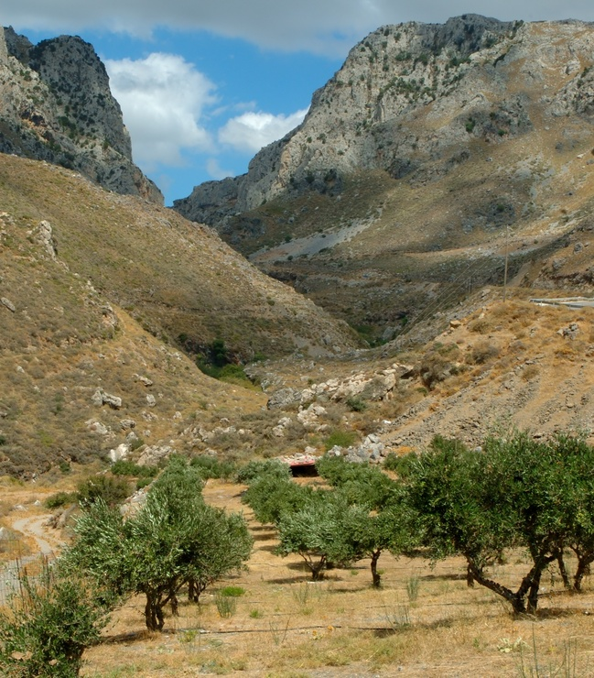
Geography/Resources
Limited fertile/arable land
Rocky, mountainous landscape
Grains, olive trees, sheep/goats
Dependence on the sea and trade
Geography made land transportation difficult
Could travel from Greece to Anatolia almost without losing sight of land

Slide 20
Dark Age
Archaic Period
150-800 BCE
Depopulation, poverty, disappearance from historical record
Following the destruction of Mycenaean civilization
Isolation from outer world
800-480 BCE
Dark Age ends with arrival of Phoenician ships to the Aegean
Writing system
Greeks added vowel sounds—the first true alphabet
Fewer symbols than cuneiform/hieroglyphics—easier for common people to learn
Population explosion
Shift to farming and diet change
Caused urban centers and specialization to develop

Slide 21
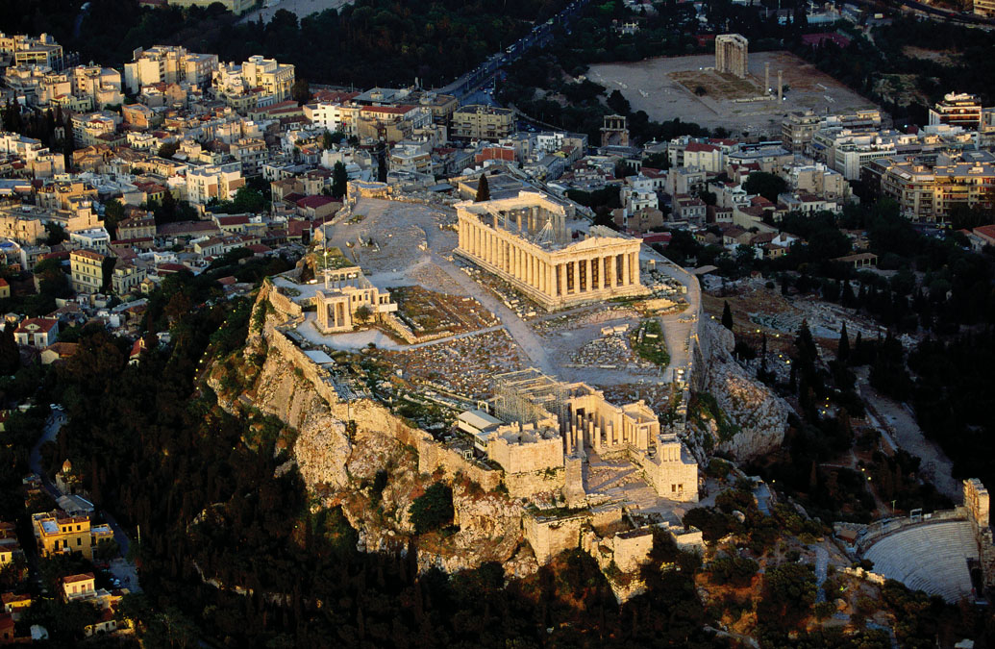
Polis
“City-state”
Greece made up of hundreds of polis due to geography
Hard to be unified
Acropolis: hilltop fortification
Agora: Large, open area / marketplace

Slide 22
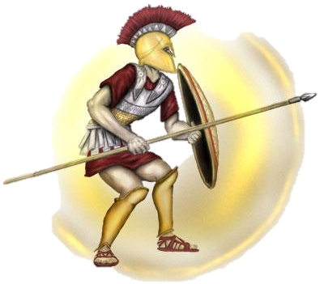
Hoplites and Colonization
Hoplite: heavily armored infantrymen
Army of private citizens
Usually farmers during “off season”
Excess population sent to colonies
Black Sea, North Africa, Italy
Greek culture spread with colonists
“Hellenes” described the Greek
“Barbaroi” described “barbarians”
Invention/use of coinage

Slide 23
Politics
Dark Ages: rule of kings
Eventually councils took the place of kings
Aristocracy
Tyrant
7th and 6th centuries BCE
Seizure of power and violation of traditional politics
Usually aristocrats supported by middle class
Eventually overthrown for either an oligarchy or democracy
Oligarchy
Rule by a few wealthy families
Democracy
Political power by all free adult males

Slide 24
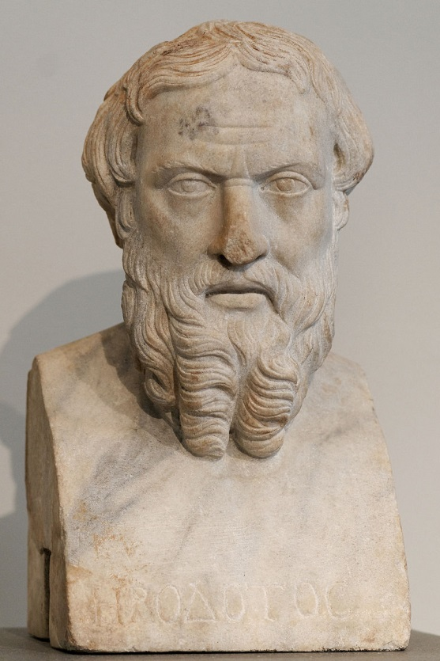
Culture
Religion
Zeus, Poseidon: gods that represented nature
Majority of gods were male
Epic poems (e.g. the Iliad and the Odyssey by Homer)gave the gods anthropomorphic characteristics
Sacrifice
Oracles: Apollo at Delphi
Intellect
Emphasis on the individual
Lyric poetry focusing on personal experience/
emotion
Rejection of traditional religious beliefs
Herodotus
First to write prose
Father of History

Slide 25
Athens vs. Sparta

Slide 26
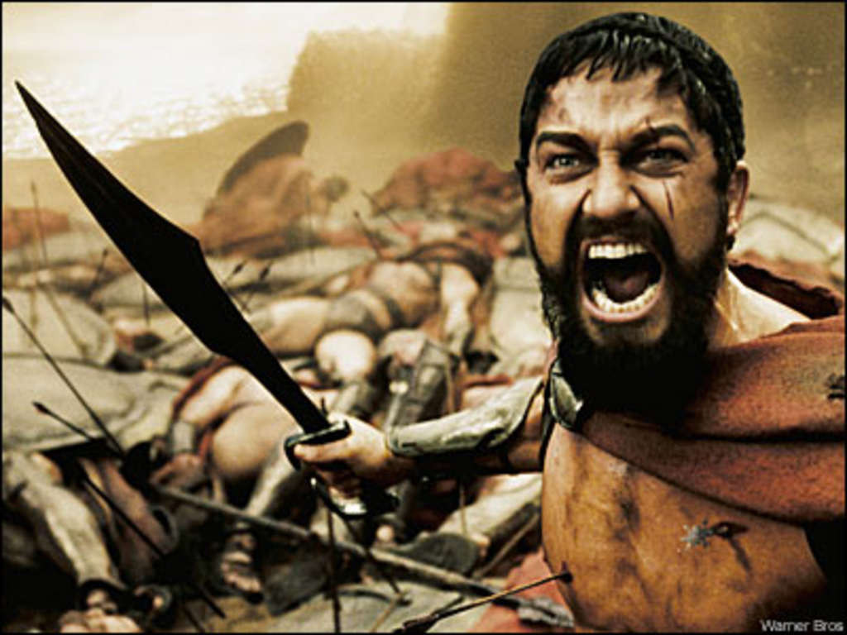
This. Is. Sparta!!!

Slide 27
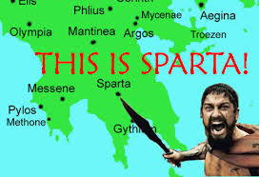
Sparta (No, really)
7th century BCE
Shortage of farm land
Population increase
Invasion of Messenia (neighbor) INSTEAD of colonization
Native population became helots (state-owned serfs)
Spartans feared helot uprising
Military state
Permanently prepared for war
Best army in Greece
Boys sent to military school at 7
Peloponnesian League
System of alliances between Sparta
and other neighbors
Maintained peace in the region
(for a while)

Slide 28
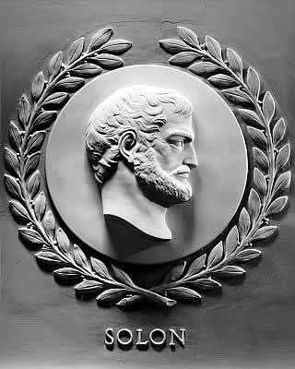
Athens
Larger in size and population than other polis
Fertile land, olive trees
Solon
Averted civil war in Athens
Divided Athens into 4 classes
Top 3 classes can hold office
Lowest class can still participate in meetings
Allowed for freedom of citizens
Pisistratus
Tyrant that created an Athenian “identity”
Monumental building projects, festivals
Pericles
460/450 BCE
All power to body of government
The Assembly
The Council of 500
The People’s Courts

Slide 29
WAR

Slide 30
Persian Wars
Ionian Revolt
Greeks in western Persia revolted against the Persians
Took the Persians 5 years to stop the rebellion
490 BCE
Darius sends troops to Eretria and Athens (both helped in the Ionian Revolt)
Eretria falls; survivors sent into exile in Iran
Athens: hoplites defeat Persians at the Battle of Marathon
480 BCE
Xerxes sends forces and takes over portions of southern Greece
Hellenic League (Sparta and allies)
300 Spartans die at Thermopylae
Persians sack Athens, then navy is destroyed at Salamis
Defeat of Persia leads to the creation of the Delian League
Alliance of city-states under the leadership of Athens
Athens eventually takes advantage of the League and becomes imperial power

Slide 31
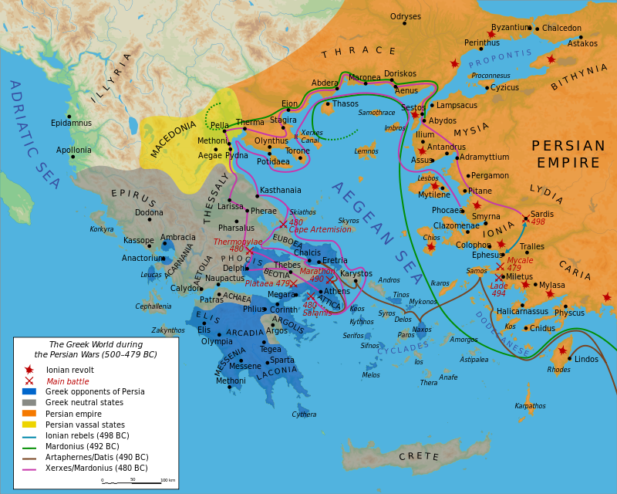

Slide 32
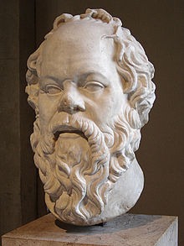
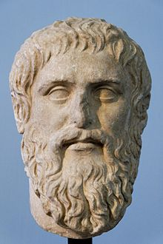
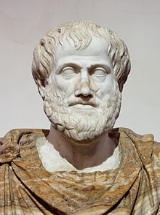
Philosophy
Socrates
Put on trial, convicted of “corrupting” Athenian youth
Forced suicide
Socratic method: questioning for deeper understanding
Plato
Founder of “the Academy”
Refused to write down thoughts/training
Aristotle
Student at the Academy
Founder of the Lyceum
Politics, philosophy, poetry, physics, psychology, etc
Tutor to Alexander the Great

Slide 33
Athenian “Equality”
Trireme
Warship with 170 rowers
Hoplites: now members of the middle/upper class
Rowers: lower class
Could demand equal rights b/c they were the backbone of the power
Only 10-15% of the population actually had a voice
Women, children, slaves excluded
Women
Athens
Arranged marriage
Relegated to the home
Bear/raise children (males)
Sparta
Expected to raise strong soldiers
Encouraged to exercise
Slavery rationalized
Most families owned 1 slave
Foreigners lacked the ability to reason/think for themselves

Slide 34
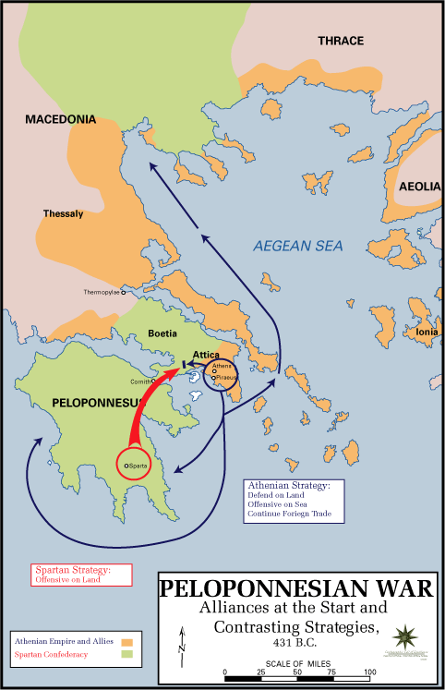
Peloponnesian War
Sparta vs. Athens
30 years of fighting
404 BCE: Defeat of Athenian navy
Sparta took over the Athenian “empire”
Same attitude toward others that Athens had
Internal fighting between other city states
Allowed the Persians to conquer lost lands

Slide 35
The Macedonians
Philip II
Alexander the Great
King of Macedonia
Created a military power in the Greek world
Hoplites
Spears
Horses/cavalry
Catapults
Corinth
Confederacy of states
Control of Greece
Defeated the Persian king, Darius III
Kept Persian style administration in conquered lands
Placed Macedonians in power
Eventually placed Persians in power/married Iranian women
Alexandria, Egypt
Died in 323 BCE

Slide 36
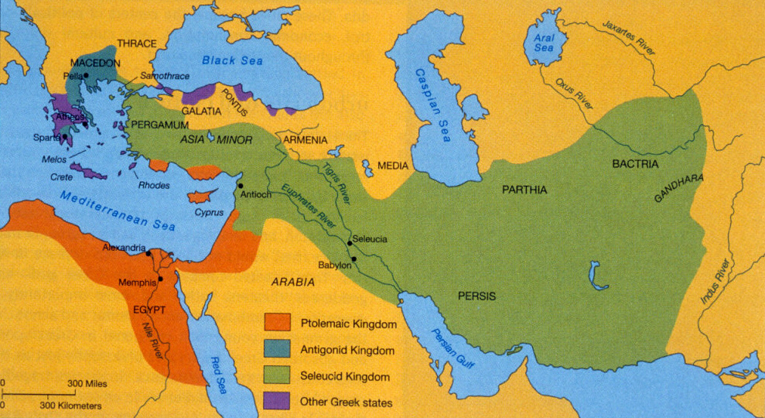
Hellenistic Age
Hellenistic Age
Spread and influence of Greek culture spread by Alexander’s empire
No clear successor to Alexander’s empire
50 years of unrest
Empire divided into 3 Hellenistic kingdoms
Seleucid (Persia)
Ptolemaic (Egypt)
Antigonid
(Greece/Macedonia)

Slide 37
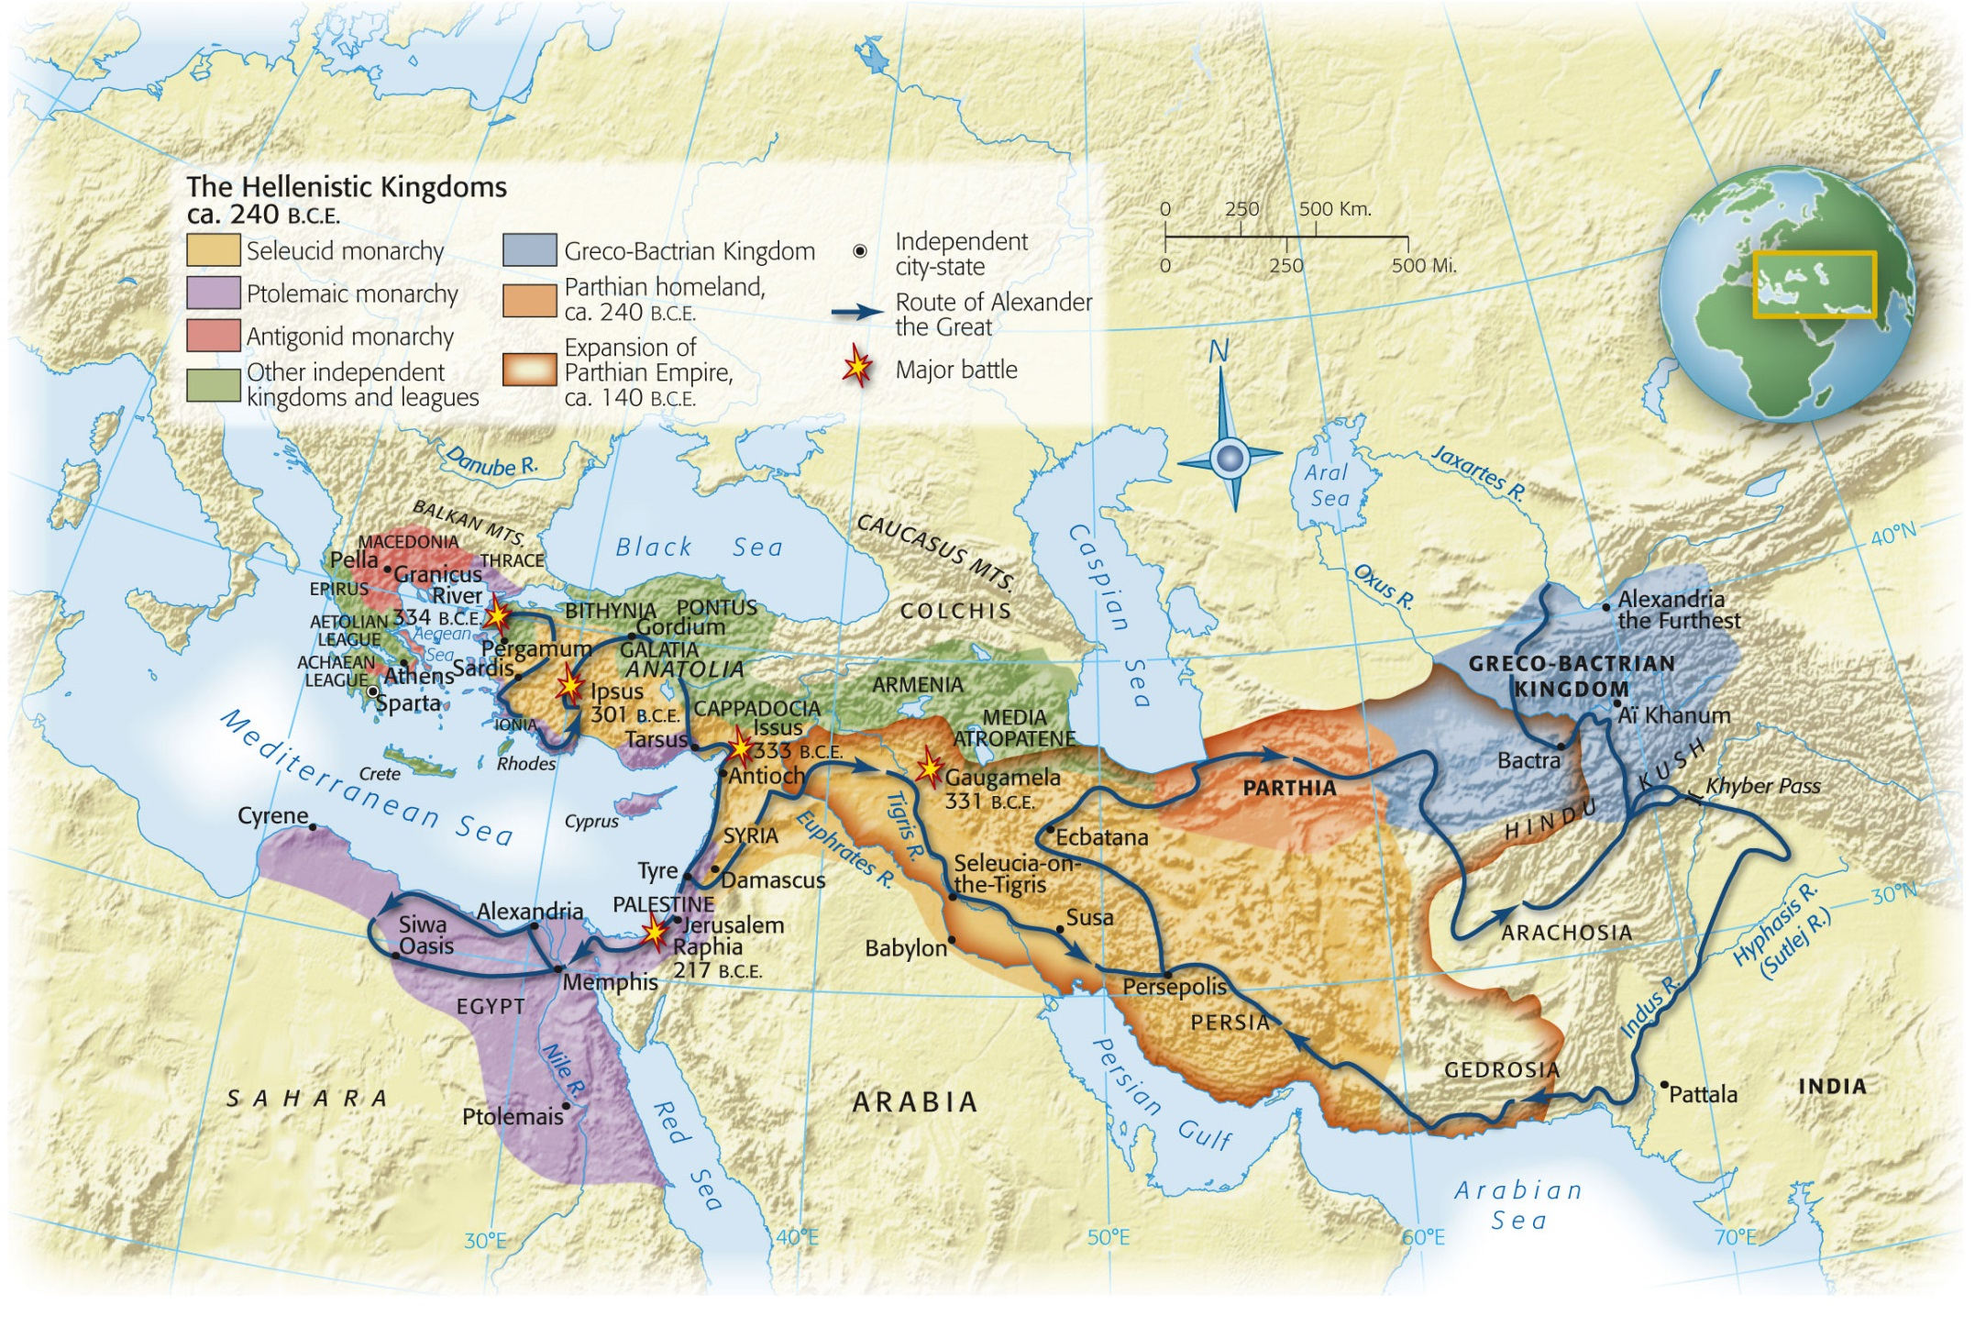
Map 5-3, p. 144
Notes:
Map 5.3: Hellenistic Civilization.
After the death of Alexander the Great in 323 B.C.E., his vast empire soon split apart into a number of large and small political entities. A Macedonian dynasty was established on each continent: the Antigonids ruled the Macedonian homeland and tried with varying success to extend their control over southern Greece; the Ptolemies ruled Egypt; and the Seleucids inherited the majority of Alexander’s conquests in Asia, though they lost control of the eastern portions because of the rise of the Parthians of Iran in the second century B.C.E. This period saw Greeks migrating in large numbers from their overcrowded homeland to serve as a privileged class of soldiers and administrators on the new frontiers, where they replicated the lifestyle of the city-state.

Slide 38
Hellenistic Kingdoms
Seleucids
Majority of Alexander’s lands
Mesopotamia, Syria, Anatolia
Many ethnic groups within the kingdom
Hard to control
Many threats from invasion
Persian administration
Antigonid
One main ethnic group
Macedonian homeland, northern Greece
Athens was a “museum” town
Ptolemies
One ethnic group
Easy to control
Pharaoh
Linked Egypt to the Mediterranean
Encouraged Greek immigration
Rule from Alexandria
Greek style polis
Alexandria
Body of Alexander “legitimized” the rule of the Ptolemies
Lighthouse of Alexandria
Library of Alexandria

Slide 39
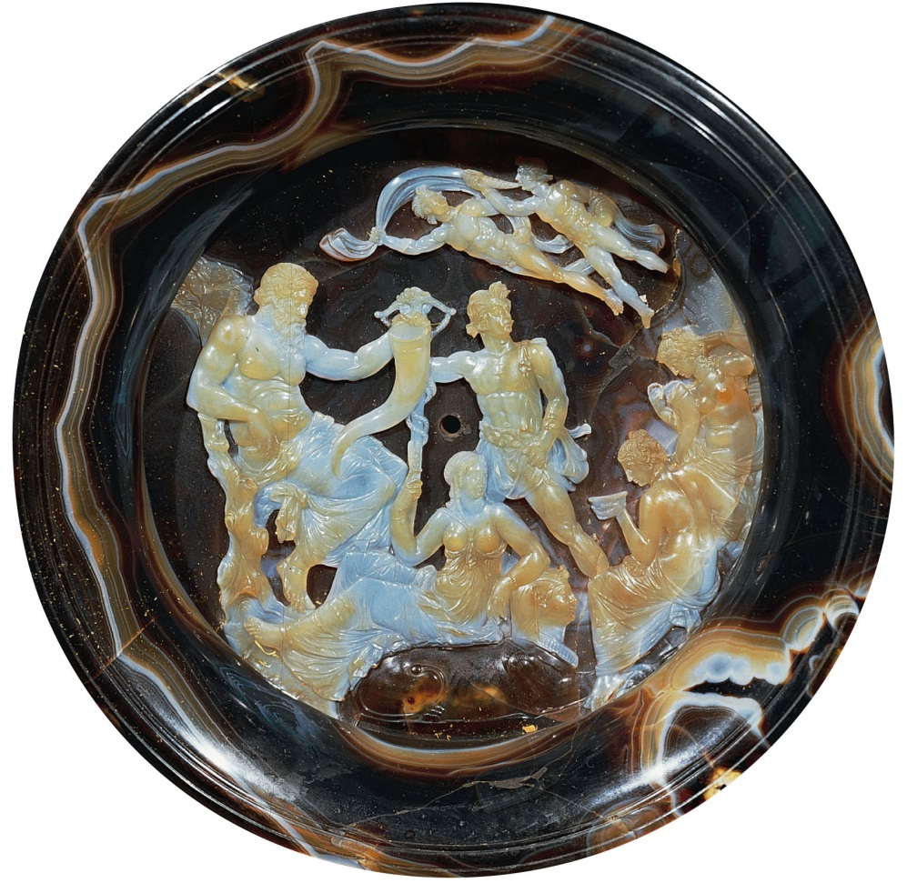
Syncretism
Diffusion
The spread of a culture, religion, idea WITHOUT changing the culture, religion, idea
EX: Spilled paint spreads out but doesn’t change colors
Syncretism
The spread of a culture, religion, idea and the changing of that culture, religion, idea into something new
EX: Two colors are spilled (blue and yellow) and make a new color (green)
Notes:
Hellenistic Cameo, Second Century B.C.E.
This sardonyx cameo is an allegory of the prosperity of Ptolemaic Egypt. At left, the bearded river-god Nile holds a horn of plenty while his wife, seated on a sphinx and dressed like the Egyptian goddess Isis, raises a stalk of grain. Their son, at center, carries a seed bag and the shaft of a plow. The Seasons are seated at right. Two wind-gods float overhead. The style is entirely Greek, but the motifs are a blending of Greek and Egyptian elements.

