Slide 1
New Civilizations in the Eastern and Western Hemispheres
2200-250 BCE
Nubia, Europe, Americas

Slide 2
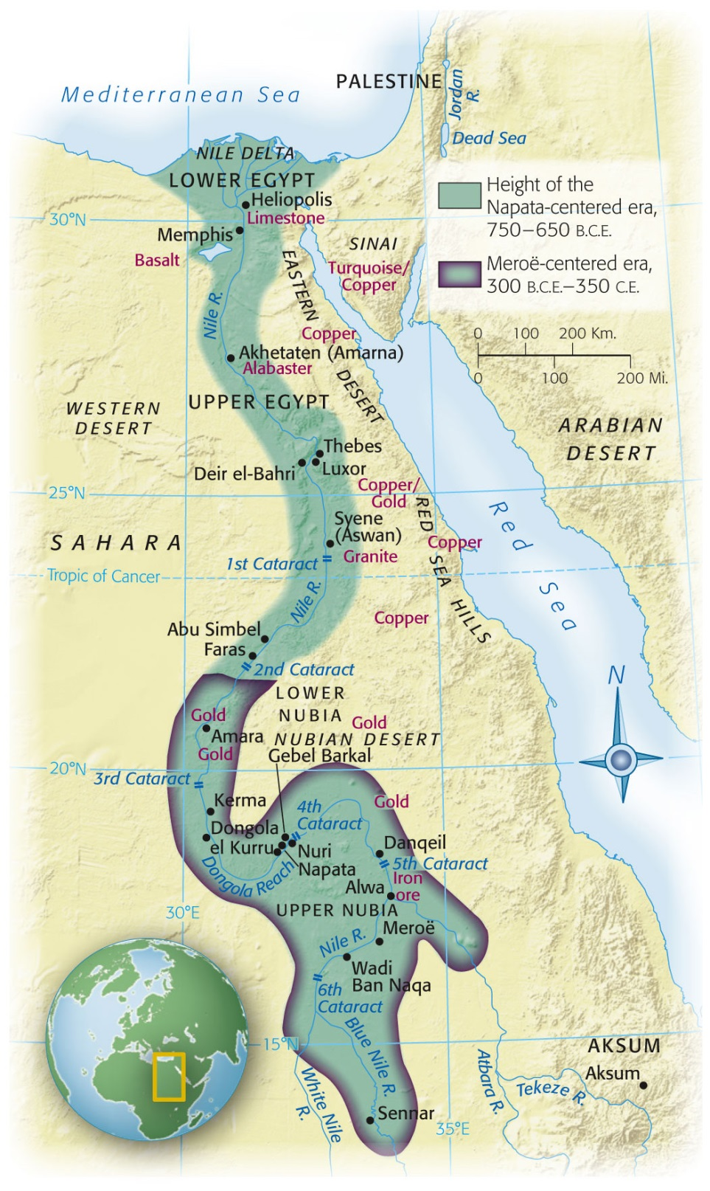
Nubia
Notes:
Map 3.2: Ancient Nubia.
The land route alongside the Nile River as it flows through Nubia has long served as a corridor connecting sub-Saharan Africa with North Africa. Centuries of Egyptian occupation, as well as time spent in Egypt by Nubian hostages, mercenaries, and merchants, led to a marked Egyptian cultural influence in Nubia. (Based on Map 15 from The Historical Atlas of Africa, ed. by J. F. Ade Ajayi and Michael Crowder. Reprinted by permission of Addison Wesley Longman Ltd.)

Slide 3
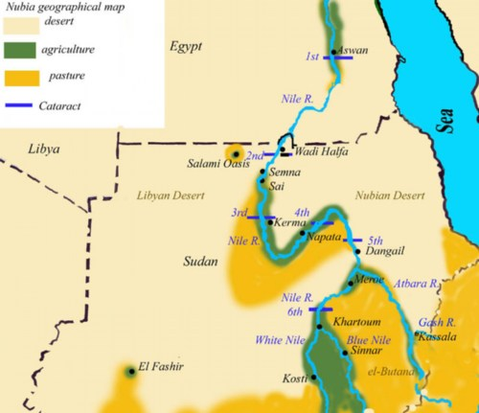
Nubia
Along Nile River
Between Modern Egypt and Sudan
Gold, Copper, Semiprecious stones

Slide 4
Egyptian Interaction
Old Kingdom (2300 BCE)
Egyptian trade missions
Gold, ebony, ivory, slaves, animals
Middle Kingdom (2040-1640 BCE)
Extension of fortifications further southward
Attempts to control gold mines in Nubia
New Kingdom
Destruction of Kush
Early urban area in Africa
Further Southern domination
Used Nubian gold to supply Middle Eastern markets
Egyptian domination for 500 years
Absorption of culture, politics, religion, culture into Nubia

Slide 5
25th Egyptian Dynasty
712-660 BCE: rule of Egypt by Nubian kings
Kept Nubian names
Ruled in Egyptian style and tradition
Capital: Memphis
701 BCE: attempt to help Palestine against Assyrian Empire
660 BCE: Assyrians drive Nubians back to the south
Meroë
Became center of Nubian kingdom by 4th cent BCE
Sub-saharan culture eventally replaces Egyptian influences
Collapse in the 4th cent CE due to invasion of nomads
Mobile due to camel domestication

Slide 6
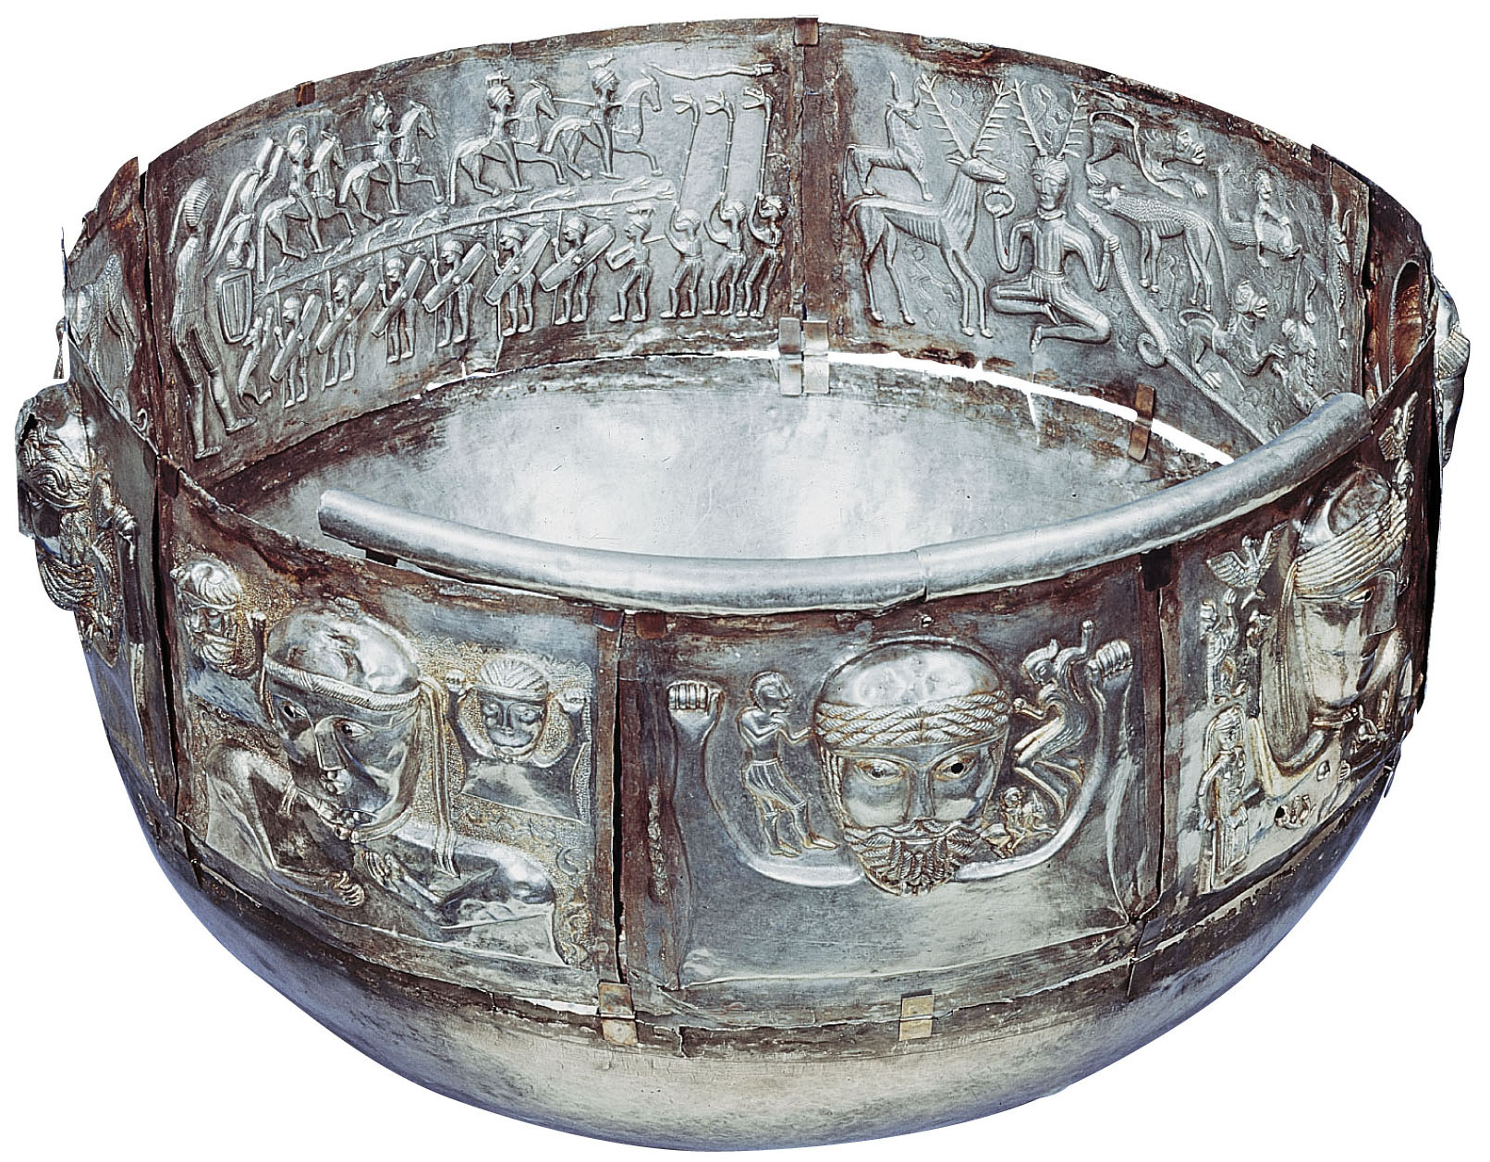
Celtic Europe
Notes:
The Gundestrup Cauldron.
This silver vessel was found in a peat bog in Denmark, but it must have come from elsewhere. It is usually dated to the second or first century B.C.E. On the inside left are Celtic warriors on horse and on foot, with lozenge-shaped shields and long battle-horns. On the inside right is a horned deity, possibly Cernunnos.

Slide 7
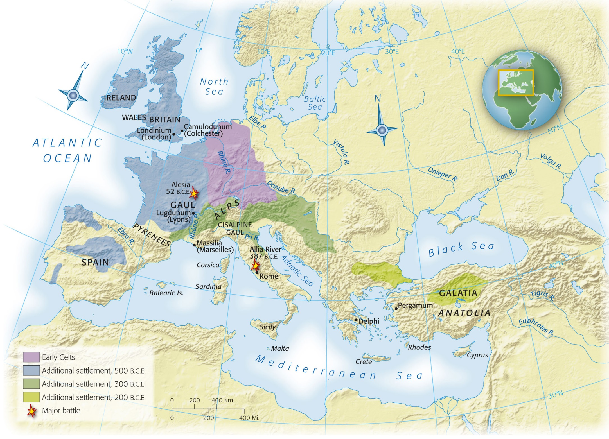
Map 3-3, p. 69
Notes:
Map 3.3: The Celtic Peoples.
Celtic civilization originated in central Europe in the early part of the first millennium B.C.E. Around 500 B.C.E. Celtic peoples began to migrate, making Celtic civilization the dominant cultural style in Europe north of the Alps. The Celts’ interactions with the peoples of the Mediterranean, including Greeks and Romans, involved both warfare and trade. (From Atlas of Classical History, Fifth Edition, by Michael Grant. Copyright © 1994 by Michael Grant. Used by permission of Oxford University Press, Inc.)

Slide 8
Celtic Europe
“Celtic” refers to Indo-European family language
First appears in Germany, Austria, Czech Rep.
Continental Europe
France, Germany, Switzerland, Austria, Czech Republic, Slovakia, Hungary, Poland, Romania
No unified Celtic nation
Divided into family groups
Elite warrior class
Wood and clay homes

Slide 9
Celtic Europe
Druids
Celtic priests
Gaul (France) and Britain
Religious and political
At times prevented warfare between rival clans
Religion
Halloween (Samhain) was a fertility festival (agriculture)
Worshipped in nature not man-built temples
Trade
Along rivers and with Mediterranean
Women
Children and food production
Partnership in marriage
More power/freedom than in Middle East, Rome, Greece
Conquest by Romans mostly ended Celtic tradition
Survives in parts of France, Scotland, Ireland, Wales

Slide 10
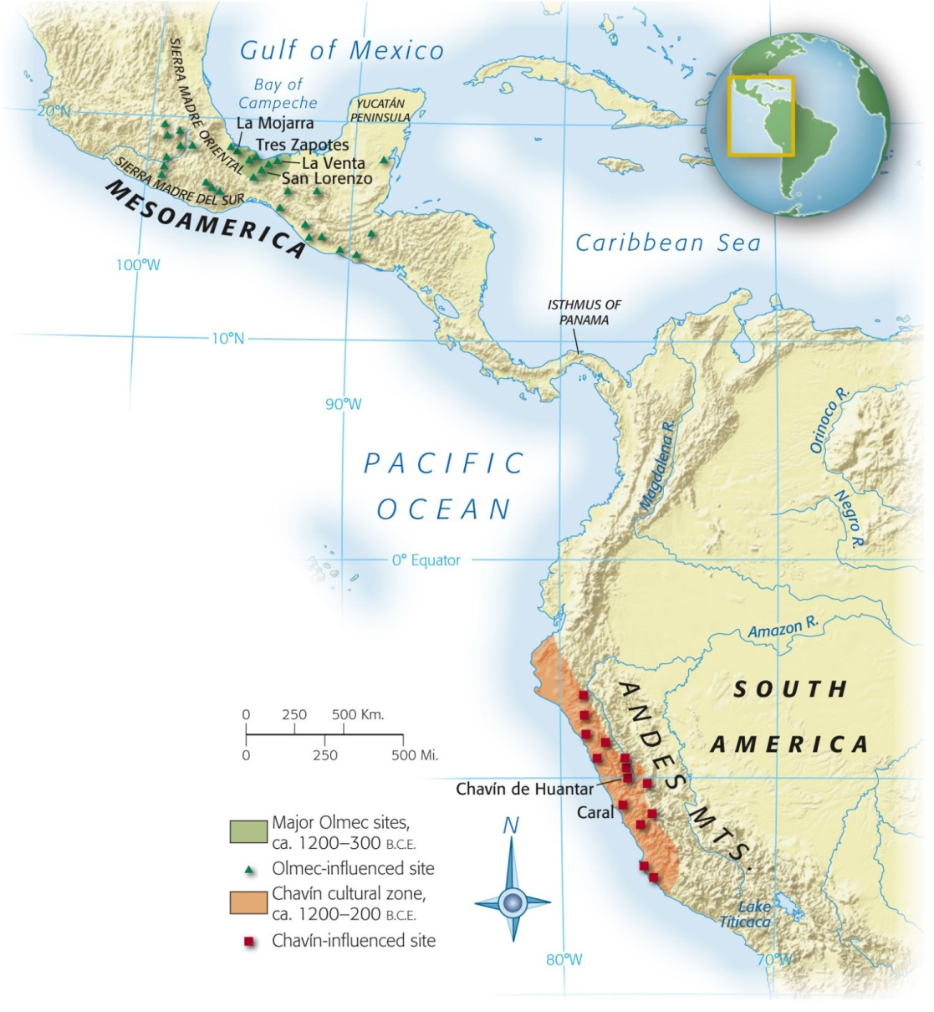
The Americas
Notes:
Map 3.4: Olmec and Chavín Civilizations.
The regions of Mesoamerica (most of modern Mexico and Central America) and the Andean highlands of South America have hosted impressive civilizations since early times. The civilizations of the Olmec and Chavín were the originating civilizations of these two regions, providing the foundations of architecture, city planning, and religion.

Slide 11
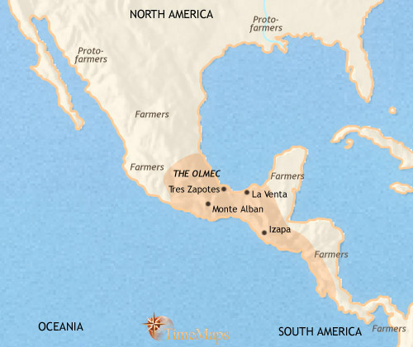
The Olmec
Mesoamerica
Meso = middle
Middle America (between N and S)
Most influential early Mesoamerican civilization
Modern Veracruz and Tabasco, Mexico

Slide 12
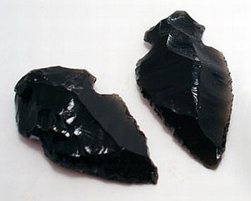
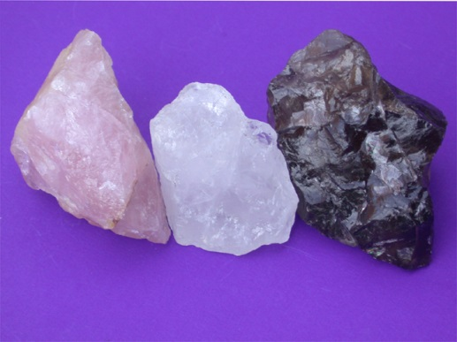
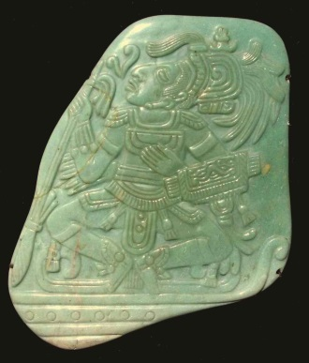
Resources
Obsidian, quartz, jade
Maize (corn), beans, fishing
Domesticated by 3500 BCE
Created specialization and social hierarchies
Led to urbanization

Slide 13
Urban Centers
Large platforms/mounds of dirt
Location of religious and political buildings
Most housing NOT in urban center
Some elite housing
Evidence of trading and merchant class
Each site eventually abandoned and buildings/monuments were destroyed
San Lorenzo (1200-900 BCE)
La Venta (c 900-600 BCE)
Became important after the destruction/ abandonment of San Lorenzo
Tres Zapotes (c 600 BCE
Rose after the destruction/ abandonment of La Venta

Slide 14
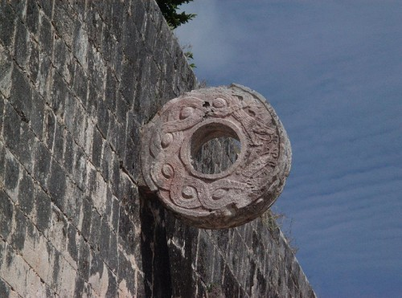
Politics and Religion
No evidence of Olmec empire
Olmec heads
Large carved heads of rulers
11 feet tall
Located near urban centers
Produced calendar
Origination (?) of the ritualistic Mesoamerican ball game

Slide 15
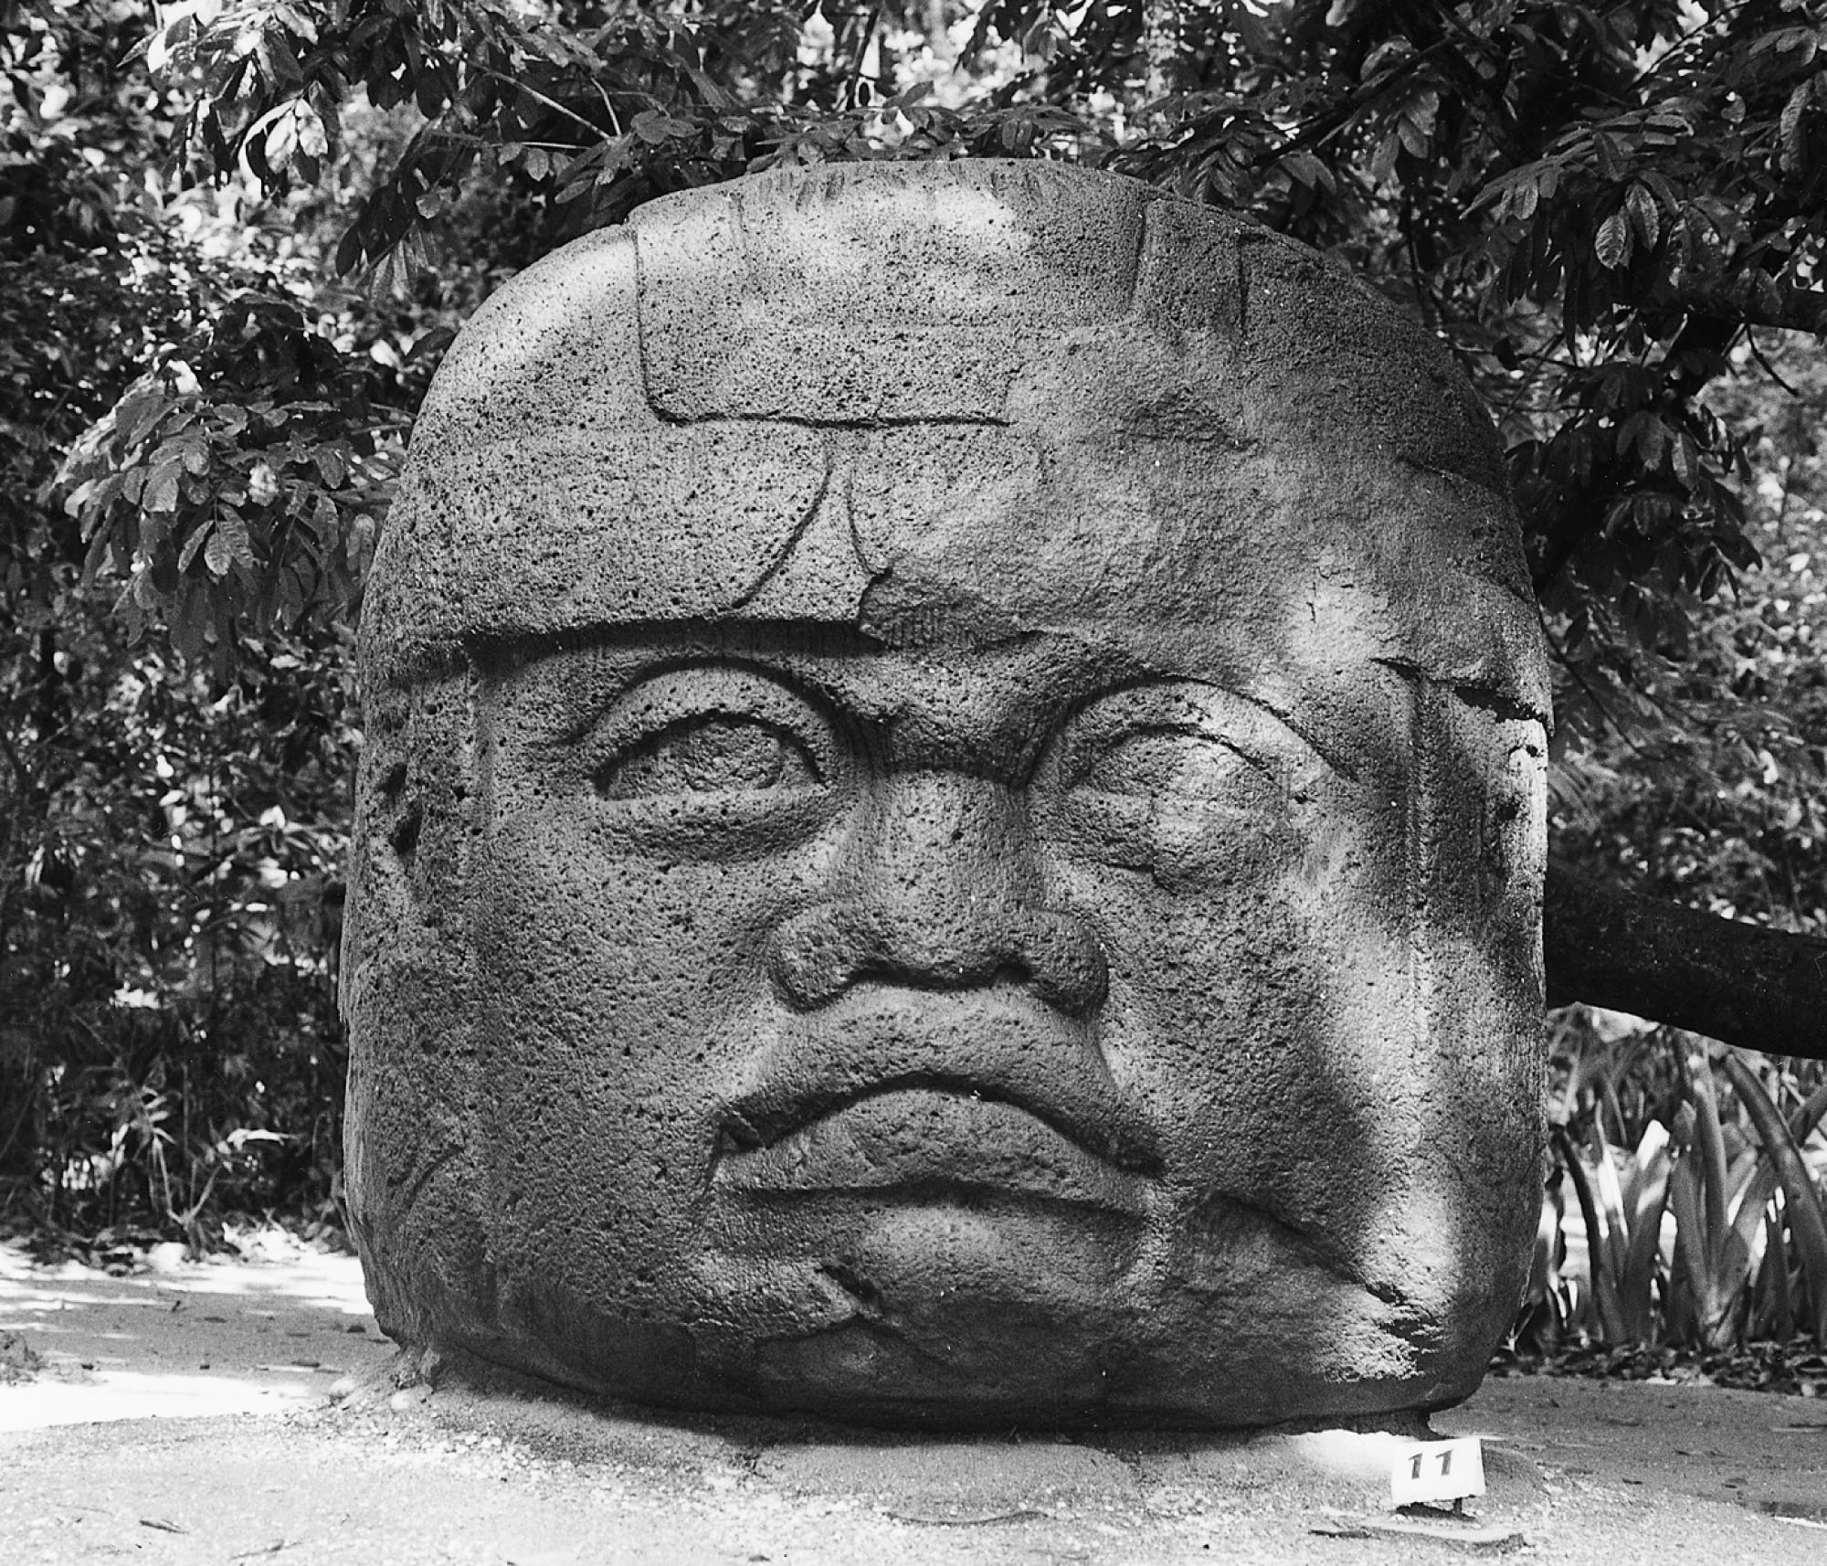
p. 74
Notes:
Olmec Head.
Giant heads sculpted from basalt are a widely recognized legacy of Olmec culture. Sixteen heads have been found, the largest approximately 11 feet (3.4 meters) tall. Experts in Olmec archaeology believe the heads are portraits of individual rulers, warriors, or ballplayers.

Slide 16
Andean Civilizations
South American coast
Urban centers first appeared in coastal areas
Fish, mollusks
Introduction of maize from Mesoamerica allowed for more urbanization
Caral
Precursor to Chavín
Included aspects of later Andean civilizations
Ceremonial plazas
Pyramids
irrigation

Slide 17
The Chavín
Modern day Peru
Capital of Chavín de Huantar was intersection of trade routes
Connected coast with inland farmers and llama herders
Trade relations allowed for work projects
Bridges, canals, roads, temples, etc
Western Hemisphere’s metallurgy evolved in Andean region
Later found in Mesoamerica
Further evidence of trade between the two

Slide 18
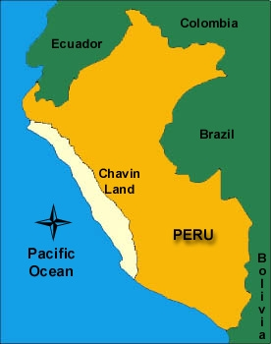

Slide 19
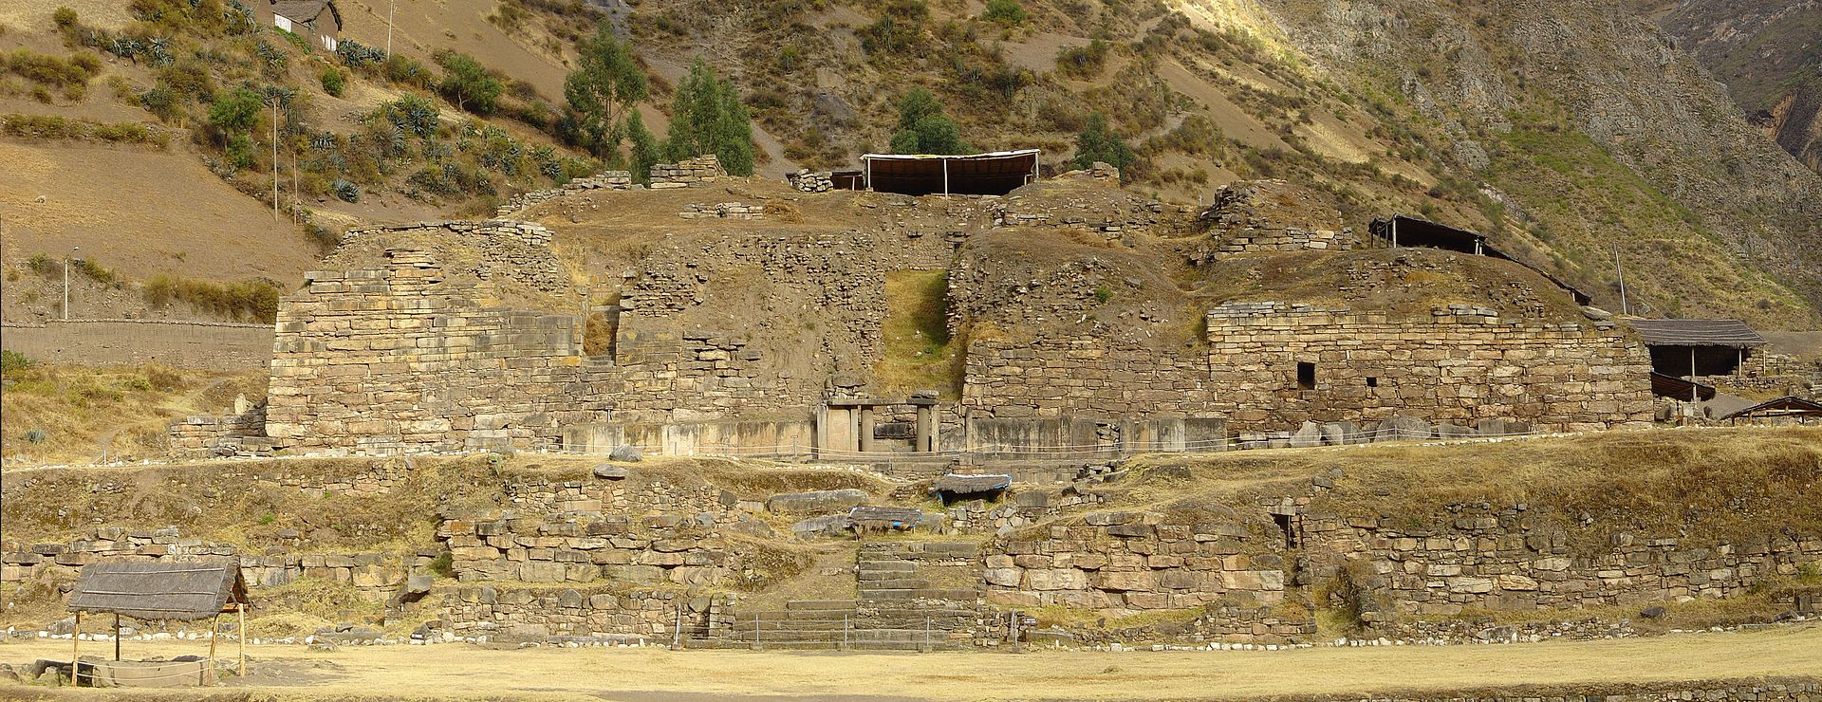
Chavín de Huantar

Slide 20
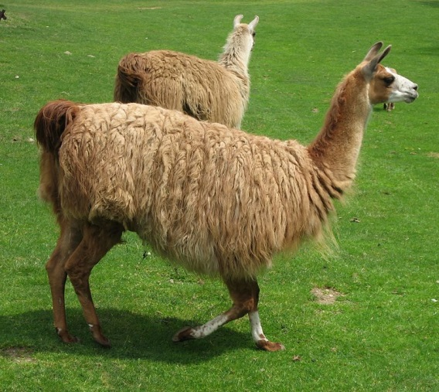
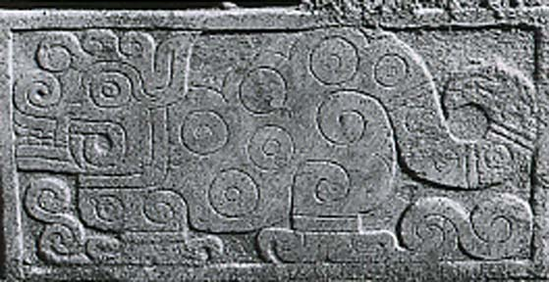
Animals
Llama
Only domesticated beast of burden in the Americas
Meat, wool, pack animal
Religion
Jaguar was most common

Slide 21
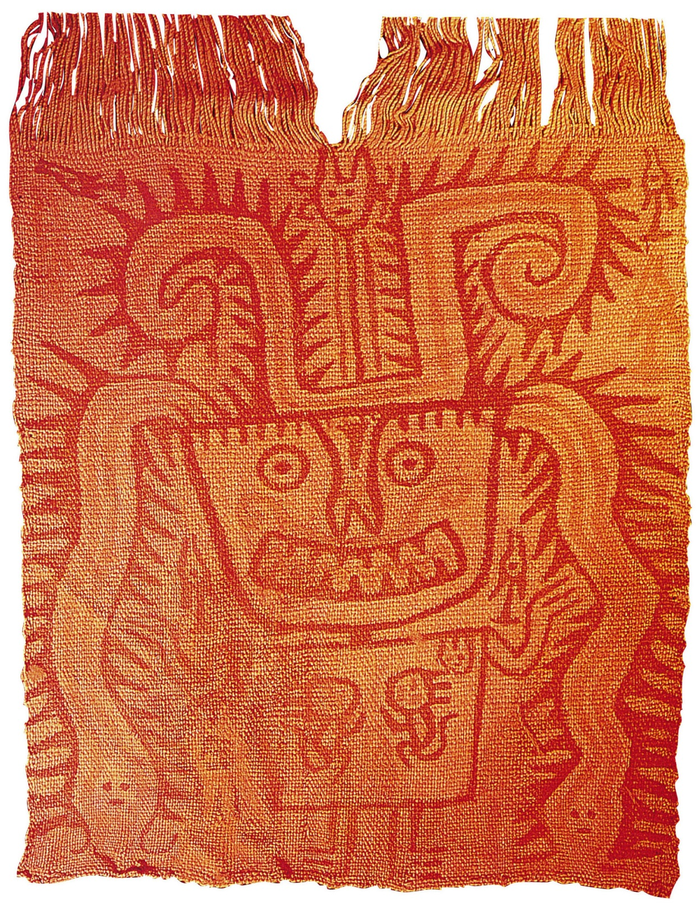
p. 104
Notes:
Ancient Peruvian Textiles.
The weaving of Chavín was famous for its color and symbolic imagery. Artisans both wove designs into the fabric and used paint or dyes to decorate plain fabric. This early Chavín painted fabric was used in a burial. Notice how the face suggests a jaguar and the headdress includes the image of a serpent.

