Slide 1
New Civilizations in the Eastern and Western Hemispheres
2200-250 BCE
Jessica Stroo
Northeast Jones HS
Bulliet

Slide 2
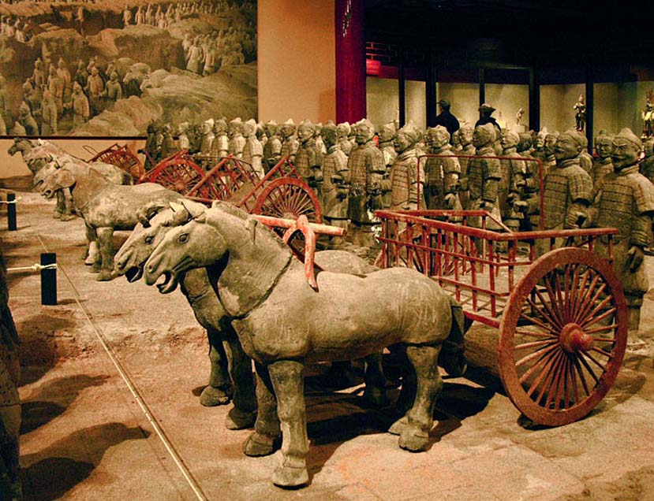
China

Slide 3
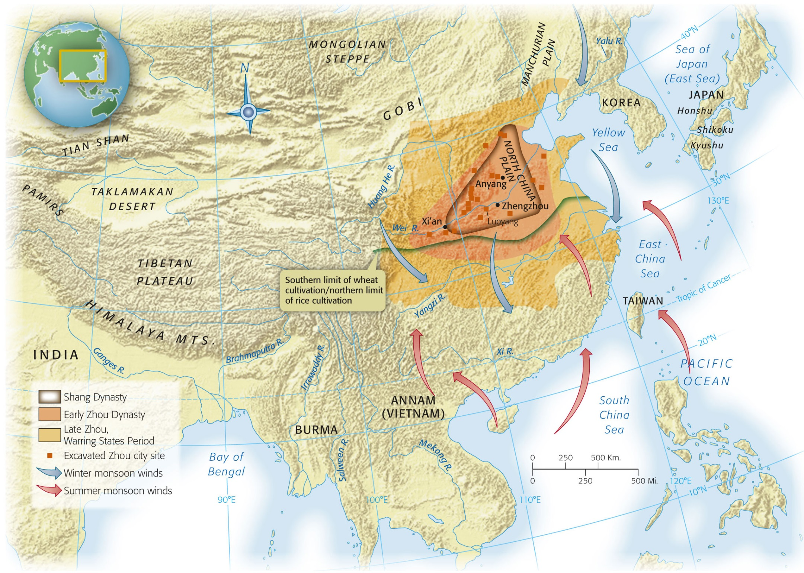
Map 3-1, p. 57
Notes:
Map 3.1: China in the Shang and Zhou Periods, 1750–221 B.C.E.
The Shang dynasty arose in the second millennium B.C.E. in the floodplain of the Yellow River. While southern China benefits from the monsoon rains, northern China depends on irrigation. As population increased, the Han Chinese migrated from their eastern homeland to other parts of China, carrying with them their technologies and cultural practices. Other ethnic groups predominated in more outlying regions, and the nomadic peoples of the northwest constantly challenged Chinese authority.

Slide 4
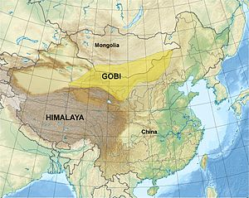
Geography
“Isolation”
Mountain ranges
Deserts
Mongolian steppe
Pacific Ocean
Evidence of trade with India/Central Asia

Slide 5
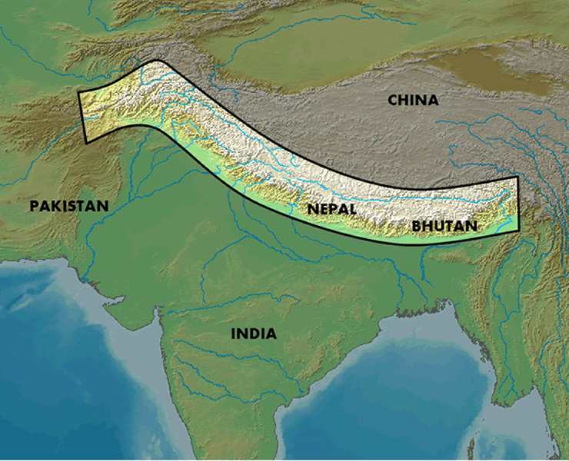
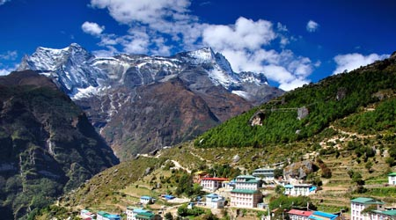
Himalayas

Slide 6
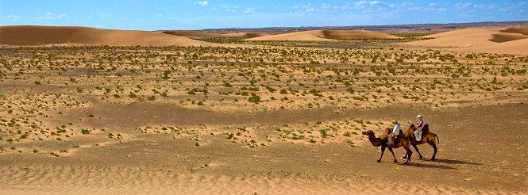
Gobi Desert

Slide 7
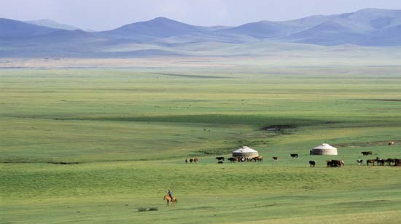
Mongolian Steppe

Slide 8
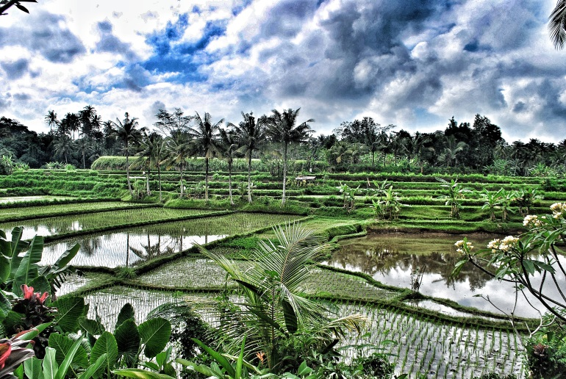
Agriculture
Northern China
Southern China
Deforestation
Retaining walls
Millet and wheat
Monsoons allow for agriculture
Rice
Rice paddies
Flooding of fields
Feeds more people per acre
More populous than the north

Slide 9
Shang Dynasty

Slide 10
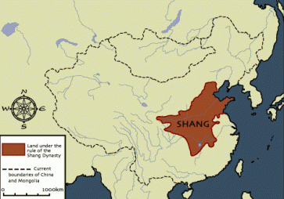

Slide 11
History of China
Follows the Xia Dynasty
Xia is not historically confirmed
China’s history begins with the Shang
Oracle Bones
Where we get our info about the Shang
Animal bones/shells
Used to contact “ancestral spirits”
Gives info on king, court, religion, society

Slide 12
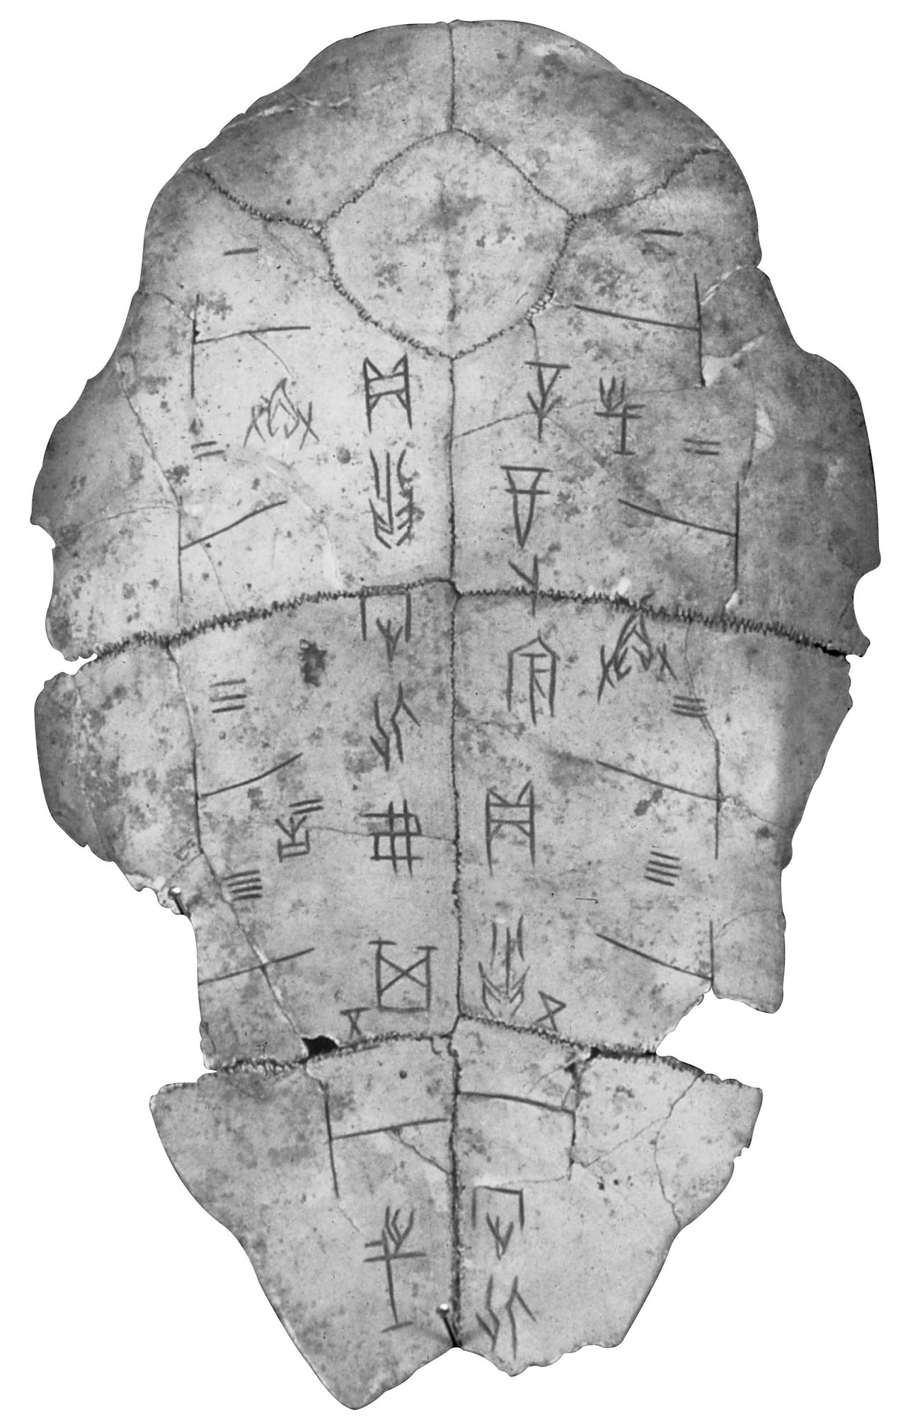
Notes:
Chinese Divination Shell.
After inscribing questions on a bone or shell, the diviner applied a red-hot point and interpreted the resulting cracks as a divine response.

Slide 13
Religion and Afterlife
Supreme god (Di) resides in the sky
Responsible for storms
Distant from humans
Death
Spirits reside with Di
Ancestral spirits can intervene on behalf of family members
Ruler has direct contact with ancestors who can intercede with Di
Ancestor veneration and ruler contact with ancestors is effective rationale for rule
Tombs of elite class
Ornate vessels used to contact ancestral spirits
Buried with family members and servants

Slide 14
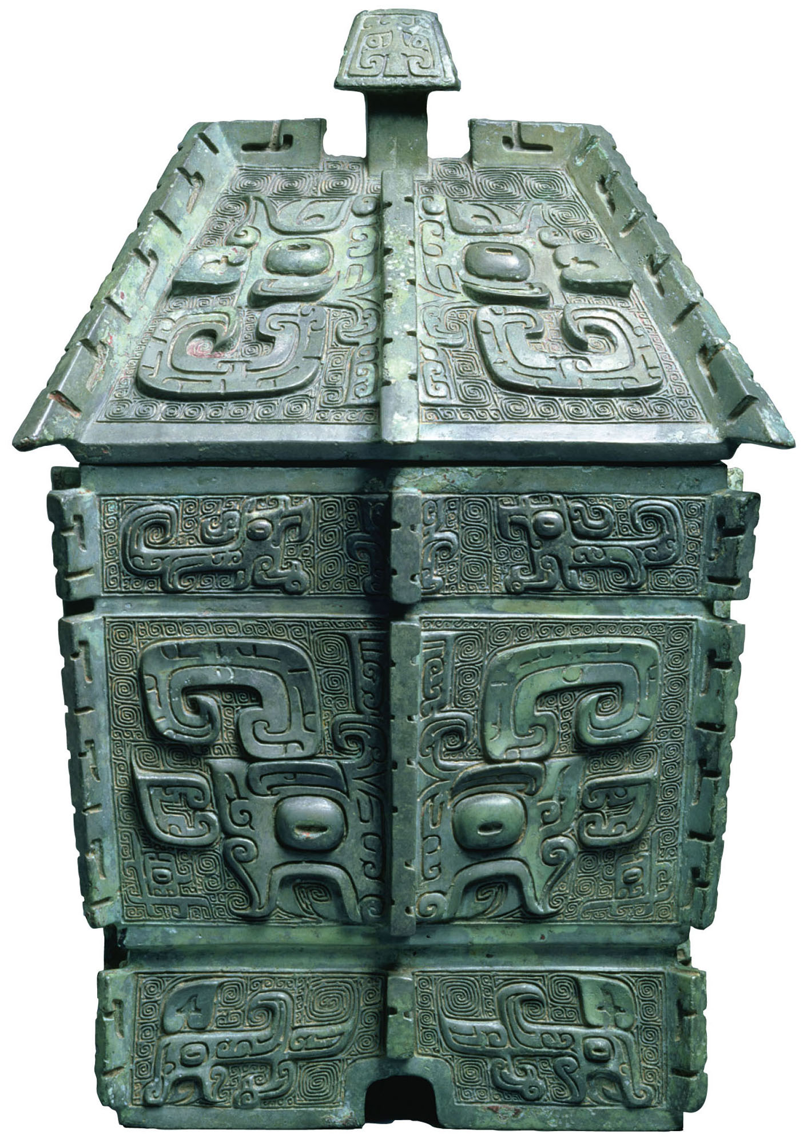
p. 56
Notes:
Shang Period Bronze Vessel.
Vessels such as this large wine jar were used in rituals by the Shang ruling class to make contact with their ancestors. As both the source and the proof of the elite’s authority, these vessels were often buried in Shang tombs. The complex shapes and elaborate decorations testify to the artisans’ skill.

Slide 15
Technology
Writing system
100s of characters
Used in court
Bronze weapons
Horse drawn chariots
Originated in W. Asia

Slide 16
Zhou Dynasty

Slide 17
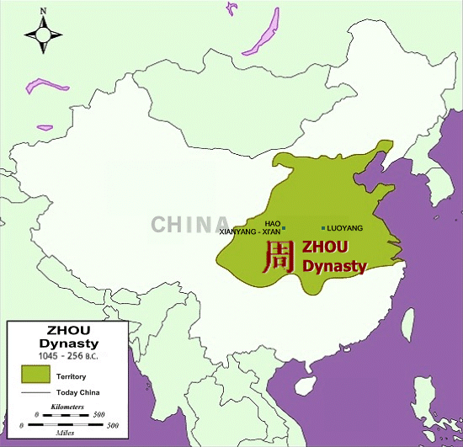

Slide 18
Rise of the Zhou
11th century BCE: overthrow of the Shang
Longest, most revered dynasty in Chinese history
Wen and Wu
Rebellion and attack of Shang capital
Wu is first ruler of dynasty

Slide 19
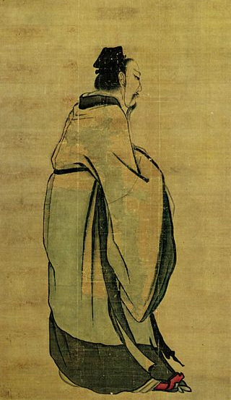
Wu, first emperor of the Zhou Dynasty

Slide 20
Zhou Timeline
Western Zhou (1045-771 BCE)
Eastern Zhou (771-221 BCE)
Spring and Autumn Period (771-481 BCE)
Warring States Period (481-221 BCE)

Slide 21
Mandate of Heaven
Use of religion to justify the rule of a king/emperor
Heaven gave authority to rulers
Authority could be taken away if the ruler did not look out for the well being of subjects
Proof of favor with the gods
Stability and prosperity of kingdom
Signs of disfavor of a ruler
Natural disasters
Invasion

Slide 22
Politics
Written texts
Book of Documents (letters, historical record)
Book of Songs (poems, songs—details the lives of all classes of citizens)
Xi’an: new capital city
Grid plan
Gates in walls opening at cardinal directions
Feng shui

Slide 23
Eastern Zhou (771-221 BCE)
Power of Zhou monarch is gradually reduced from 1045-771 BCE
771 BCE: attack of Xi’an
Capital moved east to Luoyang
(thus the name “Eastern Zhou)
Spring and Autumn Period
Spring and Autumn Annals are the historical record of the time period
Warring States Period

Slide 24
Spring and Autumn Period
771-481 BCE
Regional lords hold the power in China
Constant warfare between regions/states
Armies made up of farmers instead of the elite
Warriors on horseback
Bronze replaced by iron
First people in the world to forge steel
Development of a large and extensive bureaucracy
Government made up of appointed officials rather than elected ones
Development of philosophical systems of China

Slide 25
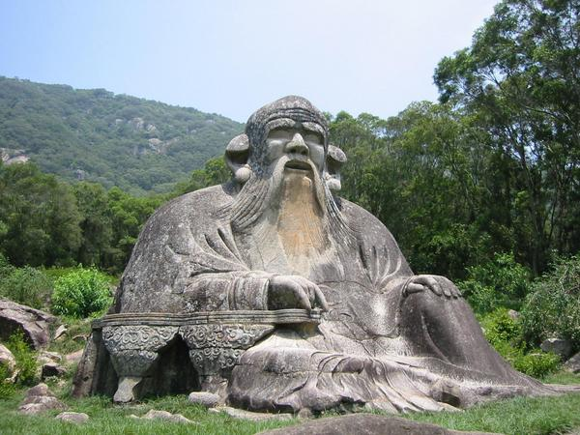
Daoism/Taoism
The teachings of the Way (Dao/Tao)
Laozi (604-517 BCE )
AKA Lao Zi, Lao Tsu
Real person?
Legend?
Composite of both?
Urged people to leave behind empty formalities, rituals, hierarchies, etc of society
*Note*
There are many different spellings of people, philosophies, etc in China. I have placed several different forms of the names in the PPT to help you become familiar with them.

Slide 26
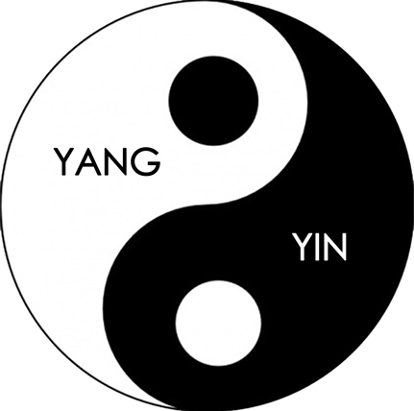
Dao
“The Way” cannot be defined with words
To obtain the dao, one must “wu wei”
Wu wei: do not tamper with nature/life—act naturally and things will work out
Yin-Yang
Balance in life
Yin: female, passive, shaded, reflective (moon)
Yang: male, active, bright, shining (sun)

Slide 27
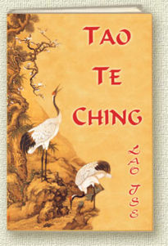
Dao Dejing
Means “Classic of the Way of Virtue”
Written by Laozi
Questions if the world is real or a dream
Education, knowledge are obstacles to understanding
Cultivate intuition
Avoid struggles

Slide 28
Dao Dejing
“ The Dao produces all things and nourishes them; it produces them and does not claim them as its own; it does all, and yet does not boast of it; it presides over all, and yet does not control them. This is what is called “The mysterious quality” of the Dao.”
“If we could renounce our sageness and discard our wisdom, it would be better for the people a hundredfold…if we could renounce our artful contrivances and discard our scheming for gain, there would be no thieves nor robbers.”

Slide 29
Confucianism
Kongzi=Confucius (551-479 BCE)
The Analects: Compilation of Confucius’ sayings
Society is broken and needs to return to the “Golden Age” of the early Zhou
NOT a religion
Emphasized family obligations
Everyone has a “place” in society
“filial piety”
Obedience to and love of parents
Devotion to ruler
Benevolence and compassion

Slide 30
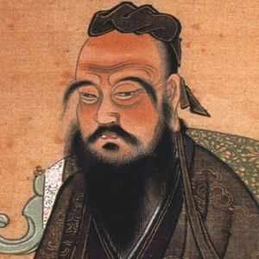

Slide 31
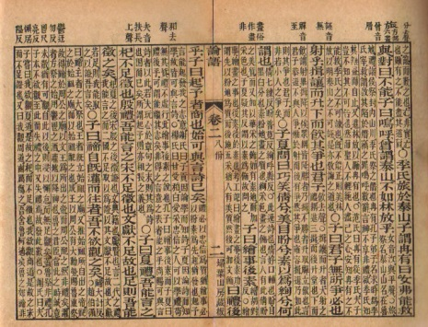
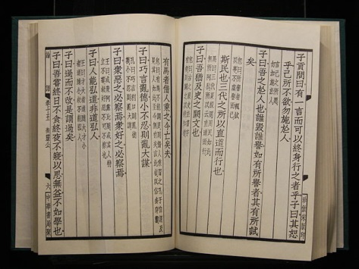
The Analects
"The superior man bends his attention to what is radical. That being established, all practical courses naturally grow up. Filial piety and fraternal submission,-are they not the root of all benevolent actions?"
“…Conduct yourself with respect; perform your duties with reverence; treat others with wholehearted sincerity…you cannot abandon these.”

Slide 32
Society
Many officials were Confucian in work, but Daoist in private life
Family = fundamental social unit
3 generation unit (grandparents, parents, children)
Patriarchy: fathers have complete authority and control over family and women

Slide 33
The Warring States Period
481-221 BCE
Warfare between Chinese states intensified
Smaller states taken over by larger, more powerful states
Build up of larger armies
Fortified walls built to protect state borders
Military innovations
Qin: most innovative state
First to use Legalism

Slide 34
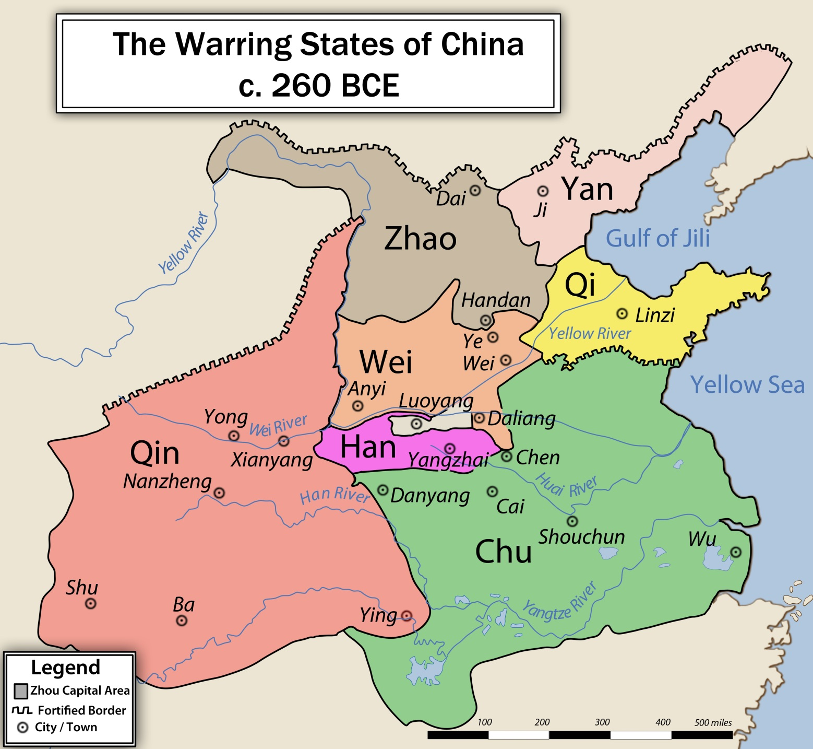

Slide 35
Legalism
Rejected both Confucianism and Daoism
Unconcerned with ethics and morals (Confucianism)
Unconcerned with nature and humans’ place in the world (Daoism)
Emphasized the law and a restructuring of society
Strengthen and expand the state no matter what the cost
Sacrifice freedom of individuals in order to aid/prosper the state

Slide 36
Legalism
Emphasized work in agriculture or military
Discouraged work that did not directly advance state interests (merchants, artists, etc)
Strict laws, severe punishments
Amputation of hand/foot for dumping ashes in street
Ruthless, but helped unify China and end Warring States Period

Slide 37
Legalist Leaders
Lord Shang Yang
Han Feizi
390-338 BCE
Minister to duke of Qin
Ruthless leader-murdered
The Book of Lord Shang
Confucians are wrong that a ruler should worry about his subjects
A ruler should us whatever necessary to obtain good behavior from subjects
Included weakening the power and privileges of the nobles
280-233 BCE
AKA Han Fei
Qin advisor
Forced suicide
Trained in Confucian thought
Realism needed to end chaos
Wrote essays on how to create a peaceful and stable state

